Slide 1
When in Rome do as Romans do: challenges of cross-cultural communication

Slide 2
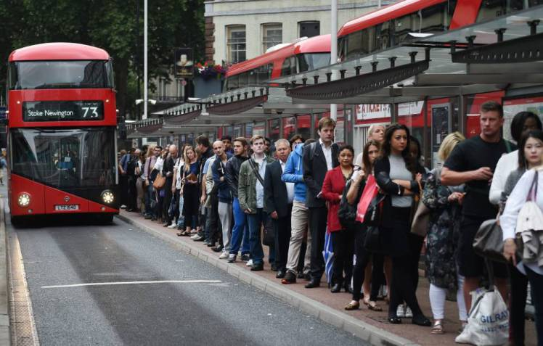
Culture

Slide 3
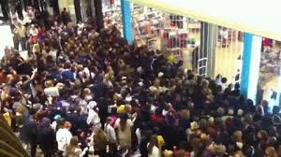
Culture Shock!

Slide 4
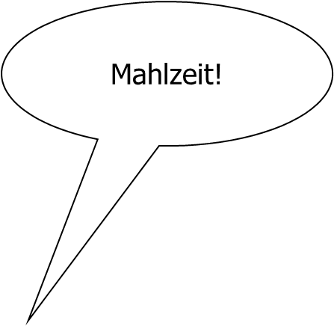
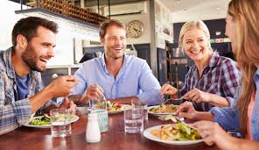
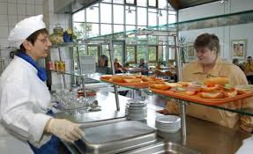
Culture
Mahlzeit!
Mahlzeit!
Mahlzeit!

Slide 5
communication
job applicatons
job interviews and assessments
being successful at work
?

Slide 6
communication
job applicatons
job interviews and assessments
being successful at work
CULTURE

Slide 7
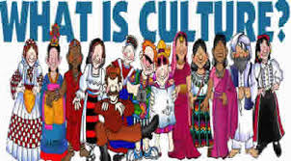

Slide 8
What is culture?
human activity/behaviour
values
background
social groups
symbols/rituals
arts
heritage
festivals
stories/myths
food
etc.

Slide 9

No man is an island!

Slide 10

Cross-culture

Slide 11
Cross-culture
global challenges & differences
work with different cultures

Slide 12
Cross-cultural communication
communication
spoken/written language
non-verbal language

Slide 13

The English Language
5,000,000

Slide 14

The English Language
Numbers vary:
  Between 350 mio and 400 mio → mother tongue/first language
  Between 1.5 billion and 2 billion → second/foreign language

Slide 15







The English language

Slide 16
Translations gone wrong
Car rental brochure, Tokyo: “When passenger of foot heave in sight, tootle the horn. Trumpet him melodiously at first, but if he still obstacles your passage then tootle him with vigor.”

Slide 17
Translations gone wrong
https://www.youtube.com/watch?time_continue=17&v=Vc8tfioOKvU

Slide 18

Same language, same meaning?

Slide 19
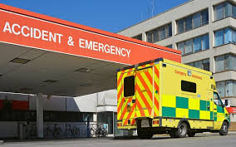

Same language, same meaning?
A&E

Slide 20
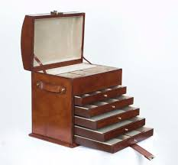
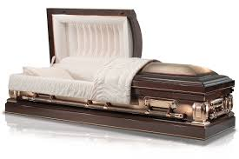
Same language, same meaning?
casket

Slide 21
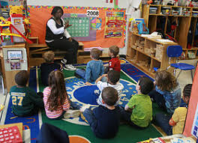
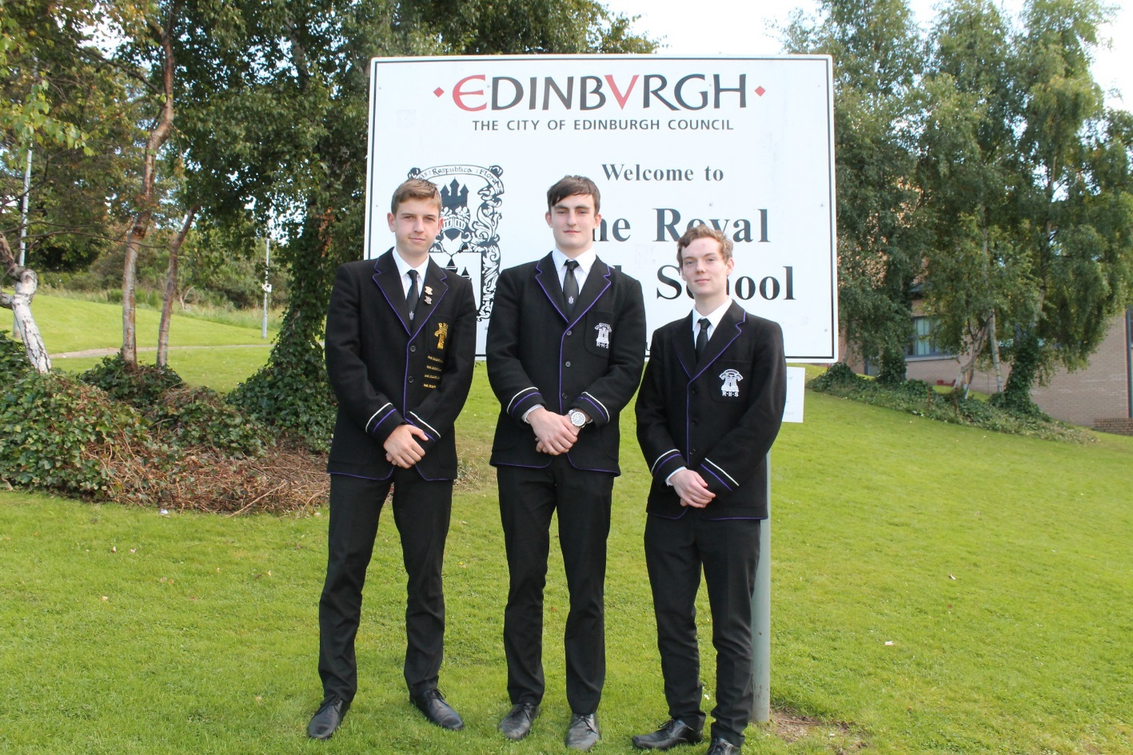
Same language, same meaning?
grammar school

Slide 22
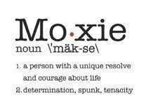
Same language, same meaning?
A.E. “moxie”

Slide 23
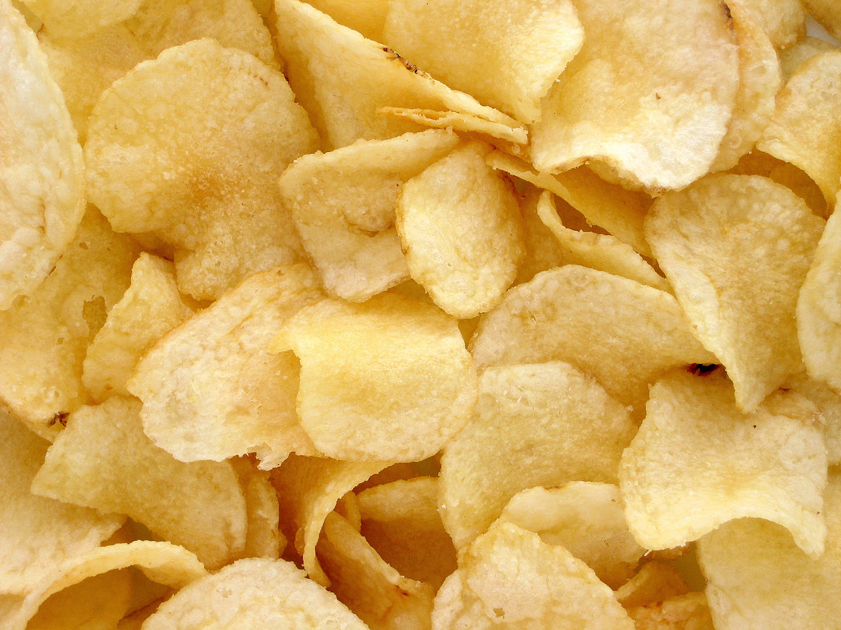
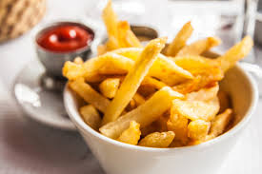

Same language, same meaning?
chips?

Slide 24
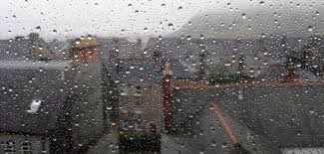

Same language?
dreich

Slide 25
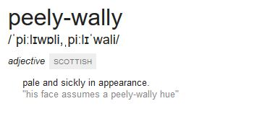
Same language?
peely wally

Slide 26

Same language?
to get the messages

Slide 27

Same language?
scran

Slide 28
Non-verbal communication

Slide 29
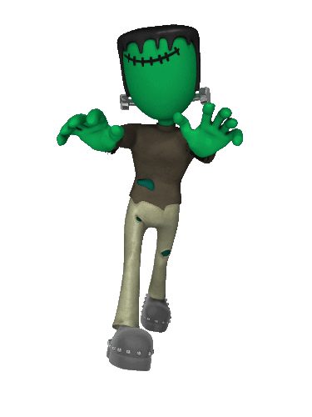

Non-verbal communication
Culturally specific gestures
oculesics
kinesics
proxemics
haptics
chronemics
paralanguage

Slide 30
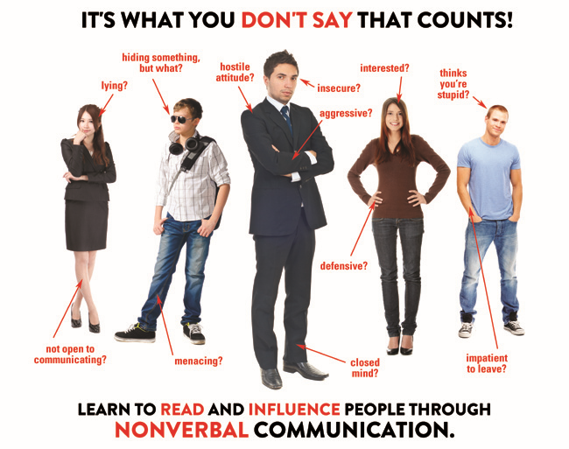
Posture
Non-verbal communication

Slide 31

Eye contact (oculesics)

Slide 32
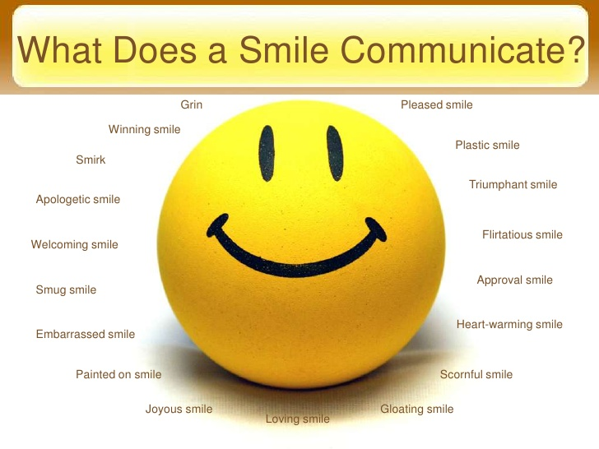

Smiles across cultures

Slide 33
Head Shaking
https://www.youtube.com/watch?v=6Gipj1caZUg

Slide 34
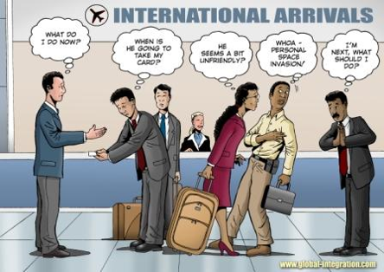
Physical space

Slide 35
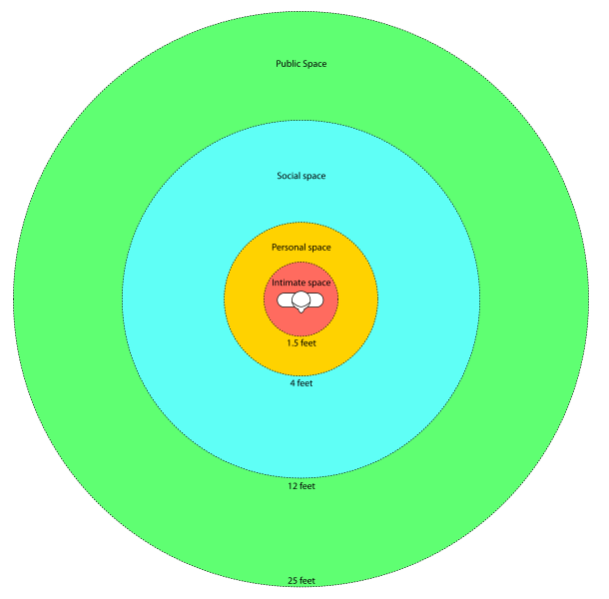
Physical space

Slide 36
Personal space
https://www.youtube.com/watch?feature=player_detailpage&v=xG-meaGqg-M

Slide 37
Personal space
https://www.youtube.com/watch?v=RhIzGrIqAk0

Slide 38
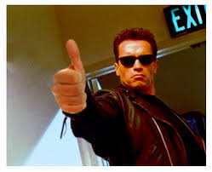
Gestures – thumbs up

Slide 39
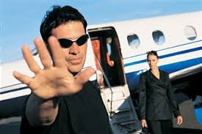
Gestures – the Moutza

Slide 40
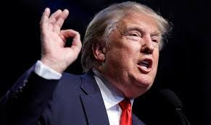
Gestures – the OK sign

Slide 41
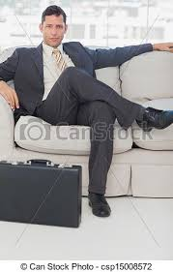
Gestures

Slide 42
Asian proverb:
“Misunderstandings don’t exist, only the failure to communicate exists.”

Slide 43

Thank you!
Happy St. Andrew’s Day

