Slide 1

International
InnovationLab
A taste of true innovation
and creativity
in SMEs!

Slide 2

International InnovationLab?
12 week study program for 3th year students
Authentic business cases from existing companies
Multidisciplinary student teams for innovative and creative projects
International dimension

Slide 3


International partners
Laurea University of Applied Sciences (Finland, Espoo/Helsinki)
School of Business and Finance (Latvia, Riga)
Yasar University (Turkey, Izmir)
SKEMA Business School (France, Lille)
Washburn University (USA, Kansas)

Slide 4

3 months journey
Notes:
Pencils: they are in different colors and you can sharp them and make beautifula drawings with them in diffent colors and that is wat an innovation lab is:
Different people form different cultures
You can sharp them by teaching and coaching them
And the end result are beautifull innovative solutions

Slide 5
Program - Startweek
Own office
Startweek
Briefing cases
International weeks
End presentations
Company visits
Trendwatching, innovation & creativity
With international partners: 11 nationalities
Own office
Notes:
They get immersed in all kind of innovative and creative techniques, such as
Lego Serious Play,
Brainstorming Techniques
Improvisation
Business Model Canvas of Osterwalder
And these techniques are integrated in the Business Cases

Slide 6
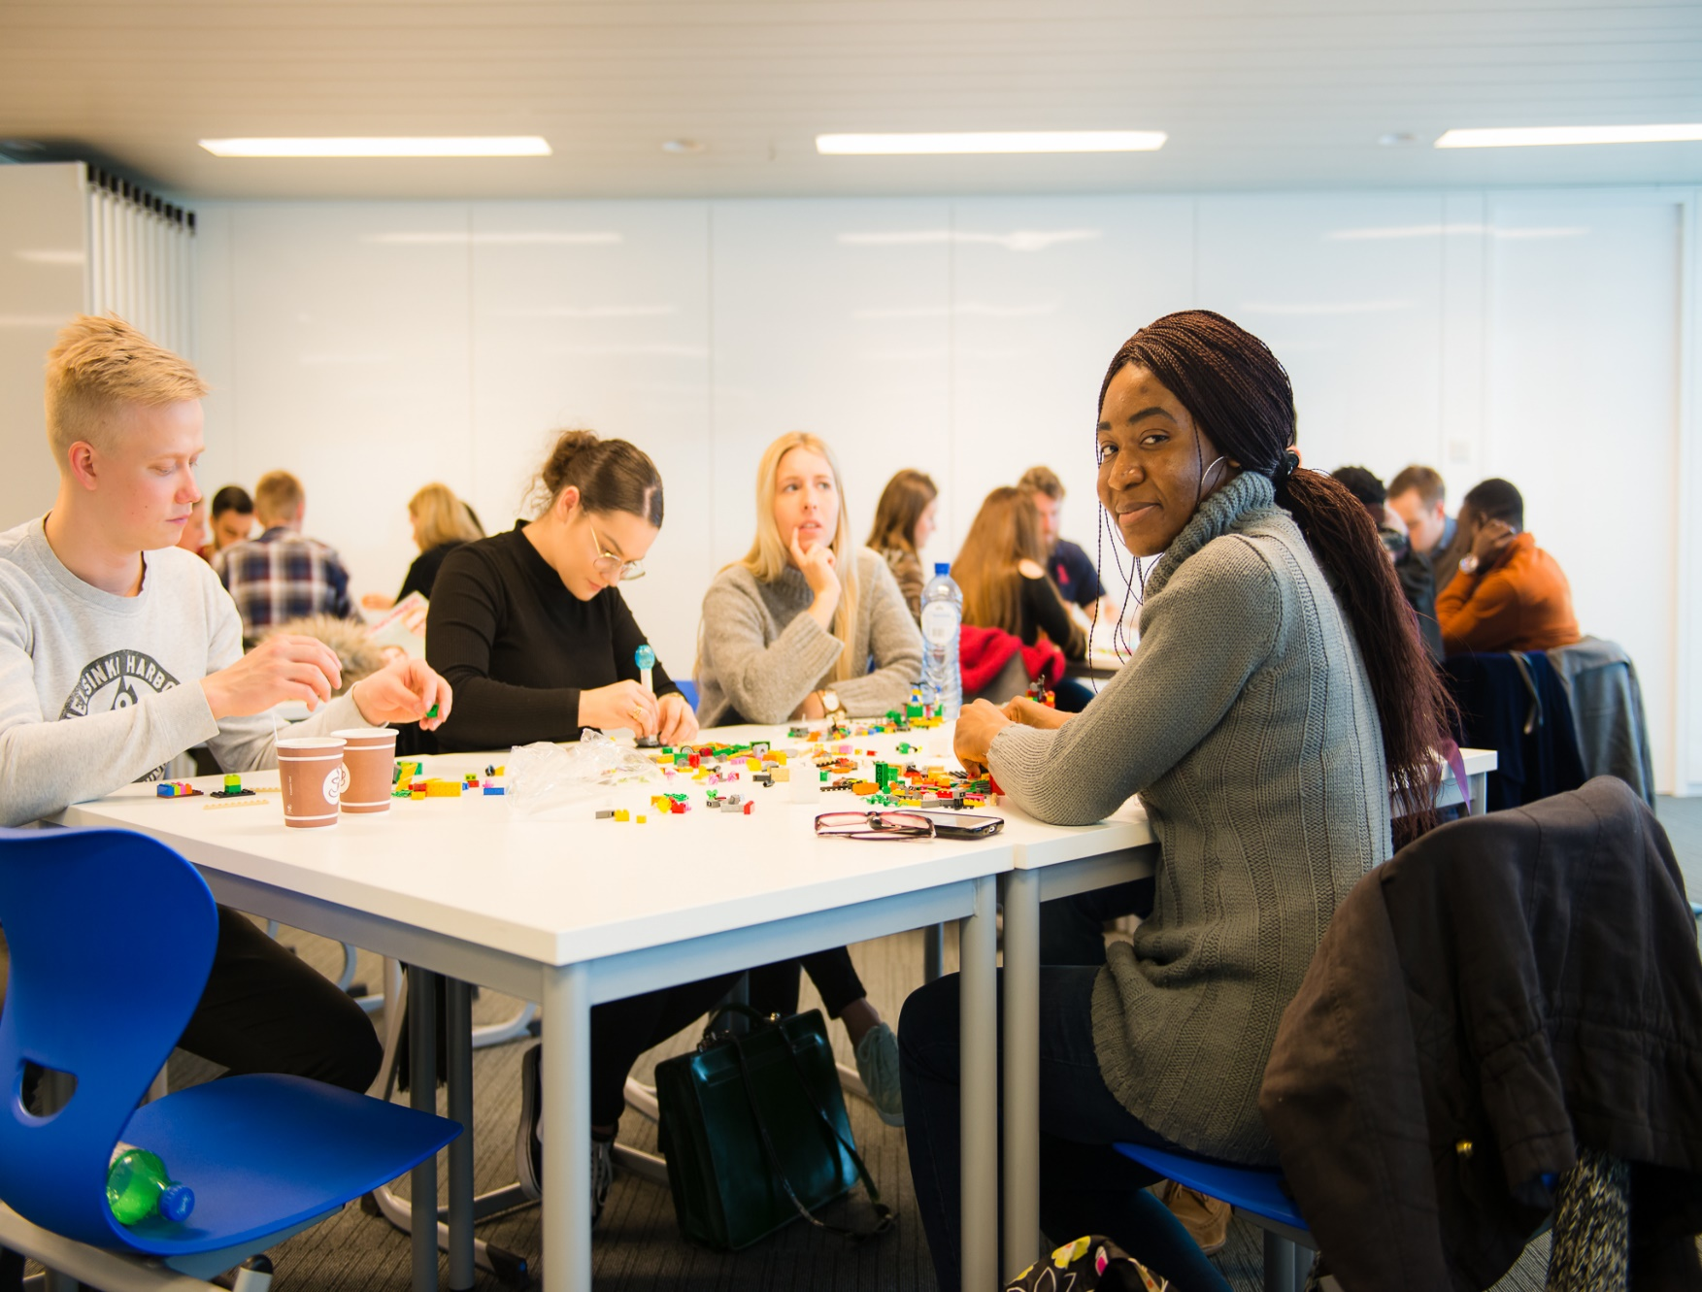
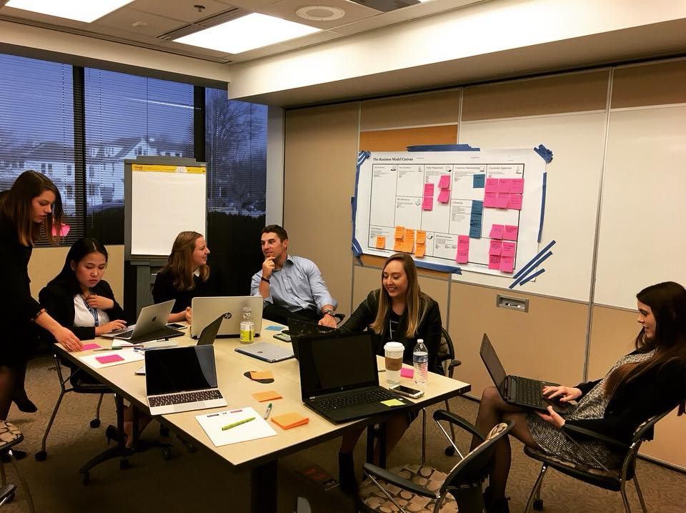
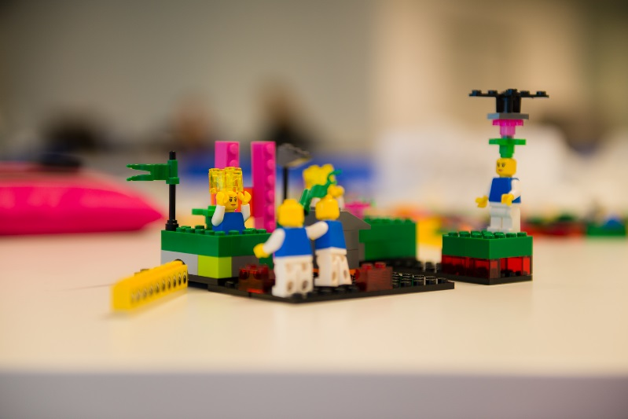
Lego serious play + andere
Notes:
Lego Serious Play – a best practice we are proud of :
Tested within the InnovationLab
Integrated in the curriculum
Sold as a training towards companies …

Slide 7
Program – International Weeks
Own office
Startweek
International weeks
End presentations
Finland
Latvia
France
Turkey
USA
Close virtual collaboration during 12 weeks
Own office

Slide 8
Program – End presentations
Startweek
International weeks
End presentations
End Pitch
Move Towards the Future-plan
Own office
Notes:
Students give recommendations to the companies

Slide 9

Competences
Team spirit
Project management
Taking ownership – Initiative
Convincing pitching
Language skills
Professional behaviour in a business context
…

Slide 10
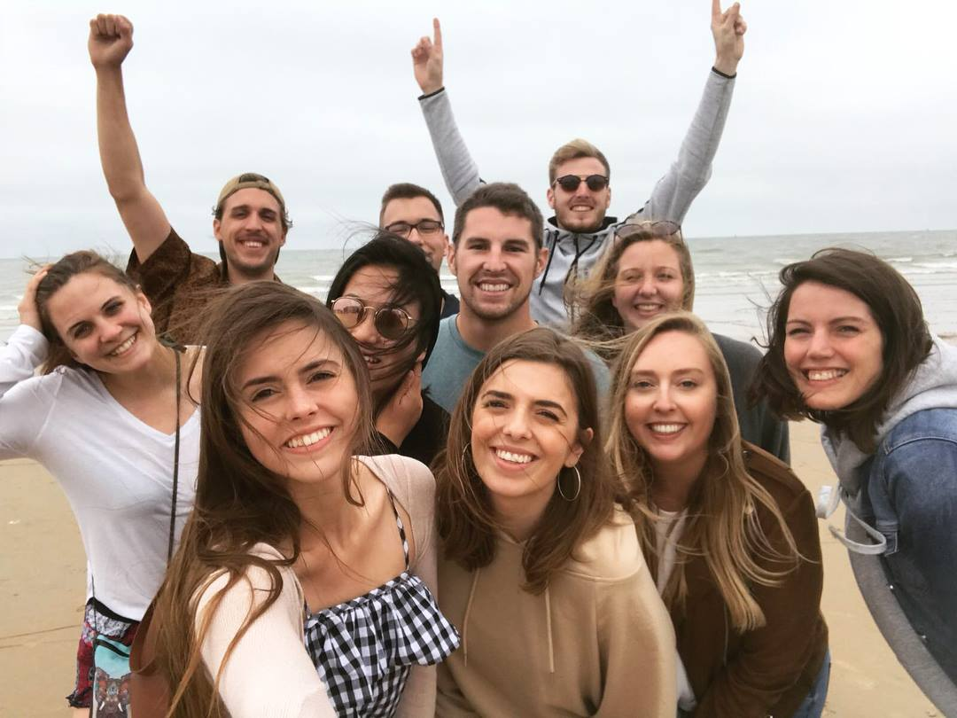

Slide 11
‘I have never had the opportunity to completely show what I had within me, but International InnovationLab gave me the chance to show all my talents.’
  IIL student
Notes:
As a conclusion I would like to quote a student

