Slide 1

Pillars of trust and Integrity
Encouraging social and ethical values
in business and entrepreneurship
Copyright © Initiatives of Change UK
www.uk.iofc.org/tige

Slide 2
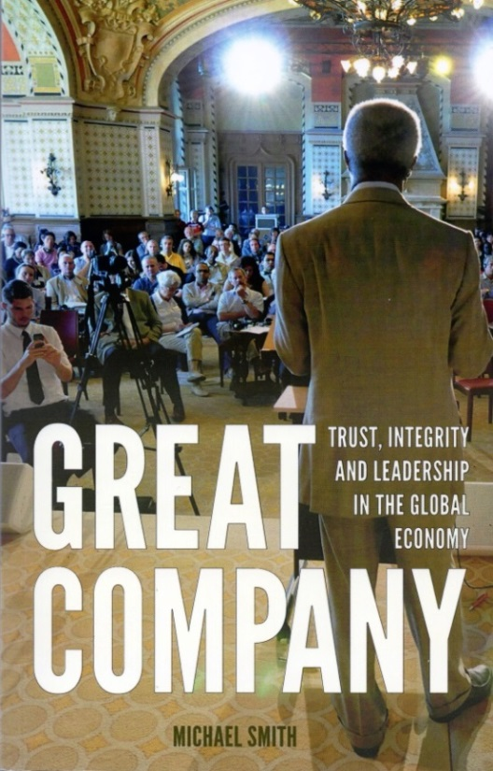

Mike Smith
Head of Business Programmes,
Initiatives of Change UK, 2010-2017
Author, Great Company (2015);
Trust and Integrity in the Global Economy
(2009); Beyond the Bottom Line (2001);
Lecturer in Business Ethics
www.uk.iofc.org/tige

Slide 3

I Imparting values to students
Huge privilege and responsibility to impart values to the students in our care
They are the future on which the world depends
Now imagine that you are my class of students

Slide 4
Global dynamic
Capital market economy seemed to have won the war of ideas at the end of the Cold War and the collapse of Communism in 1989: Fall of Berlin Wall.
Yet Capitalism also has the potential to self-destruct through materialistic motivations of greed and acquisition; corruption; leading to economic disparities; injustices in the system.

Slide 5
Global dynamic
Human motivations play a critical role.
Those who are motivated solely by acquisition can be seen, in the long-run, as destroyers.
Those who are motived by contribution, benefitting all stakeholders, are the builders.
Need is to work towards an economy for the common good of humankind.
We’re going to look at this in business context.

Slide 6
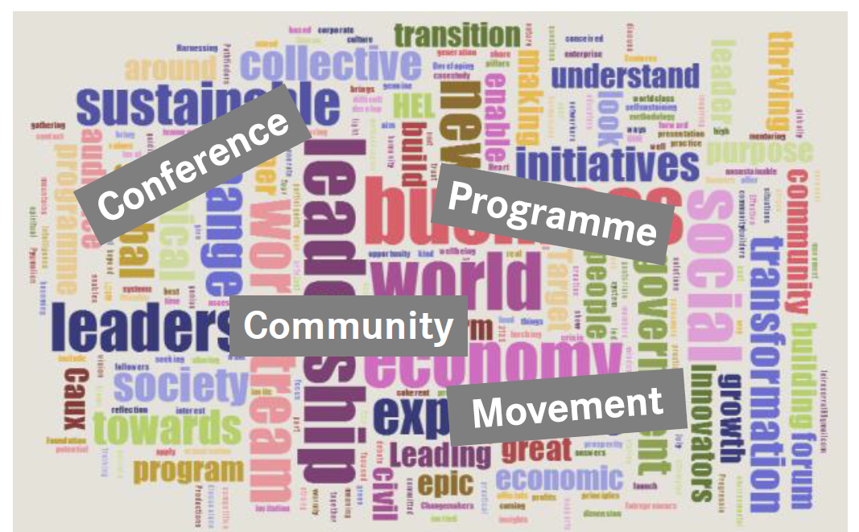
Trust and Integrity in the
Global Economy
Imagine a global network of individuals and institutions practising
trust and integrity in private, corporate and public life.
To enable all economic stakeholders to explore a journey of personal, organizational and societal transformation leading to
an outcome of human and ecological well-being.

Slide 7
Core values & principles
Creating a safe haven for all economic players to explore a journey of personal transformation, leading to organisational and global transformation.
The journey begins with encouragement towards inner reflection to see where change starts personally.
Informed by the values of:
  Honesty; including integrity and the stance against corruption
  Purity of motive in defining the purpose of our organisations, beyond the profit motive and towards contribution to society.
  Equity (mutual interest) across all stakeholders; stewardship and service;
  Love for people, planet, peace, prosperity and future generations.
Change in the world starts with change in individuals’ motivations and behaviours. This encourages not just Corporate Social Responsibility (CSR) but also Personal Social Responsibility (PSR).

Slide 8
Dynamics of trust framework
Five pillars as “business principles”
Inside Out: the personal, organisational and societal context
7 C’s of Trust
Inner reflection
(personal)
5 Pillars (organisational)

Slide 9
Five pillars of trust
Integrity
Cooperation
Purpose
Stewardship
Sustainability

Slide 10

Pillars of trust
Q: What do you understand by Integrity?
Q: Where does Integrity begin?
Discuss with your neighbour in pairs.

Slide 11

1. Integrity
Honesty (Don’t steal office supplies! Don’t cheat on your travel tickets! Return ‘borrowed’ library books!)
No corruption
True to our values; Walking the talk
Derives from the word Integer: whole number
‘The truth, the whole truth, nothing but the truth’
Integrated personalities, same values at home and work
‘Integrity is doing the right thing when no one is watching’
Conscience-based decision-making
www.uk.iofc.org/tige

Slide 12
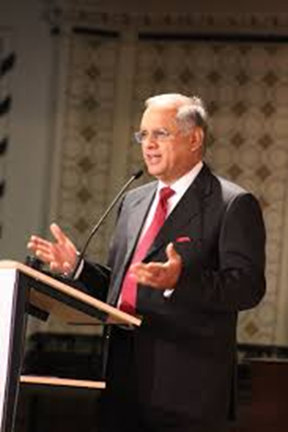
Case Study: Integrity
Suresh and Mala Vazirani, founders
and owners, Transasia Bio-Medicals,
Technology company, Mumbai, India.
Manufactures blood diagnostic machines for hospitals. Testing for over 200 diseases. Saving lives.
Employing 1,500 people; exporting to over 100 countries from India. World class technology.
Global players. National award-winning technology.
Company run on the basis of no corruption.

Slide 13
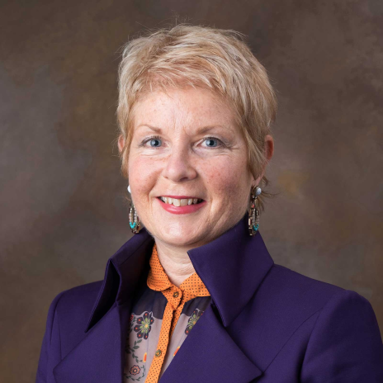
Case Study: Integrity
Whistleblower Wendy Addison
Group International Treasurer: LeisureNet, health and racquet clubs, South Africa. Discovered embezzlement by the two founding CEOs. Death threats forced her to leave and live in London. Lost her job and ended up begging on the streets of South-West London with her young son. Two CEOs eventually prosecuted and jailed. Biggest corporate collapse in South African business. Wendy now an international speaker on whistleblowing and anti-corruption. Founder of
SpeakOut, SpeakUp: http://www.speakout-speakup.org

Slide 14
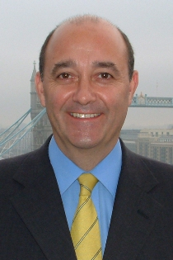
Case Study: Integrity
HBOS whistleblower Paul Moore
Was Head of Group Regulatory Risk at Halifax Bank of
Scotland. Warned the management board that their sales culture was too excessive for their risk management. Was sacked by the CEO, Sir James Crosby. Paul took his case to the Treasury Select Committee, giving them pages of ‘explosive’ inside information.
Became publicly known as ‘the HBOS whistleblower’. Motivated by desire to get to the truth. HBOS collapsed and was sold to Lloyds Banking Group. James Crosby stripped of his knighthood.
Moore’s book entitled Crash, Bank, Wallop!

Slide 15
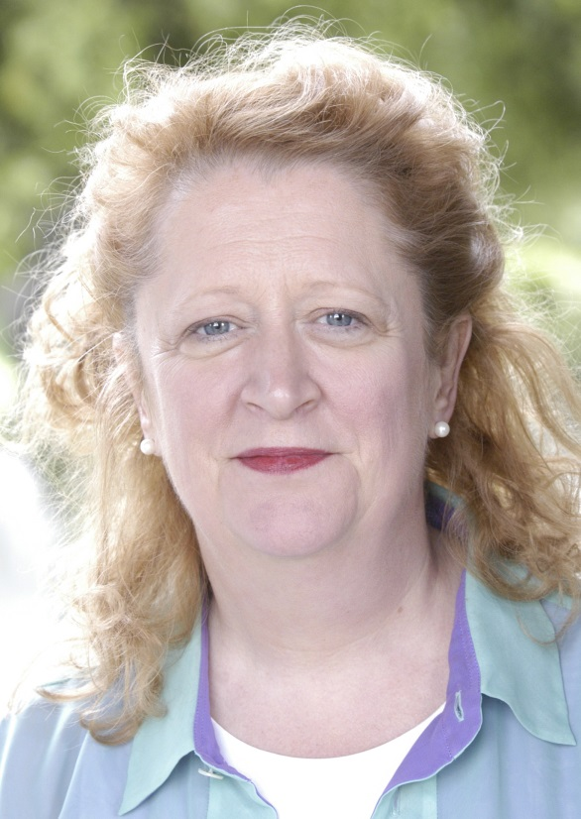
2. Cooperation
As effective as competition.
(Counter-intuitive in a competitive
free market)
A Bigger Prize by Texan business author
Margaret Heffernan
Cooperation across all stakeholders.
Case study: Story of Ocean Spray cranberry juice drink and sauce. New England farmers decided to cooperate instead of competing; shared information about crops, weather patterns; became a cooperative. Now a global brand.

Slide 16
Cooperation
Questions:
What do you understand by cooperation inside your organization?
Do people encourage and appreciate each other?
Do they share information?
Or are there jealousies and rivalries?
Cooperation is about human relationships and systems. What is the effect of culture of bonuses, rankings, targets? Do they undermine trust?
How can cooperation help towards peak performance?

Slide 17
3. Stewardship
Looking after other people’s resources
It is what banks are supposed to do!
Defined by Tomorrow’s Company as: ‘The active and responsible management of entrusted resources now and in the long term, so as to hand them on in better condition.’
‘Wise stewardship, good governance and concern for the common good need to be core values of any market economy… a rich set of ethical principles for doing business should underpin all business activity.’ – Caux Round Table group of senior business executives

Slide 18
Stewardship
Japanese experience:
20,000 companies existed for more than 100 years;
600 companies for more than 300 years;
30 companies for more than 500 years;
5 companies for more than 1,000 years!
Therefore: long-term orientation
-- ‘Timeless Ventures’ by Haruo Funabashi (2009)
www.uk.iofc.org/tige

Slide 19
Stewardship
Japanese experience: What did they have in common?
‘Leadership driven by clear values, vision, mission,
strong sense of legacy, vision of the long-term, emphasis on the value of people, commitment to society, customer orientation, innovation and continuous improvement’
-- Mark Goyder, CEO, Tomorrow’s Company think-tank, London,
writing in his book, ‘Living Tomorrow’s Company’ (2013)
www.uk.iofc.org/tige

Slide 20

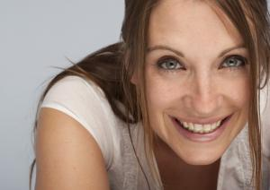
Case study: stewardship
Whistleblower Genevieve Boast
Stock Manager at satellite
broadcasting supply company,
Sheffield, UK
Found that stock of TV set-top boxes was being stolen
Reported this to the recipient broadcasting company. Great courage in decision-making.
Employed by broadcasting company because they trusted her. Appointed her Stock Integrity Manager!

Slide 21
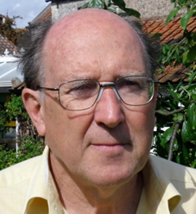
Case study: stewardship
Roddy Edwards and his brother Jonathan cofounded Walkerswood Caribbean Foods, a social enterprise in Jamaica. Their purpose: to promote economic justice after years of colonial exploitation.
Created jobs in the rural sector; invested in the local economy. The company employed 140 people, with a turn-over of US$6 million. Edwards’ aim was to make sure that anyone in the local community who wanted a job should get one. They created a market for produce grown by 3,000 Jamaican farmers.
Edwards ran the company on the principle of ‘conscience-based’ decision-making. They exported produce to US and European supermarket chains and were commended by the World Bank. Sold the company in 2009: continues to thrive, employing 80 people.

Slide 22
4. Purpose
What is your sense of purpose? Purpose of your organization?
Is it clearly defined? Is it honourable?
Profit maximization? (Milton Friedman, NYT, September 1970)
Purpose maximization for all stakeholders? (Stephen Stern, FT: “Too narrower a focus on shareholder value can lead to disaster.”)
‘Contribution not acquisition’
- Conscious Capitalism movement in the USA and elsewhere
‘Someone without a purpose is like a ship without a rudder’
– Thomas Carlyle

Slide 23

What makes a good company ?
Purpose
Environment
Social
Economic
CASS Business School, City of London, and Frank Bold Institute, Czech Republic, state:
Business must return a profit to survive but there must be a balance between profit and a company’s responsibility to society and the environment
Great businesses exist to provide goods, services and employment.

Slide 24
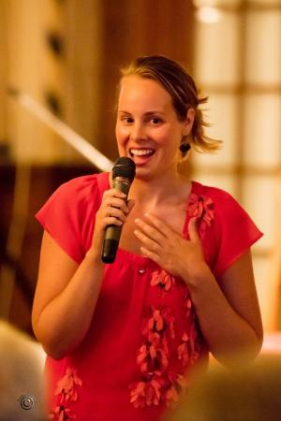

Case study: purpose
Merel Rumping, social entrepreneur from
The Netherlands, founded LegBank.
Some 30 million people word-wide have
suffered amputations due to land mines, car accidents and occupational accidents. The highest number of amputees are in Colombia, following its civil war. She has developed a method of supplying on-sight, easy-to-fit prosthetics for amputees. She is this year’s alumnus of the year at her Dutch university of 30,000 students.

Slide 25
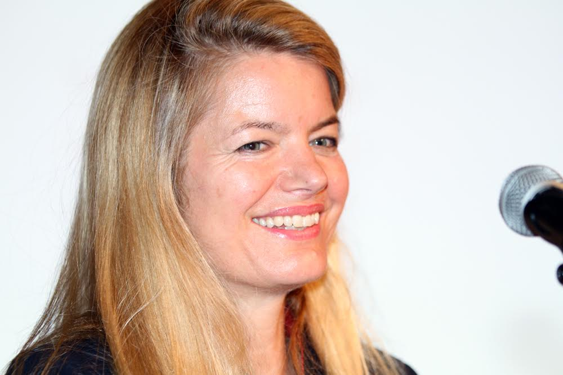
Case study: purpose
Sophia Swire
Former merchant banker,
City of London,
Left banking after crash of 1987, 30 years ago.
Founded girl-education charity for children in India, Pakistan, Afghanistan.
Now runs Future Brilliance charity and its Aayenda Jewellery range, Afghanistan.

Slide 26
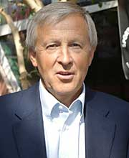
5. Sustainability
‘Creating a desirable, sustainable future
is the leadership challenge of our time’
-- Goran Carstedt, Board member IKEA, 1990-97,
and Chair of Natural Step International , Sweden
Sustainability of our organizations;
Sustainability of the planet

Slide 27
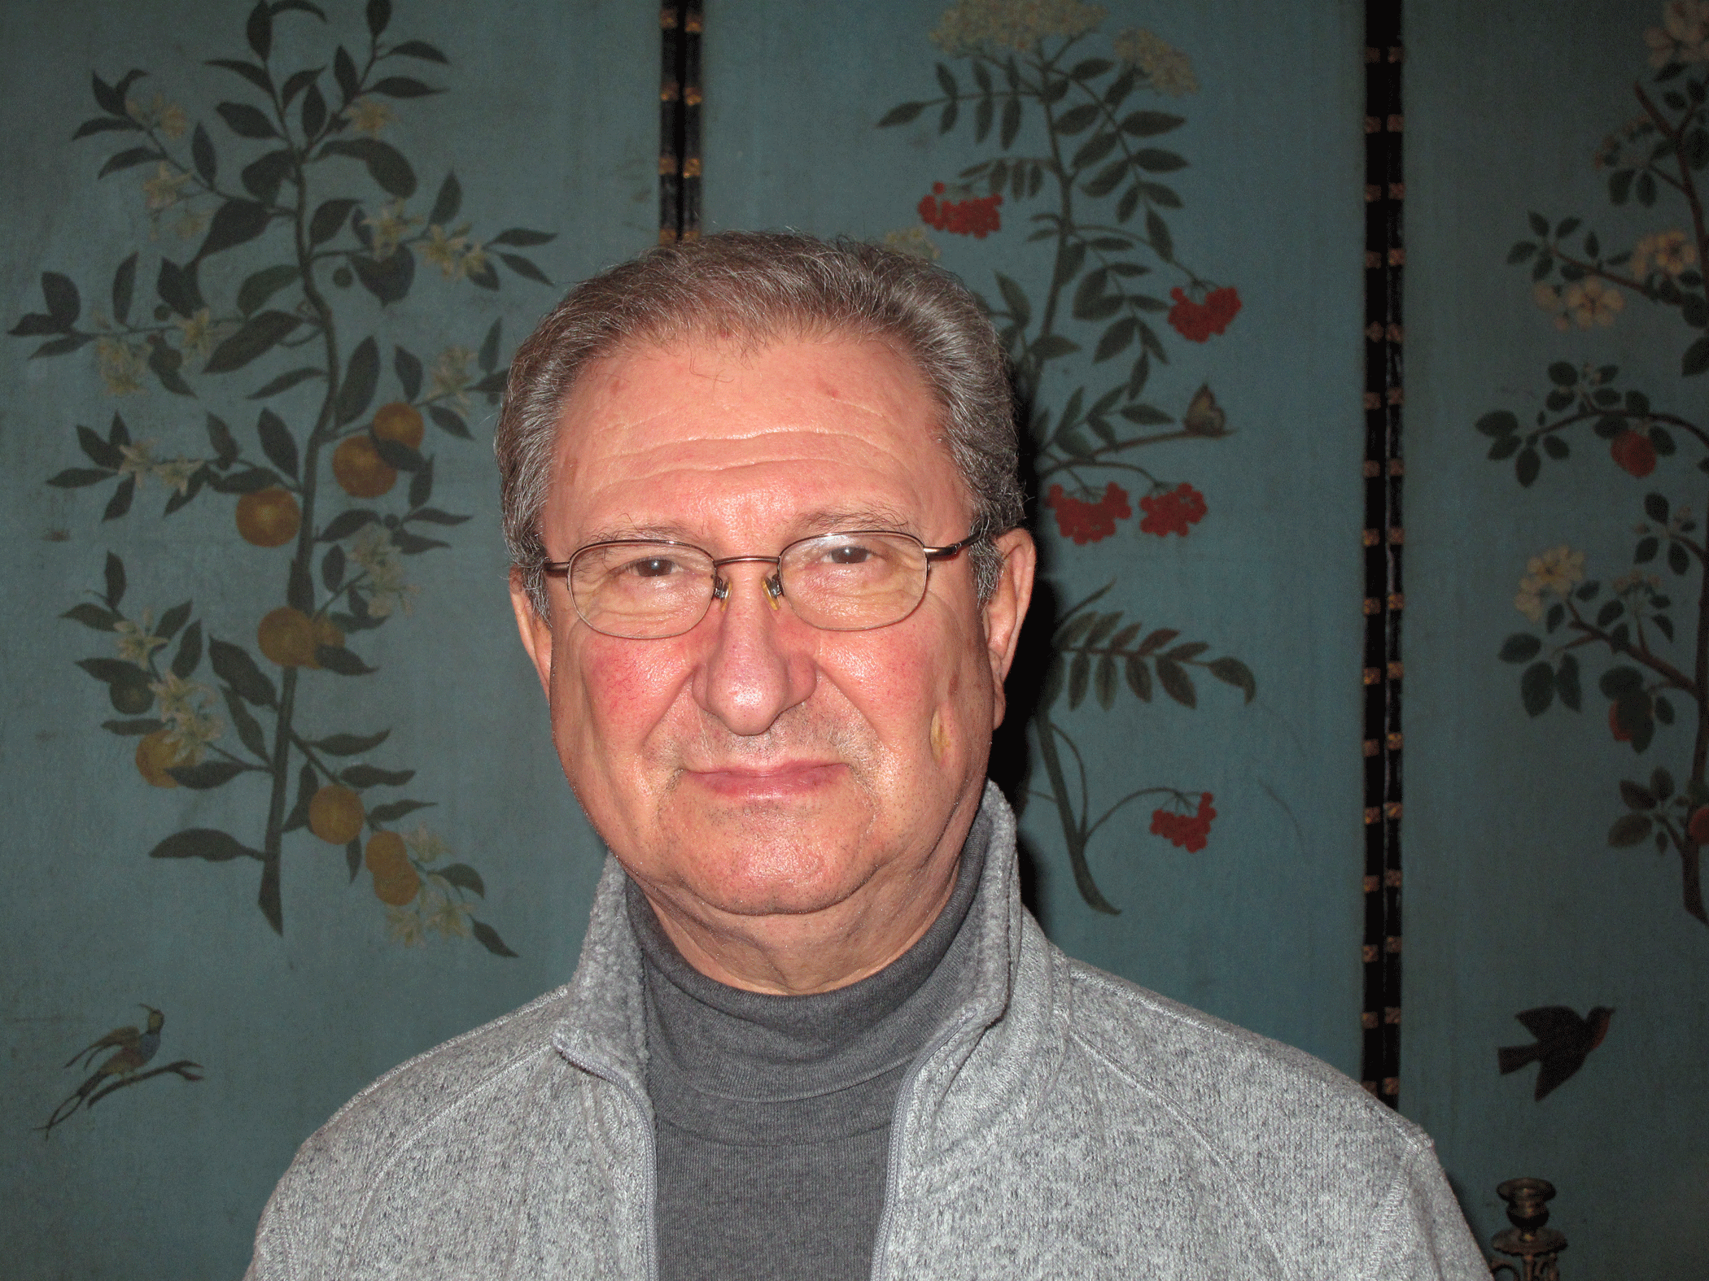
Case study: Sustainability
Lawrence Bloom’s story:
Executive Committee member,
InterContinental Hotels, 1988-1993.
i/c $3 billion global real estate portfolio.
Wrote their three-volume environmental manual.
Transformed the environmental impact of the global hotel industry. Recycling towels now standard practice in 5.5 million hotel bedrooms worldwide. AccorHotels group aims to plant 10 million trees by 2021.

Slide 28
Seven Cs of Trust
Contractual
Competence
Covenant
Character
Conscience
Calling or contribution
Courage

Slide 29
Seven Cs of Trust
1 Contractual basis of trust:
Written, signed agreements between parties in the sale and purchase of goods, services and property, which everyone honours. Underwritten by the rule of law.
Undermined by the sub-prime mortgage crisis: home owners defaulted on their mortgage repayments; unable to pay for them. Contracts were broken. Fundamental dishonesty built into the system of selling mortgages to people who could not afford them.
Mortgage lenders also encouraged customers to inflate their incomes in order to qualify for a mortgage: became known as ‘liar loans’. The bubble was bound to burst.
www.uk.iofc.org/tige

Slide 30
Seven Cs of Trust
2 Competence basis of trust:
Fundamental trust in the competence of the person whose skill I pay for—the plumber, electrician, airline pilot, surgeon—that they will deliver their skills to maximum competence, on time and within budget. We trust them to do a great job.
This is also an emphasis on the pursuit of excellence across all disciplines—musicians, sports stars, all of us with our various skills and talents.
The market dictates that we walk away from those who prove to be incompetent or slovenly.

Slide 31
Seven Cs of Trust
3 Covenant basis of trust:
Old-fashioned Biblical word which refers to the promises we make to one other over the long term, often agreed by a handshake. Traditional concept including the notion of ‘My word is my bond’ in the City of London.
Undermined by the crash of 2008, and destroyed further by rogue traders who manipulated key interest rates for their own or others’ greed.
It put self-interest before mutual interest and was unconscionable.

Slide 32
Seven Cs of Trust
4 Character basis of trust:
Do I really trust a person’s character? Is he or she really trustworthy? Am I trustworthy?
Character is built into our lives by our daily decision-making, right versus wrong, over a life-time. Defined as ‘how we behave when no one else is looking’; and ‘Being put to the test and found fit for purpose.’
New York Times columnist David Brooks tells stories of people in public life who have grown into their roles through their growth of character in his book The Road to Character.

Slide 33
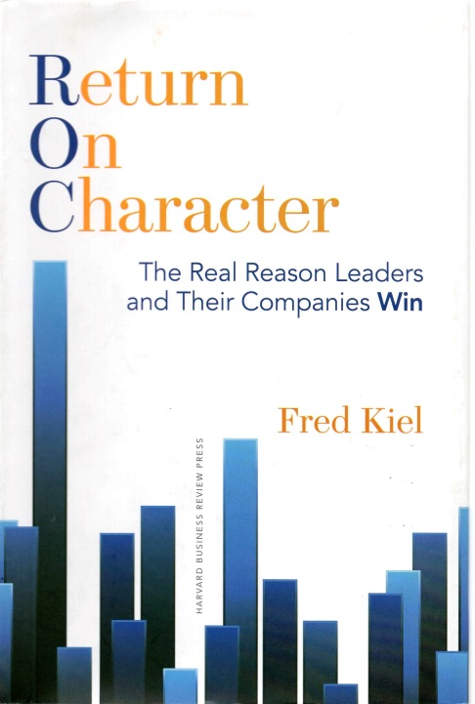
Seven Cs of Trust
Character basis of trust:
‘Return on character: the real reason leaders and their
companies win’ by Fred Kiel
Harvard Business Review Press, ISBN: 978-1-62527-130-3
Research shows that companies led by CEOs of ‘character’ outperform companies led by ‘self-focussed’ CEOs, by a factor of 5:1.
Character defined as ‘Integrity, Responsibility, Forgiveness, Compassion’

Slide 34
Seven Cs of Trust
5 Conscience basis of trust:
The choice between what’s right and what’s wrong. Social and ethical entrepreneurs have a strong sense of social conscience.
What about personal conscience?
Rogue traders, corrupt officials or politicians who steal resources and salt them away into offshore accounts and tax havens have little sense of personal conscience. The world of business and the economy needs conscience-based decision making at its heart.
If we lose our sense of conscience we lose our humanity. Then we go after the false god of mammon. We lose our soul. That is what happened in the financial crash of 2008. It could too easily happen again.
From where do we gain our sense of conscience?

Slide 35
Seven Cs of Trust
Adam Smith, founding father of modern economic thought, made a single passing reference to the ‘invisible hand of the market’ in his book The Wealth of Nations.
In his earlier book, The Theory of Moral Sentiments, he referred dozens of times to the ‘Impartial Spectator’, which acts like a ‘demigod within the breast’ and the ‘man within’ which is ‘the vice-regent of the deity’— in other words one’s conscience.
Subsequent generations overlooked his moral philosophy.
Need to rediscover his moral philosophy; to be true to our sense of conscience and consciousness about what needs to happen in the world; to follow our dreams for what we want to achieve.

Slide 36
Seven Cs of Trust
6 The Commitment or Calling basis of trust:
What are we called to achieve in the world? What is our commitment, our contribution? The contribution of our organizations which defines their purpose?
Far greater than the pursuit of profit. Profit is like the fuel that propels a vehicle forward. It is necessary but is not the purpose of the journey.
The commitment, the purpose, must be to work towards an economy that serves the common good of humankind.

Slide 37
Seven Cs of Trust
7 The courage basis of trust:
It takes courage to act with integrity.
‘Courage’ comes from the same word as heart: coeur in French. It is at the heart of ethical decision-making. Different from being foolhardy. It may take courage to swim against the prevailing tide, to do what is right.
In the end people will trust you for doing what is right.
Can be decisive in times of ethical dilemmas.

Slide 38
Taking time for self-reflection
‘Don’t let the noise of others’ opinions drown out your own inner voice’—Steve Jobs, Stanford University, 2005
USA Today poll found that six out of ten people say workplaces would benefit from having a greater sense of spirit in their work environment.
‘Spirituality could be the ultimate competitive advantage’—Prof Ian Mitroff, A Spiritual Audit of Corporate America

Slide 39
Taking time for self-reflection
Meditation-type classes now held in major corporations: Apple, Google, Yahoo, McKinsay, IBM, Cisco.
Employees use silence/prayer/meditation/visioning/deep listening for: guidance in decision-making; preparing for difficult situations; reducing stress; building shared values; listening to others; making intentions and actions congruent; doing the right thing; addressing a world of great complexity.

Slide 40
Taking time for self-reflection
‘In the age of information real inspiration comes in times of silent reflection.’
‘For many around the world, the daily time of silent reflection has become an anchor, and a springboard to action, over the years.’
The Sound of Silence by Michael Smith
www.soundofsilence.org

Slide 41
Method of ‘Quiet Time’
Give a daily time for quiet reflection an honest try
Start each daily QT at the same time and location
Begin with 30 minutes and increase as needed
Include ‘food for thought’: spiritual or scriptural text, candle, nature
Write down thoughts as an aide memoire
Share thoughts with trusted friend
Start/end group meetings with QT: a democratic process as each person’s thoughts count.

Slide 42
Intercultural aspects
The way trust is valued or understood depends on the cultural context. Westerners regard information sharing, clear instructions, effective communication and transparency as efficient trust-building strategies. In Eastern cultures these strategies may look very different or may not be common at all.
In the northern European countries, North America and Australia, trust is recognised as being scientific, based on facts and figures. It is almost an impersonal concept, as trust is based on efficiency, officialdom and laws. Integrity is cemented by doing what you say you are doing on a consistent basis.
In Latin America, South and East European countries, trust is instead placed in family, former teachers and close friends (in-group intimates). People are trusted who show compassion, accept closeness and, if necessary, disobey regulations to keep that trust.
In Asian countries such as China, Japan and Korea people are trusted who show respectful behaviour, protect the other’s ‘face’ and reciprocate favours. Shared experiences and common friends are important factors, but closeness and compassion are not necessarily required.

Slide 43
Questions for reflection/discussion
Integrity:
What do we understand by Integrity?
How can you enhance the integrity of your organization?
Purpose:
Should companies have a purpose beyond profit motive and shareholder value?
How does the purpose of your organization satisfy the interests of all stakeholders?
Does the purpose of your organization affect its structures?
Stewardship:
What do you understand by ‘stewardship’?
Where did stewardship go drastically wrong? Why?
Sustainability:
What examples of Sustainability can you give?
How is sustainability practised in your organization?
How does your organization define sustainability?

Slide 44
Expanding and sharing
What most resonates with you ?
What most challenges you ?
What are you taking away with you ?
www.uk.iofc.org/tige

Slide 45

Pillars of Trust and Integrity
Thank you for listening and participating!
Keep in touch :
www.uk.iofc.org/tige;
Michael Smith: mike.smith@iofc.org
Simone Muller: simone.mueller@iofc.org

