Slide 1
Networking in the Connected Age
Stuart Moss – s.moss@leedsmet.ac.uk

Slide 2
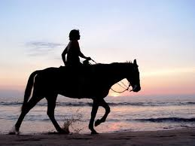
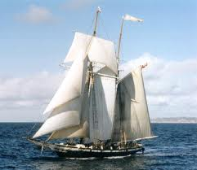
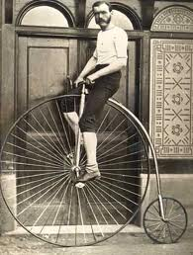
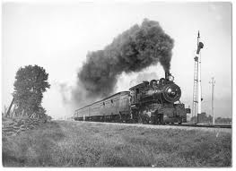
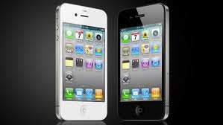
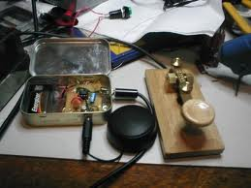
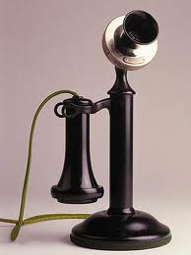
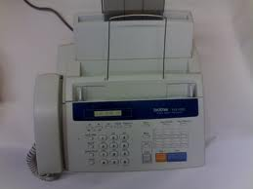
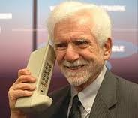
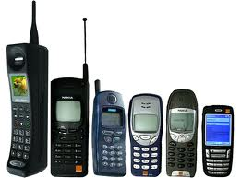
For every desktop computer, there are 10 mobile devices.
Around the world, mobile phones outnumber toothbrushes two-to-one (Weber, 2011).

Slide 3
People networking
Academic networking
Business networking
Professional networking
Research networking
Social networking

Slide 4
Some networking definitions
The action or process of making use of a network of people for the exchange of information, etc., or for professional or other advantage (Oxford English Dictionary, 2011).
The practice of making contact and exchanging information with other people, groups or institutions (Your Dictionary, 2011).
The process of using one contact to gain others (Travel Industry Dictionary, 2011).
Communicate with and within a group (WordNet, 2011).

Slide 5
Networking
May be planned and focused or happen when unexpected.
A minimum of two people need to be involved.
Information is traded.

Slide 6
Ask yourself
Why do I want to network?
What benefits do I want to achieve from networking?
Who are the people that I want to be networking with?
Where can I feasibly network with these people?
When are the best times for networking to take place?
How should I present myself to others?

Slide 7
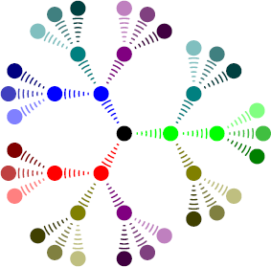
Networks = Support

Slide 8
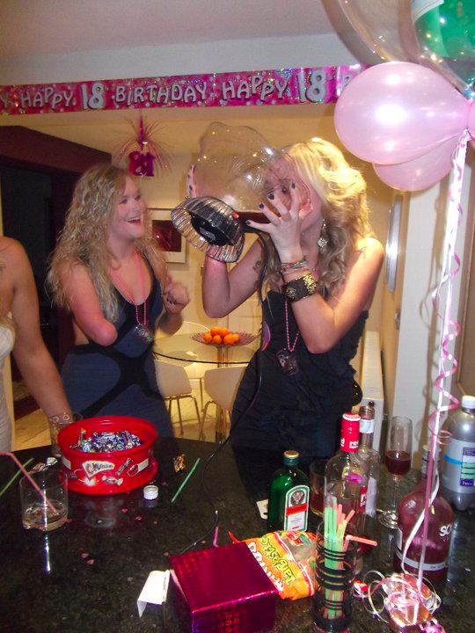
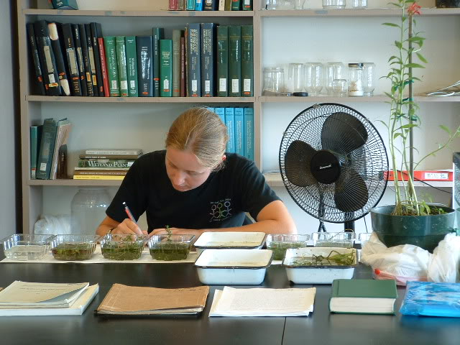
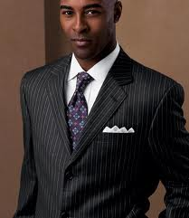
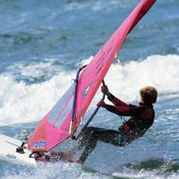
Presenting yourself

Slide 9
Image and persona
Offline
Online
Appropriate attire for the situation
Friendly greeting
Smile
Handshake
Eye contact
Business or contact card
Speak AND listen
Be confident
Be culturally aware
Appropriate avatar
Friendly greeting and text
Polite language used
Introduce yourself properly
Contact details offered
Answer and ask questions
Be professional
Be culturally aware

Slide 10
Entrepreneur networks
Other entrepreneurs
Researchers
Financers
Employers and industry figures
Specialist agencies
Support groups e.g. business incubators

Slide 11
Where
Specific networking events, such as business lunches.
Conferences / seminars.
Training sessions.
Industry events such as trade shows.
In social locations such as the gym, coffee shops and whilst travelling on public transport.
Online in a plethora of locations, but most notably, bulletin boards where users have a shared interest; social networking websites / web applications; and other communicative internet based applications.

Slide 12
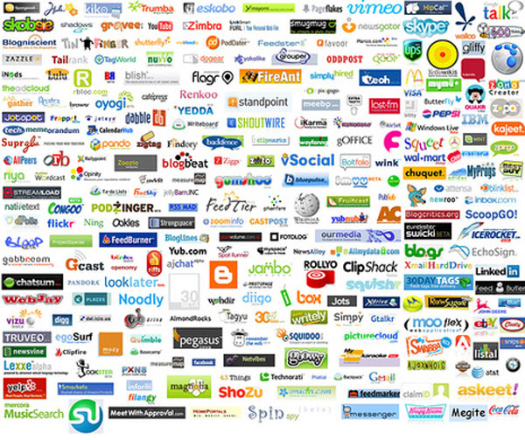

Slide 14
Facebook
1 billion users (October 2012).
Socially used by students, often to show ‘good times’. Suitability for professional graduate networking questionable.
Personal safety and security issues.
Increasingly used by businesses.

Slide 15
LinkedIn
175 million users (June 2012).
Generally an older and more professional user base.
Can work as an online curriculum vitae (CV).
A growing tool, worth investing in an account for graduates.
Can ‘bump’ e-business cards if F2F using smartphones.
Transition from Facebook to LinkedIn.

Slide 16
Twitter
Micro blog of 140 characters (max) per post (Tweet).
500 million global users (April 2012).
800,000 searches performed daily.
Rapidly growing due to rise in smartphones.
Possibly the most useful and effective global networking tool in the world today.

Slide 17
Twitter
Examples of ‘useful’ Tweeters for students:
@artsjobs – features jobs in the arts around the UK.
@ents_leeds_met – an example of a degree course tweet feed for the BA (Hons) Entertainment Management at Leeds Metropolitan University.
@leedsmet – Leeds Metropolitan University’s official tweet feed.
@mycareersadvice – career advice and guidance for graduates.
@postgrants – educational grants and scholarships.
@SocialMediaJob - jobs and internships in social media marketing, product management, community management and related fields.
@thestartupeu - this feed supports business startups and entrepreneurship.
@uclcareersblog – careers advice from the University of Central London’s blog.

Slide 18
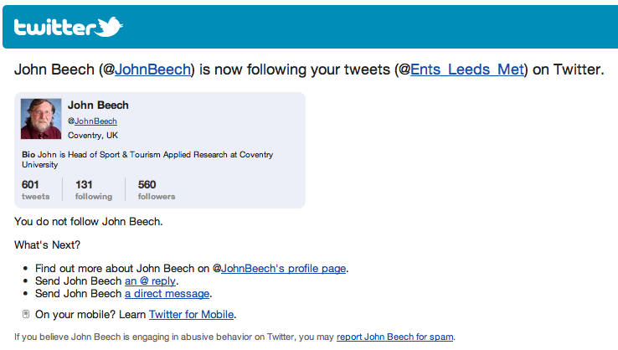

Slide 19
Twitter
Key words and terms given a # for search purposes. For example:
#careers – tweets relating to careers advice and guidance.
#dissertation – tweets relating to student dissertations.
#employability – tweets relating to issues associated with employability skills development.
#ERASMUS – tweets relating to ERASMUS exchange programmes.
#ICrEAM – Issues in contemporary entertainment and arts management.
#intern – tweets containing information relating to internships.
#yep - young entrepreneurs and professionals.

Slide 20
Foursquare
Only 20 million registered users, but growing quickly due to smartphone proliferation.
Geo-social networking platform.
Works by users ‘checking in’ to venues.
Huge networking potential.

Slide 21
MySpace
Declining user base.
Users for creators of media content, particularly audio and video.
Geared towards a teen audience.
Professional networking for the majority of graduates is limited.

Slide 23
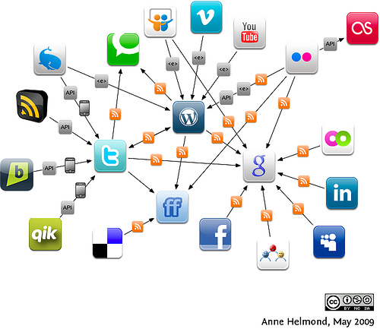
Social media apps CONNECT

Slide 24
The Future
The only certainty with networking in the connected age is that it will continue to become faster, easier and more prolific in future.
Engaging with a variety of social media will future-proof your networking skills.
Social media is rapidly growing in importance.
Many of the ‘Facebook generation’ will be in senior management positions in the next 5-10 years.
Choose sensible usernames, safeguarding YOUR NAME is advisable.

Slide 25
Safety
Do you know WHO you are networking with?
How many personal details do you disclose online?
How accessible are your profiles?

Slide 26
Thank you Any Questions?
The paper that this presentation is based upon can be found on
www.entertainmentplanet.eu

