Slide 1
Unité Conference
Edinburgh
27th November 2017
Stephen Manion

Slide 2
your
Making the Most of Opportunities
v

Slide 3
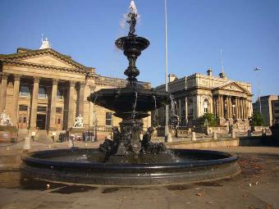
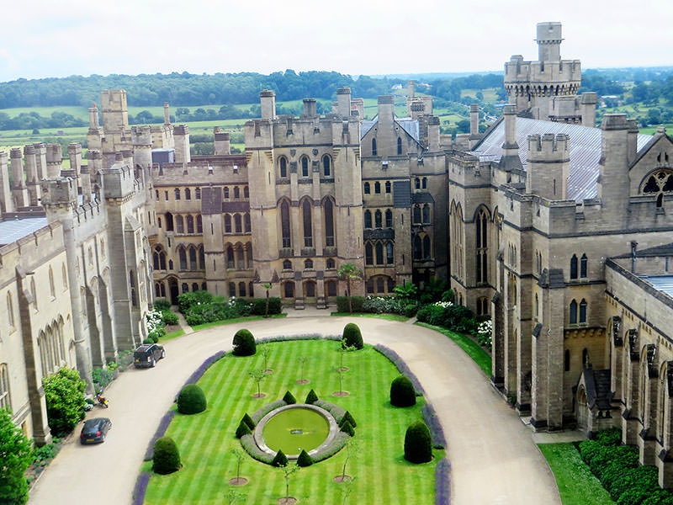
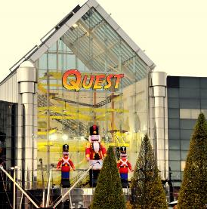
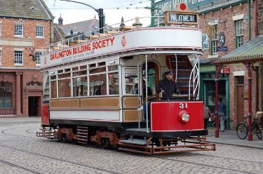
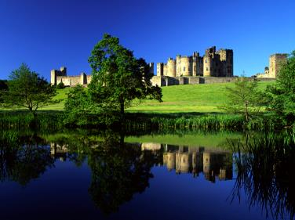
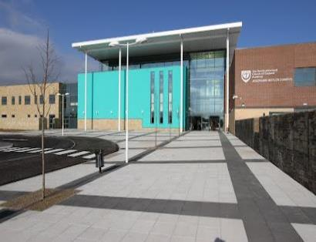
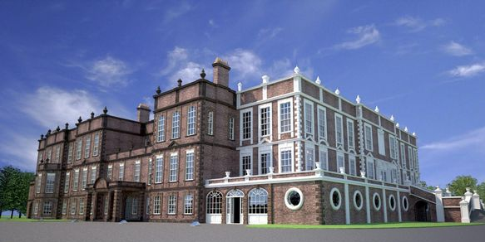
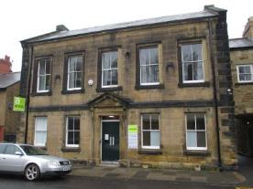
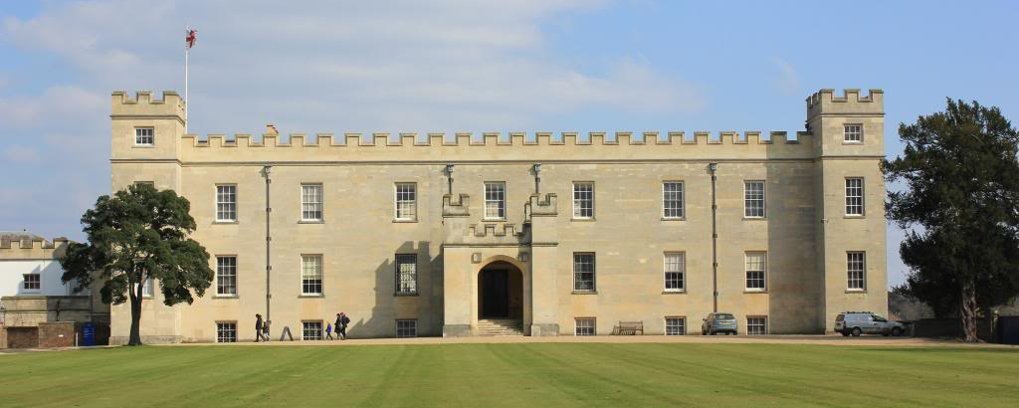
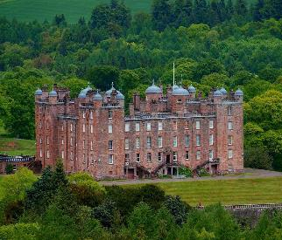
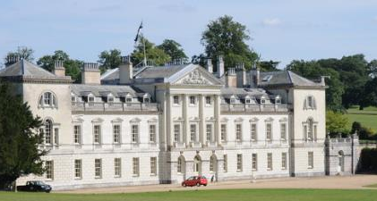
Some of the places where I gained
knowledge, experience and skills

Slide 4
Back to the topic of opportunities…
What is an opportunity?
  The circumstances which enable you to have the chance to do what you want to do to improve your life
  You are in the right place at the right time. This can be good luck
We all have opportunities:
  In work
  At college
  During leisure
You will get opportunities at this conference through who you meet, what you see, hear and do
It is you who can take advantage of the opportunities that come along
This can bring benefits to you, both professionally and personally
Here is how I took advantage of an opportunity which brought benefits for me professionally and personally

Slide 5


Let’s start with a little story…are you sitting comfortably? Then I will begin…
Once upon a time there was a manager standing in his castle office. He heard a tinkling noise and at first thought little David was playing with his balls in the bath again. But no, it was the telephone.
He strode across the room, grasped the receiver with a firm, but gentle, hand.
‘HELLO!’ he bellowed into the mouthpiece ‘WHAT DO YOU WANT?’ he shouted.
…and that’s the end of that story…let’s try again.

Slide 6

Answering the telephone…or having an opportunity!
You never know who is going to be on the other end…or what they are going to say
Always listen carefully and start by thinking that your answer will be ‘yes!’ or ‘oui!’ or ‘ja!’ – have a positive attitude
You never know what might fly in later…

Slide 7

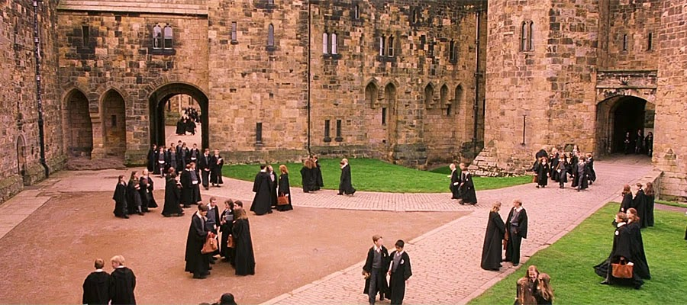
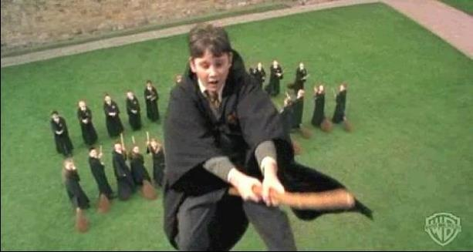
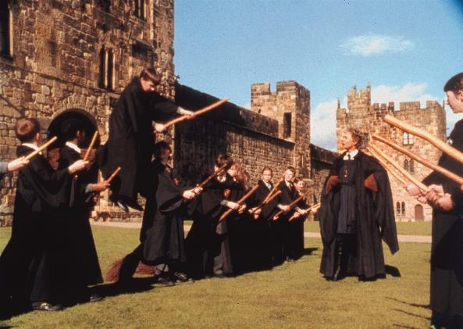
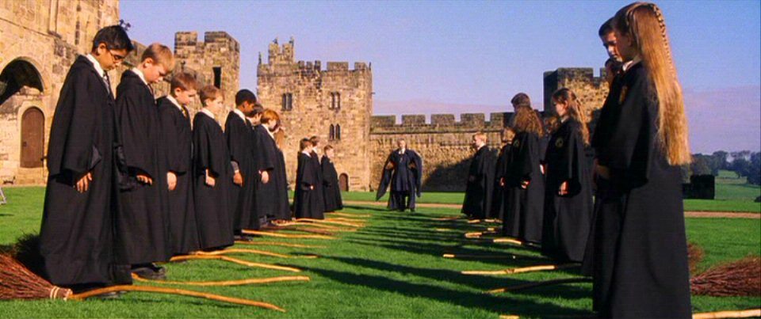
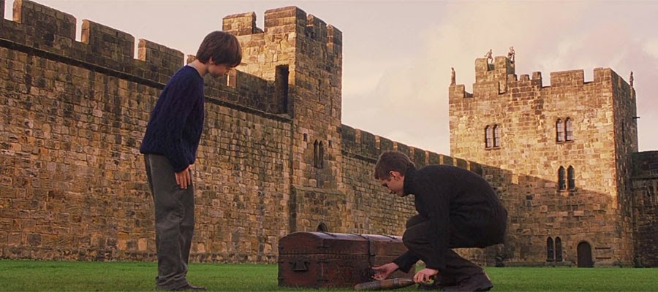

Slide 8
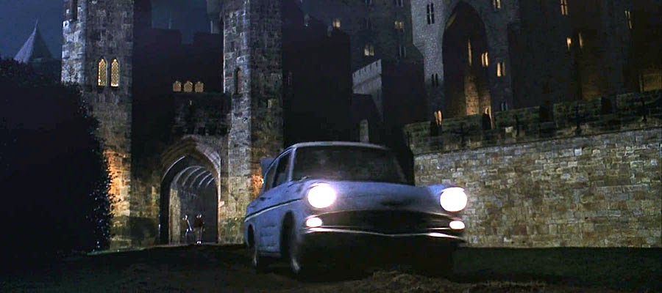
Harry Potter flew into Alnwick Castle…twice

Slide 9
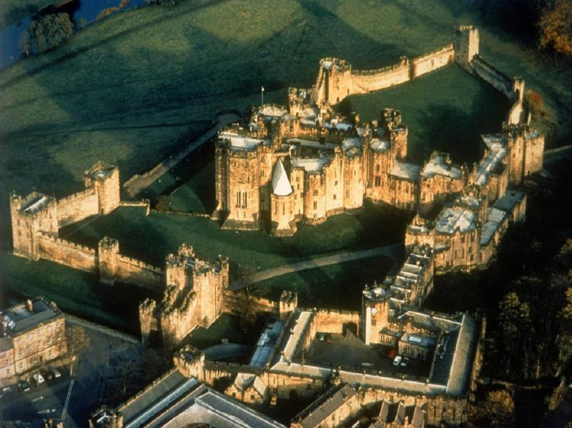
Alnwick Castle

Slide 10
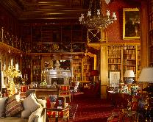
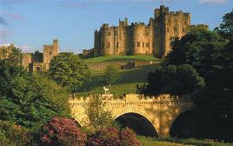
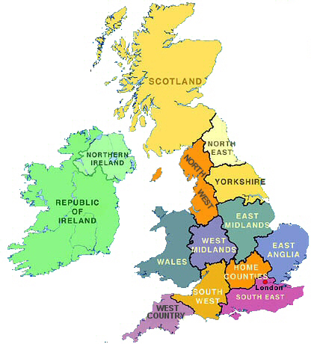
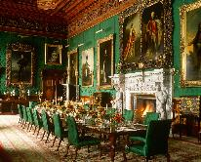
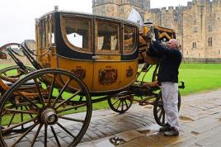
Where is Alnwick Castle?

Slide 11
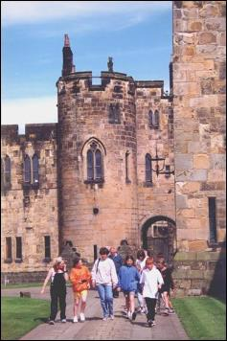
Visitor numbers per year
before Harry Potter films
52,000

Slide 12
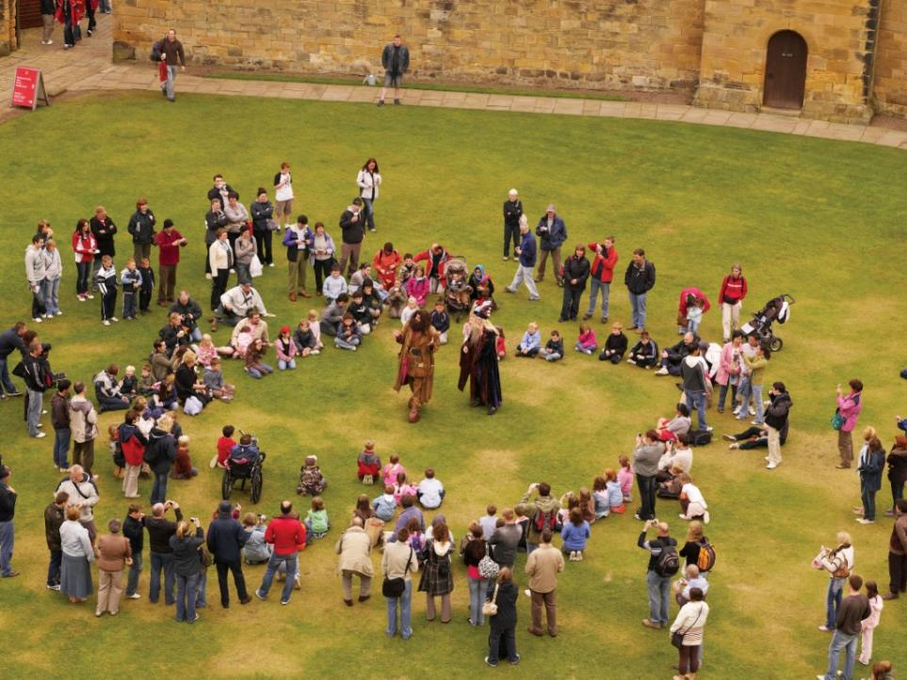
After the Harry Potter Films…..
Year 1
Year 2
Year 3
61,000
272,000
140,000

Slide 13


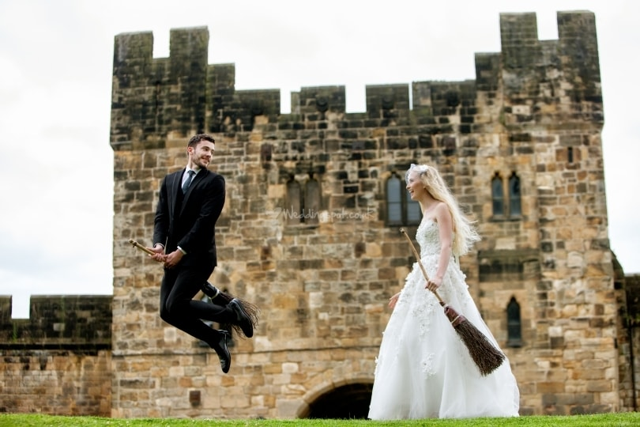

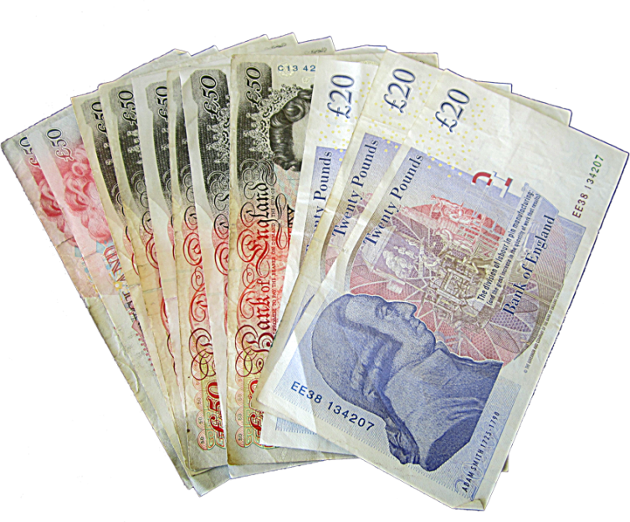

This gave us
More ticket sales
Increased media coverage
Weddings, functions and corporate entertaining
Which all leads to more…

Slide 14
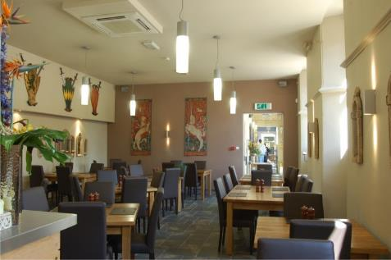
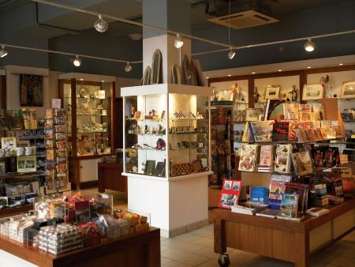
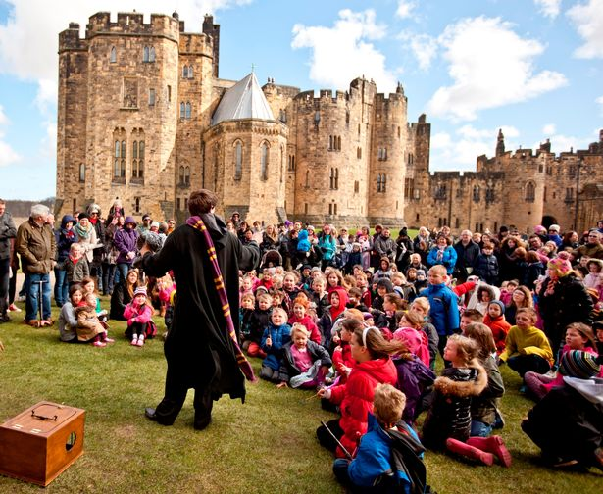
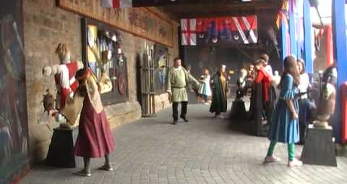
This gave us the opportunity to invest in new attractions, restaurant and shop

Slide 15
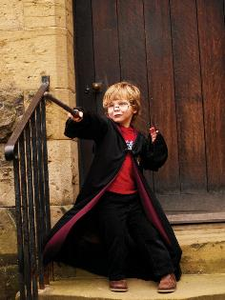
How did this happen?
It was not magic…

Slide 16
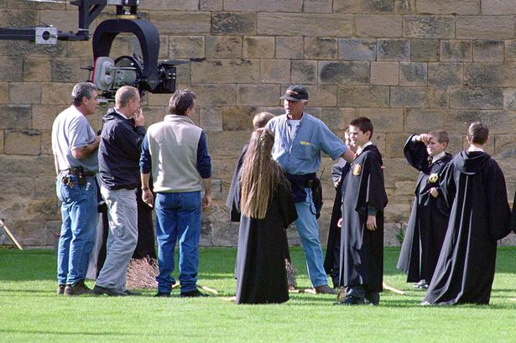

It was because I answered a telephone and said ‘yes’ to the people in this photograph

Slide 17
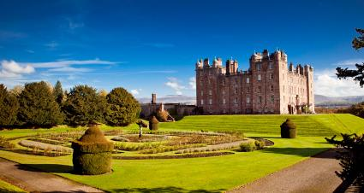
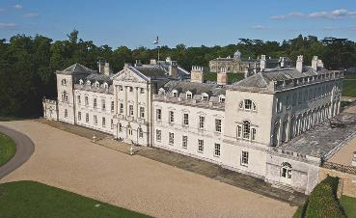
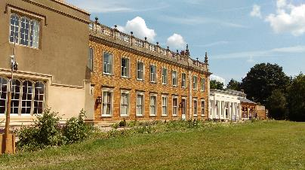
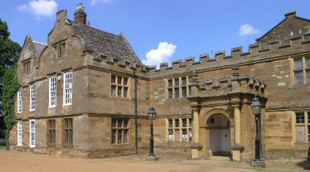
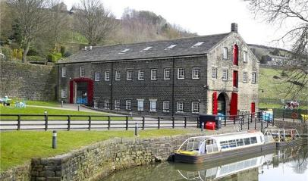
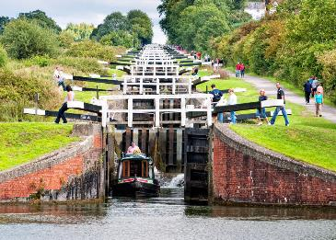
I became a consultant and used my knowledge, experience and skills to develop other historic attractions

Slide 18
How does this apply to you?
You have:
  Knowledge
    Subject, technical
  Experience
    Work experience, university, voluntary
  Skills:
    Communicating, negotiating, presenting, teamworking, creativity, problem solving
  Positive attitude
  Willing to take a risk
Confidence
These are all transferable to new opportunities.
You also have the motivation to want an interesting, challenging and rewarding career, and perhaps some fun and enjoyment.

Slide 19
Significant opportunities I made the most of in my personal career path
…or rolling the dice…
Training as a teacher
Going to manage Alnwick Castle
Becoming a consultant
Some of it was a gamble – but it makes life more exciting, rewarding and enjoyable

Slide 20
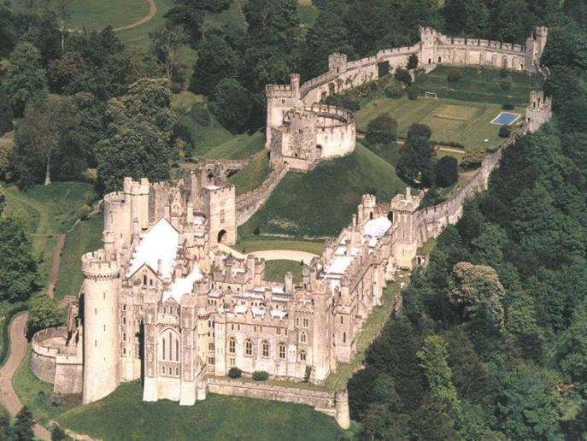
How did this all help me?
I am now the Manager of

Slide 21
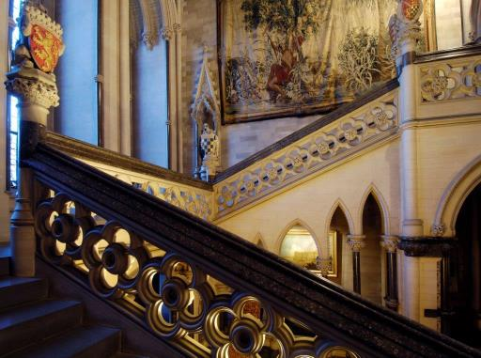
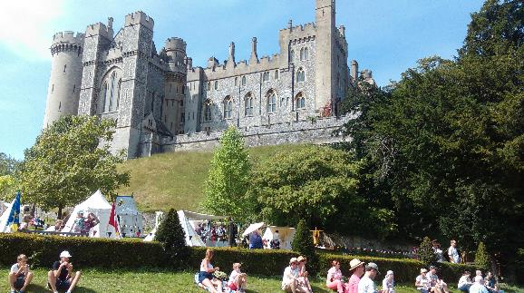
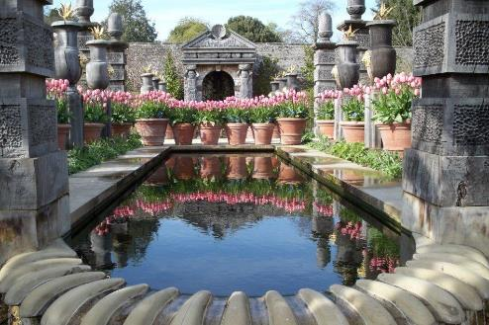
Arundel Castle

Slide 22
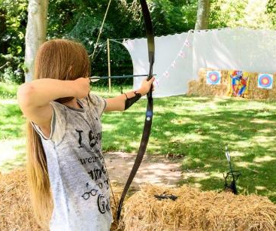
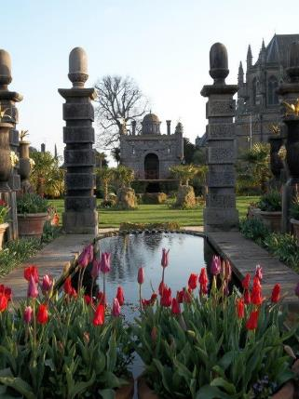
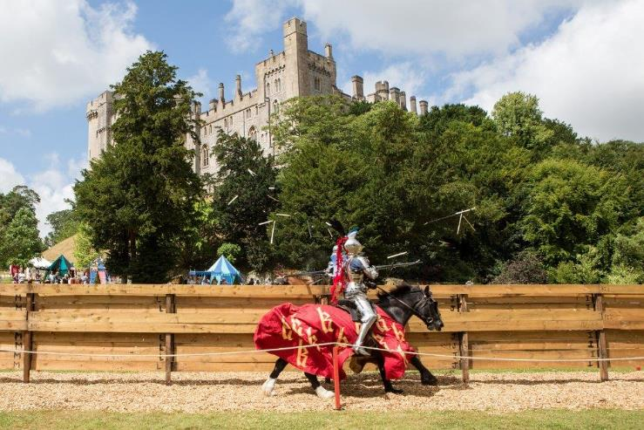
Bringing together all of my skills and experience to develop a
major historic visitor attraction

Slide 23
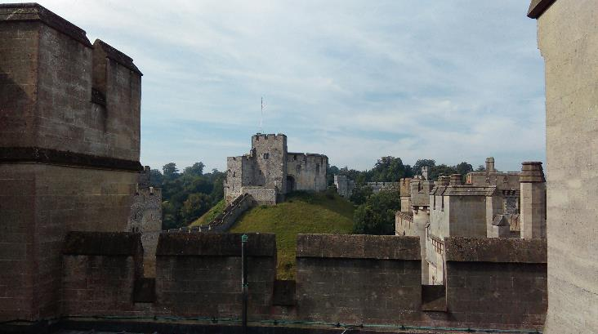
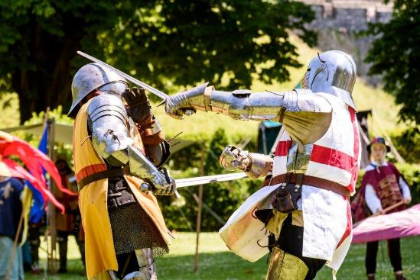
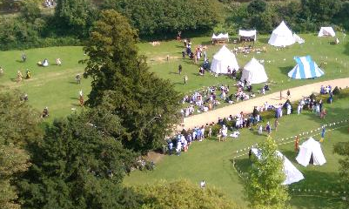
The aim is not to attract more visitors, it is…
…to make sure it is a high quality visitor experience and profitable.
A new challenge for me

Slide 24
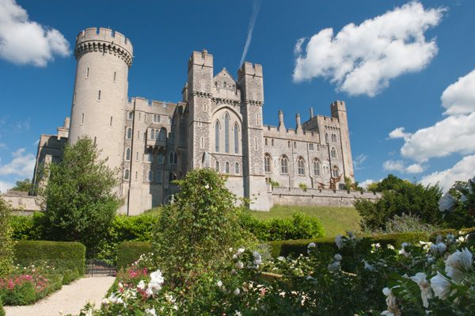
I have made the most of
my opportunities

Slide 25
Now it all depends on you…
…to make the most of
your opportunities for success
Good luck to you all

Slide 26
Thank you

