Slide 1

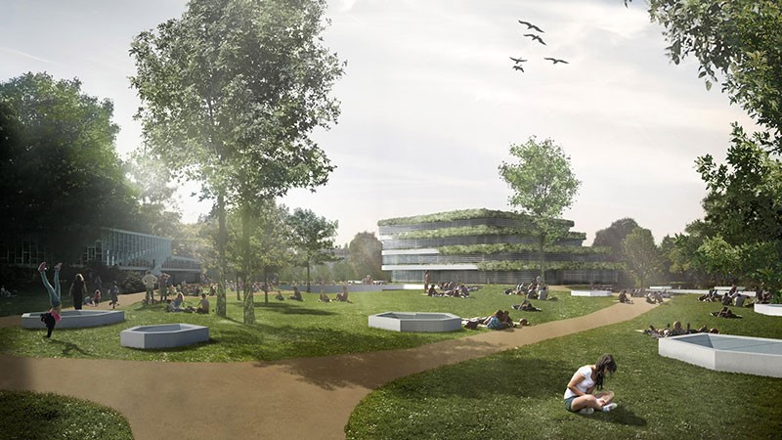



Slide 2



Slide 3



Slide 4
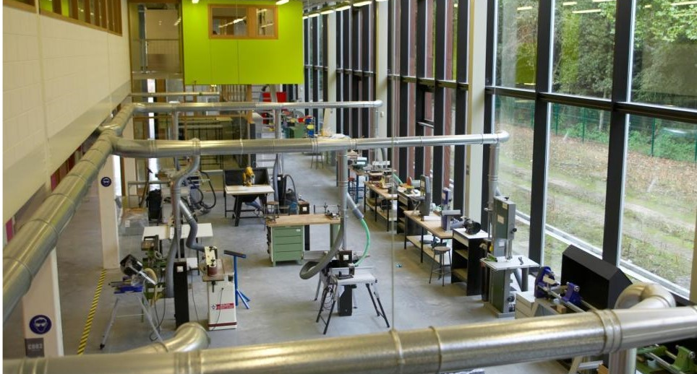


Slide 5
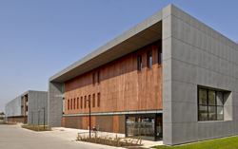
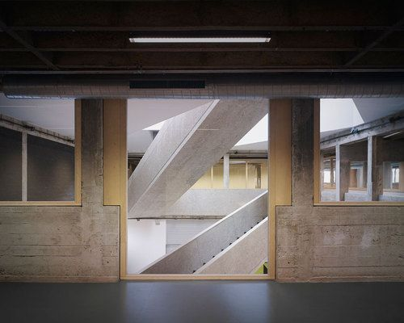
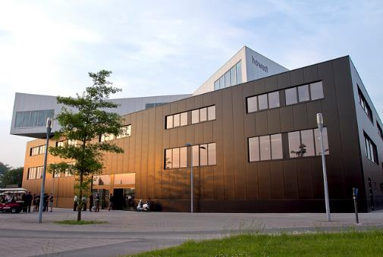
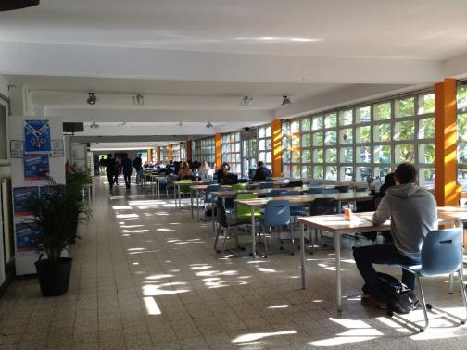
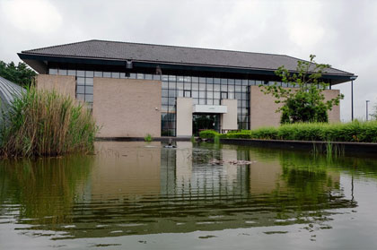
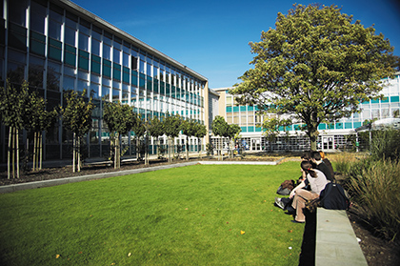
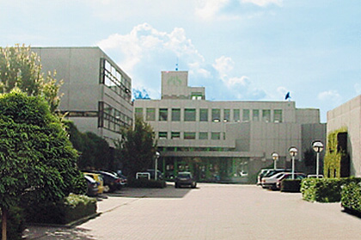
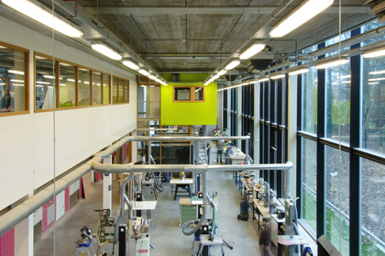

CAMPUSES HOWEST

Slide 6

12 international semesters (30 ECTS) in English (Autumn)
    Global business management
    Applied computer science
    Digital creative project in new media and IT
    Digital creative project in journalism
    Digital creative project in tourism
    Realisation in product design
    Applied Health and Lifestyle Sciences
    Integrated building design and construction
    International nursing programme
    New media and communication technology: web and app developer specialization
    We teach the world
    Migration and refugees: international semester social work

Slide 7
12 international semesters (30 ECTS) in English (spring)
    Global business management II
    Applied computer science
    Digital creative project in communication
    Digital creative project in product design
    International nursing programme
    Methodoglogy in product design
    New media & communication technology : infrastructure engineer foundations

Slide 8


Slide 9

The future of work?

Slide 10
5 TRENDS
Globalization
Mobility
Millenials and changing demographics
New behaviours
Technology

Slide 11

A global economy and

Slide 12

fierce competition

Slide 13
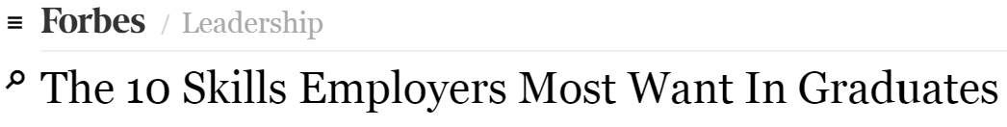
1. Ability to work in a team structure
2. Ability to make decisions and solve problems
3. Ability to communicate verbally with people inside and outside an organization
4. Ability to plan, organize and prioritize work
5. Ability to obtain and process information
6. Ability to analyze quantitative data
7. Technical knowledge related to the job
8. Proficiency with computer software programs
9. Ability to create and/or edit written reports
10. Ability to sell and influence others

Slide 14

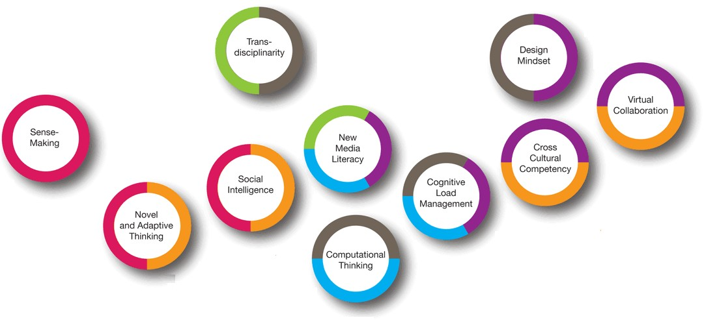




FUTURE WORK SKILLS 2020
PALO ALTO - CALIFORNIA

Slide 15
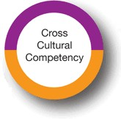
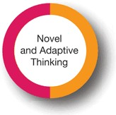
= Operating in different cultural settings
= Coming up with creative solutions

Slide 16

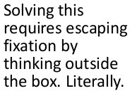
NINE-DOT PROBLEM
Use four straight lines to connect the nine dots without lifting your pen from the paper

Slide 17
NINE-DOT PROBLEM
Use four straight lines to connect the nine dots without lifting your pen from the paper

Slide 18

Inventing new business models

Slide 19


Business models are less durable than they used to be
The basic rules of the game for creating and capturing economic value were once fixed in place for years, even decades.
But now, in a disruptive age, established business models are under attack.
Disrupting beliefs: A New Approach to Business-Model Innovation – Harvard Business Review

Slide 20
Established companies should innovate in their business models and overturn the conventions in their industries before others do
Disrupting beliefs: A New Approach to Business-Model Innovation – Harvard Business Review

Slide 21





Slide 23

The relationship between living abroad and creativity

Slide 24

Solving the candle problem

Slide 25
THE CANDLE PROBLEM
Introduction
In this experiment, researchers measured the amount of time living and travelling abroad as an individual difference and then examined how these experiences were related to participants’ creative abilities.
Cultural Borders and Mental Barriers: The Relationship Between Living Abroad and Creativity
– Journal of Personality and Social Psychology

Slide 26

THE CANDLE PROBLEM
Participants
Participants | were | 205 full-time | MBA
students at | a large | business school | in the
United States (127 men, 78 women).

Slide 27

THE CANDLE PROBLEM
Participants
150 participants
were American citizens,
and 55 were citizens of foreign countries,
including :
Bangladesh (1), Brazil (4), Canada (7), China (1), Ecuador
(1), the Philippines (1), France (1), Germany (1), Hong
Kong (1), Italy (1), Ireland (1), India (12), Japan (5), Korea
(1), Mexico (1), Morocco (1), Pakistan (1), Peru (2),
Puerto Rico (1), Russia (1), Singapore (1), Switzerland (1),
Thailand (1), Taiwan (1), and the United Kingdom (5).

Slide 28

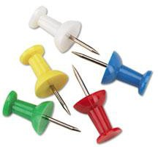

THE CANDLE PROBLEM
Creative task
Individuals are presented with three objects on a table placed next to a plaster wall: a box of drawing pins, a candle and some matches.
The task is to attach the candle to a cardboard wall so that the candle burns properly and does not drip wax on the table or the floor.

Slide 29
Creative solutions to solve the candle problem

Slide 30

THE CANDLE PROBLEM
Solution

Slide 31

The correct
solution
involves using the box of drawing pins as a candleholder — one should empty the box of drawing pins and then tack it to the wall placing the candle inside.

Slide 32
Studies more
found that the individuals had
integrated themselves into the foreign cultures when they lived abroad, the more likely they were to solve the candle problem.

Slide 33
It involves the ability to see objects as performing different functions from what is typical, to make unexpected links among concepts.

Slide 34

The benefits of active multicultural engagement

Slide 35

Studies suggest that the psychological approach individuals take when immersed in a general multicultural environment may provide a boost in integrative complexity.
Expanding Opportunities by Opening Your Mind: Multicultural Engagement Predicts Job Market Success Through Longitudinal Increases in Integrative Complexity
– Social Psychological and Personality Science

Slide 36

Integrative complexity deals with how people process information.
Some people may view things in simple terms and some may view them in more complex ways.
The level of complexity depends on two underlying variables:
Integrative Complexity
– Online Research Network psychology.iresearchnet.com

Slide 37
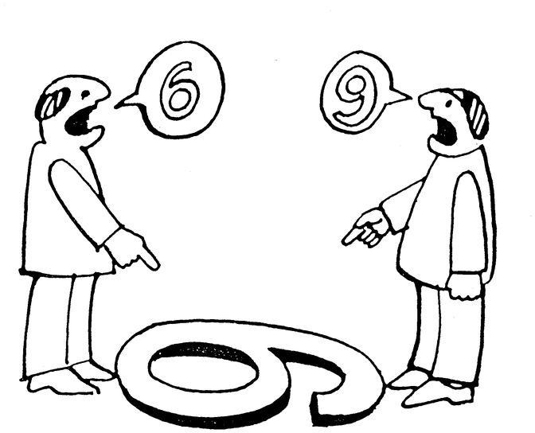
– The capacity and willingness of an individual to accept that there is more than one way to look at an issue and to acknowledge that these differing perspectives are all legitimate.

Slide 38

– The ability to form conceptual links among these perspectives and to integrate them into a coherent overall judgment

Slide 39

Living abroad can lead to more career opportunities

Slide 40

Studies predict that active multicultural engagement will increase integrative complexity and that this increased complexity will produce more job offers.
Expanding Opportunities by Opening Your Mind: Multicultural Engagement Predicts Job Market Success Through Longitudinal Increases in Integrative Complexity
– Social Psychological and Personality Science

Slide 41

The relationship between living abroad and creativity

Slide 42

Integratively complex individuals are seen as creative, open to new experiences and able to bring seemingly unrelated ideas together into meaningful wholes.
This may appear as more attractive to recruiters.
Expanding Opportunities by Opening Your Mind: Multicultural Engagement Predicts Job Market Success Through Longitudinal Increases in Integrative Complexity
– Social Psychological and Personality Science

Slide 43
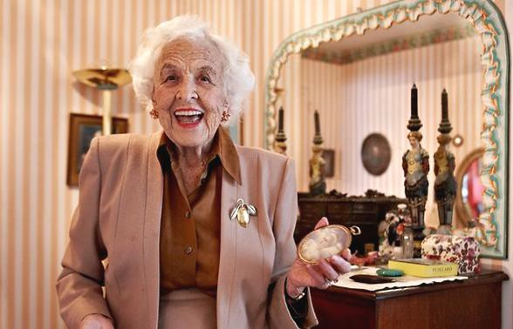
Extreme longevity

Slide 44

Life expectancy at birth continues to increase in EU countries, rising on average by 3 months each year.
Health at a Glance: Europe 2016 – State of Health in the EU Cycle
OECD/EUROPEAN COMMISSION

Slide 45
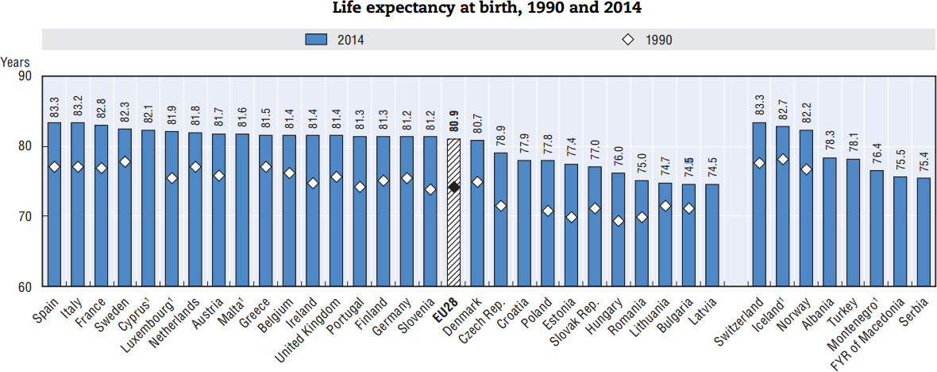
Life expectancy at birth across the 28 EU member states reached 80.9 years on average in 2014, an increase of around seven years since 1990.

Slide 46

Job hopping is the new normal

Slide 47
The days of lifetime employment at a single company are long gone
The idea of graduating from school, immediately entering the working world and sticking with one position until retirement with a pension is long gone.

Slide 48
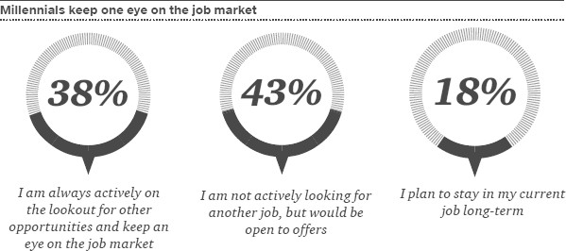
Talent Mobility: 2020 and Beyond – PricewaterhouseCoopers PwC

Slide 49
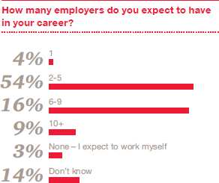
Talent Mobility: 2020 and Beyond – PricewaterhouseCoopers PwC

Slide 50

Global talent mobility

Slide 51

Global mobility becomes part of the new normal.
For example, a Chinese company may engage a European team to manage an investment in Africa.
Talent Mobility: 2020 and Beyond – PricewaterhouseCoopers PwC

Slide 52

Analysts predict the global mobility will continue to grow in volume in the coming years.
Talent Mobility: 2020 and Beyond – PricewaterhouseCoopers PwC

Slide 53
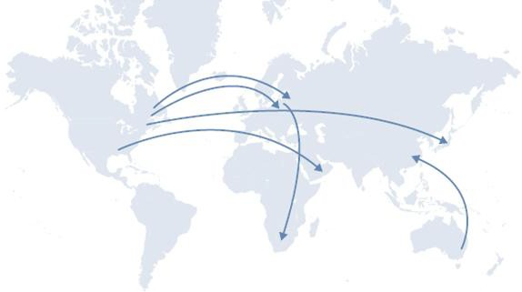
1970-1990
International assignments are mostly multinationals based in the US and Europe.
driven
by large

Slide 54
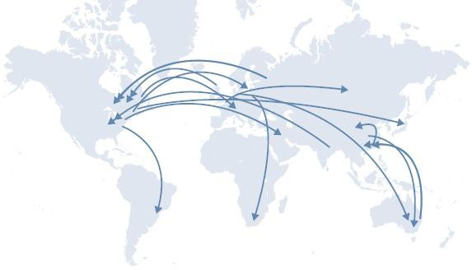
1990-2010
Demand for global mobility of talent increases as new markets emerge for companies to sell their products and services to, and also manufacture their goods at lower cost.

Slide 55
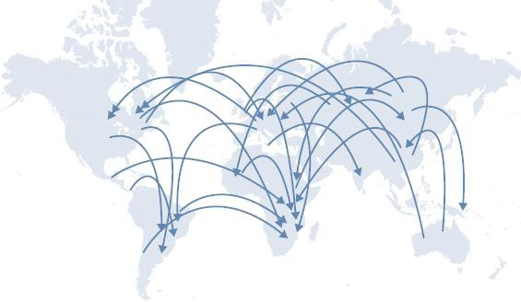
2020
Global mobility continues to grow in volume.

Slide 57
So the question is ….

Slide 58


