Slide 1
BEST PRACTICE:
HOW TO ORGANIZE SUCCESSFUL
INTERNATIONAL WEEK (IW)

Slide 2
DEU Faculty of Business International Mobility Numbers
Agreements & Mobility | Numbers | Countries
Erasmus Agreements (ICC) | 63 | 15
Academic Collaboration Protocols | 15 | India, S. Korea, China, Ukraine, Kazakhistan and Russia
Outgoing Students since 2003-2004 | 976 | 18 Countries in Asia and Europe
Incoming Students since 2003-2004 | 621 | 18 Countries in Asia and Europe
International Week (IW) Participants since 2007 | 200 Lecturers 1763 Students | 18 Countries in Asia and Europe
Faculty of Business student numbers | 2700 out of 550 is int’l degree seeking | Kazakhistan, Azerbaijan, Iran, Turkmenistan, Bulgaria and Germany

Slide 3
Why International Week (IW)?
For Students?
For Partners?
For Faculty ?

Slide 4
For Students:
Chance to take a course from an international lecturer
Collect 1 ECTS credit that issued at the Diploma Supplement
Bounding
Get to know a diffirent culture
Experience a diffirent method of teaching

Slide 5
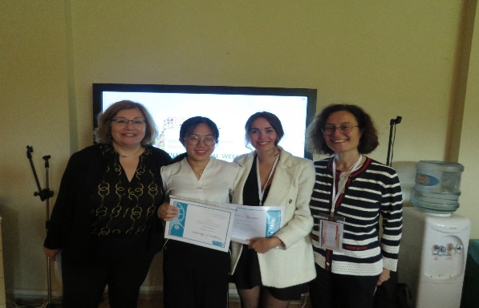
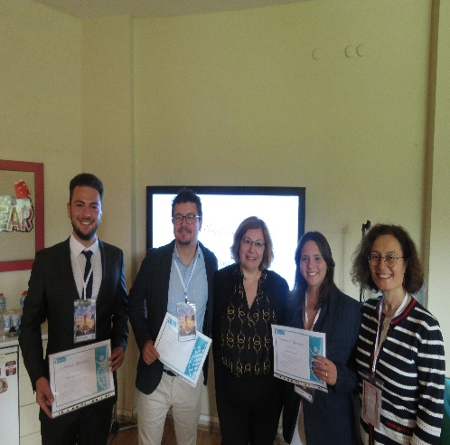
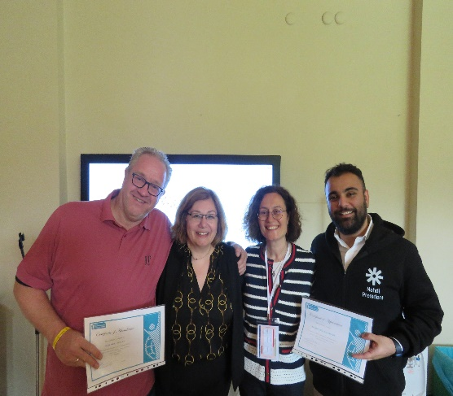
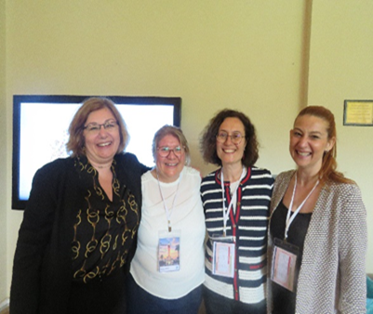
For Partners:
Networking
International teaching experience
Explore a new destination
Infuse into Turkish Culture and hospitality
Get out of the routine for a week

Slide 6
Some feedbacks from our participants:
2009 – 3rd International Week
2015 – 8th International Week
Dear Friends in İzmir,
My first experience in teaching abroad could not have been better than here in İzmir. The organisation was excellent. The students interested and during teaching hours i could concentrate on giving the best lectures.
I would love to come back one time.
Warm regards,
Participant from
Saxion University, Netherlands
I’ve been heard of legendary hospitality of Turkish people and that’s true. Thanks for the wonderful days, you and the wonderful team.
Participant from
Catholic University of Lyon, France
2019 – 14th International Week
2023 – 16th International Week
I am so thankful for inviting me to the International Week. This is always a big event, great people, lots of work which brings enjoyment and exploration of the wonders of Turkey. You are amazing people and great hosts! My admiration of the country, the people and everything is in here exceeding all expectations. Always looking forward to see you and welcome Russia any time. Teşekkürler! Our countries are friends forever.
Participant from
Voronezh State University, Russia
What a week!
I was enjoying it very much, thank you for the fantastic organization, your legendary hospitality and your new friendship! Hope to be back next year.
Participant from
Deggendorf University, Germany

Slide 7
For Faculty:
Mingling with the colleagues
Pave the way for making the promotion of the school & the city
Networking
Enhance the collaboration, go beyond than exchange
Get to know each other better ,empathy

Slide 8
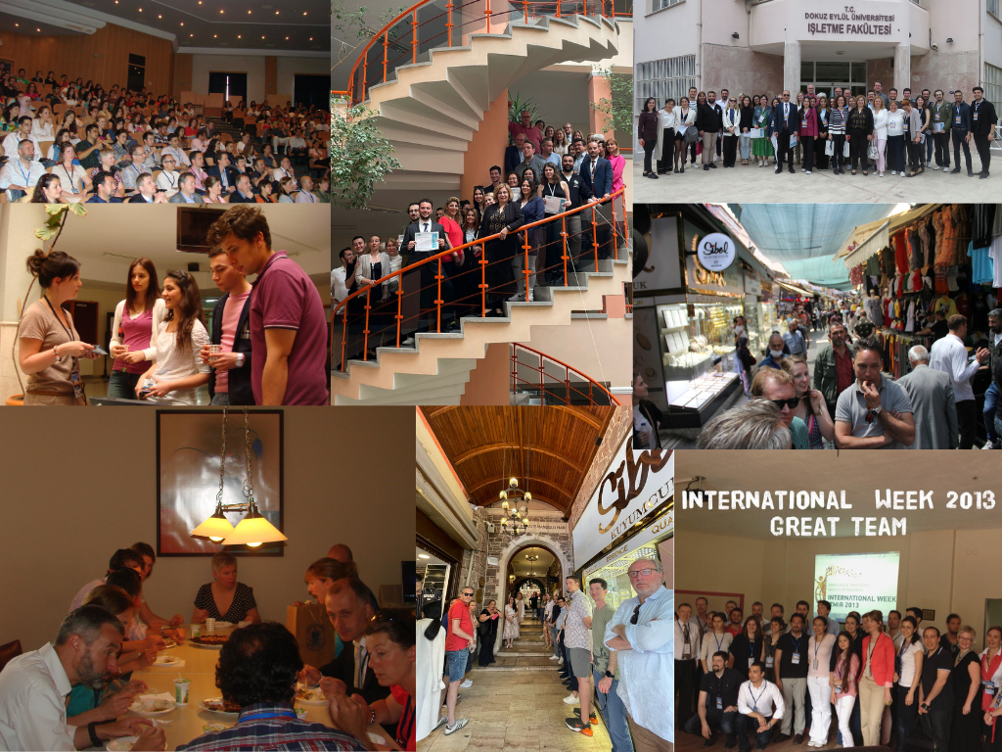

Slide 9
Tips for sucessful organization
Inform students about the IW courses & benefits of the activity : be consicious
Award students 1 ECTS for full participation : extra credit
Appoint a mentor student to each IW insructor : make him/ her feel comfortable
An IW course requires 9 hours of teaching for 3 consecuative days: both parties take it serious
All IW instructors teach at the same time span : parallel courses
Shuttle is provided
Hotel recommendation with a special offer where is located at the vicinity of the city
Create a spirit of unity
Make them feel they are the one!
Provide detailed info before the IW about practicalities, social part, IW rules, class lists, how to reach the city , mentor student & recomendations for the leisure time etc.

Slide 10
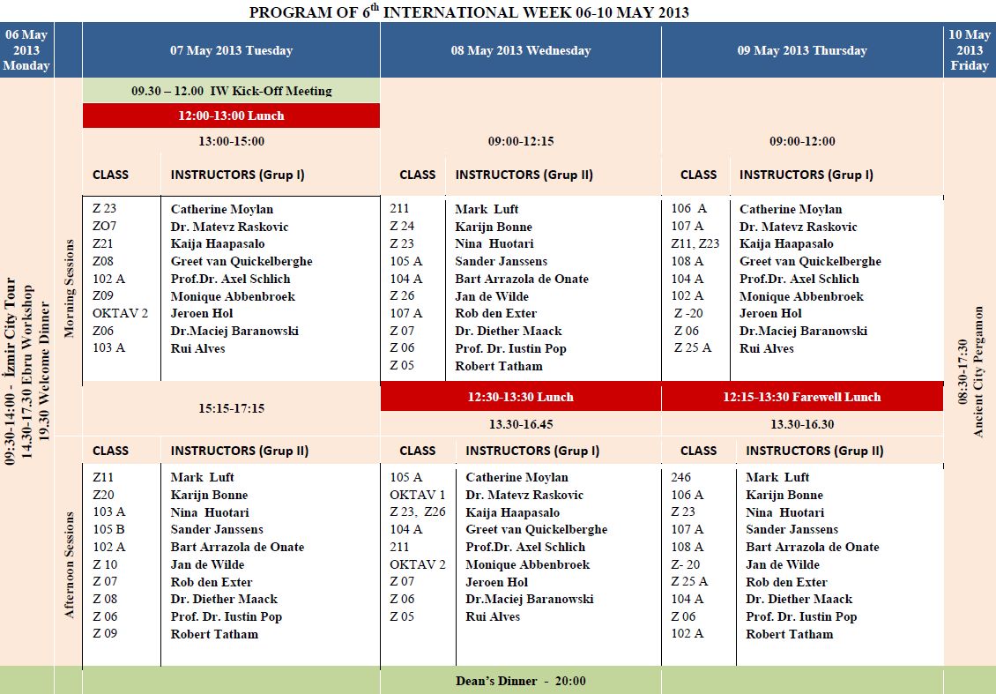
International Week Program

Slide 11
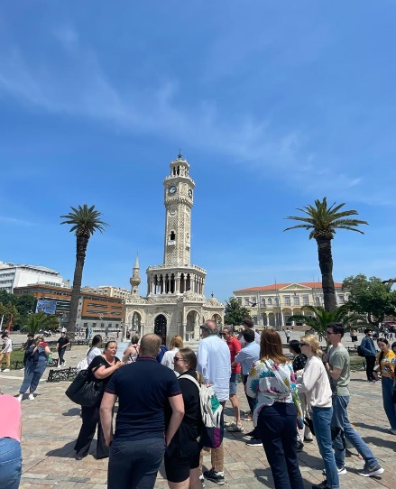
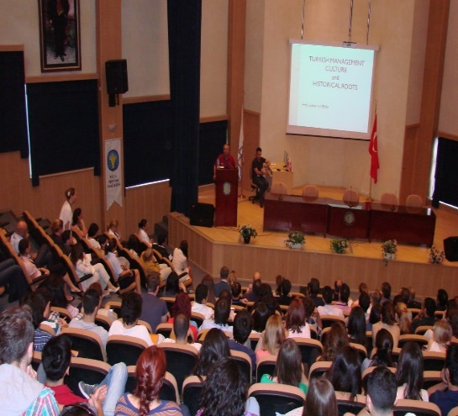
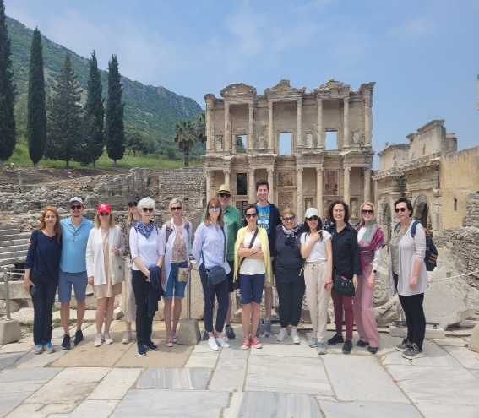
Social Part
IW takes place from Monday to Friday and we both start & end with excursions
Monday : guided İzmir city tour takes place ,so we meet before the offical part start
Tuesday,Wednesday and Thursday are teaching days and two afternoons are
free to explore the city and the culture : individual time
Tuesday: start with kick off meeting, IW participants informed about Turkish culture, history &policy.
Wednesday night: Dean’s Dinner
Thursday night: Informal Dinner ( optional participation)
Thursday : Official part ends with farewell lunch which we distrubuate certificates to all the partcipants
Friday: Whole day excursion to one of the ancient cites around like Ephesus, Pergamon etc.

Slide 12
Thank you for your participation
Any Comments ???
Isınsu Atalay, MSc.
isinsu.atalay@deu.edu.tr

