Slide 1



Helping Incoming Students Master Specialized Vocabulary
Presentation of Leapsy
Businet- 2023
© Accent Languages - 2023

Slide 2





Accent Languages
Our approach
Methodology based on
neurosciences
Adaptive solutions
3 major differentiators
  Bespoke content
  Focus on speaking
  Long-term retention
Who are we?
70 dedicated people
2 core-businesses:
  In-company language training
  Developer of digital solutions
Major EdTech player in Wallonia
© Accent Languages - 2023

Slide 3

ELAO
Smart language assessments
How do you assess languages?
6 languages : EN – FR – DE – IT – SP - NL
Based on CEFR
Fast, accurate and reliable
Tailor-made to suit your needs
Selection of tested languages
Selection of interface languages
Creation of bespoke reports
Interface customisation
API to connect to your tools
Extremely easy to use

Slide 4

ELAO
How do you assess languages?
Smart language assessments
6 languages : EN – FR – DE – IT – SP - NL
Based on CEFR
Fast, accurate and reliable
Tailor-made to suit your needs
Selection of tested languages
Selection of interface languages
Creation of bespoke reports
Interface customisation
API to connect to your tools
Extremely easy to use

Slide 5

Learning a language in 2023
Efficiency
Best ways?
Apps
Best apps?
Content
General vs. Specialized?

Slide 6


Learning a language in 2023
Efficiency
Best ways?
Apps
Best apps?
Content
General vs. Specialized?

Slide 7

Visual, auditory & kinaesthetic
Speech recognition
Pronunciation
Adaptive
Micro-learning
Spaced recall
Fun & interactive
User-friendly & engaging
User-centric
Open and guided paths
Integrated translator
Vocabulary
Grammar
Audio content
Specific content
Easy to create new content
What if …?
… our wish list

Slide 8
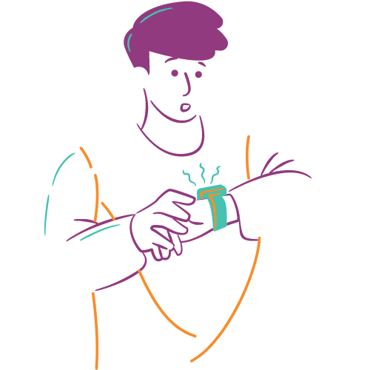
This has lead to …
Our quest,
a 15-month journey
Innovations
Using ChatGPT and other tools to generate content automatically
Some figures
15 people involved
More than 100 meetings
More than 1000 cups of coffee
More than 3000 development hours

Slide 9
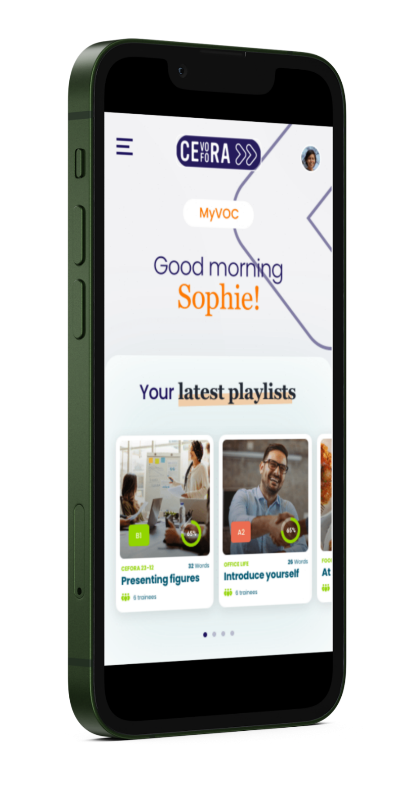

Spotify & Languages = Leapsy
An enticing mobile application that allows students to learn a new language easily and in a fun way.
1
2
On the trainers' side, Leapsy is an extension of their distance or face-to-face lessons.

Slide 10

How Leapsy is structured
Playlist 1
=
Lesson 1
Item 1
Item 2
Item 3
…
Course = Training
Playlist 2
=
Lesson 2
Item 1
Item 2
Item 3
…
Playlist 3
=
Lesson 3
Item 1
Item 2
Item 3
…

Slide 11



Benefits for your students, your professors and your organisation
Students
Professors
Organisation
Content adapted to their needs and level
A Lagom approach
Getting instant feedback
Measuring their progress
Specific playlists easy to creafe
Shared and reusable content
Student follow-up
…
Measuring progress
Supporting professors
Best possible ROTI/E

Slide 12


Your/Our Challenge
Help us make it better

