Slide 1
Principles for Responsible Management Education (PRME) initiative
Nathalie Ormrod
Senior Lecturer in Marketing and Business Ethics
Manchester Metropolitan University

Slide 2
PRME Network
Launched at the 2007 UN Global Compact Leaders Summit in Geneva
Largest organised relationship between UN and business schools
Over 650 leading business schools and management-related academic institutions from over 80 countries worldwide
The PRME Principles – framework for gradual, systemic change in business schools and management-related academic institutions

Slide 3
PRME Steering Committee
The PRME initiative is a partnership of international co-convening organisations which form the :
  UN Global Compact
  AACSB International (The Association to Advance Collegiate Schools of Business)
  European Foundation for Management Development (EFMD)
  Association of MBAs (AMBA)
  Central and East European Management Development Association (CEEMAN)
  Association of African Business Schools (AABS)
  Latin American Council of Management Schools (CLADEA)
  Accreditation Council for Business Schools and Programs (ACBSP)
  The Academy of Business in Society (ABIS)
  Globally Responsible Leadership Initiative (GRLI)
  (www.unprme.org/about-prme/steering-committee, 2016)

Slide 4
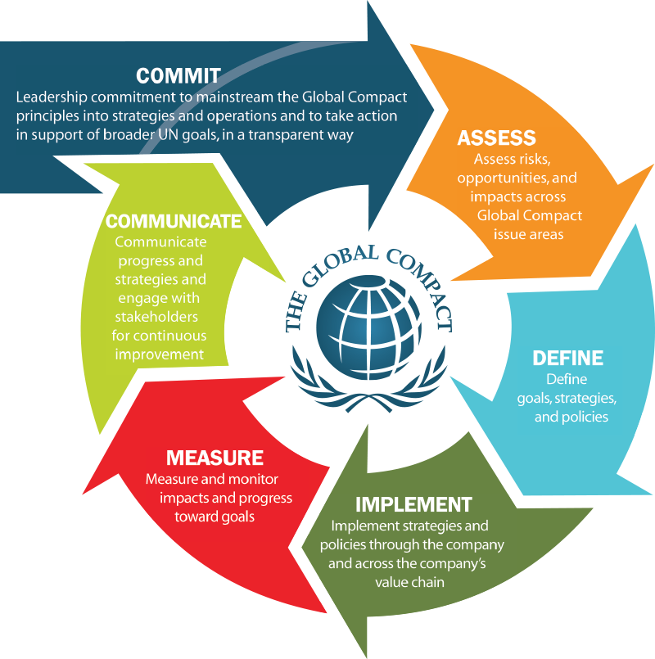

Slide 5
PRME – Mission, Goals, Characteristics
Mission – to transform management education, research and thought leadership globally by providing the Principles for Responsible Management Education framework, developing learning communities and promoting awareness about the United Nations' Sustainable Development Goals.
Internationally accepted values (such as UN’s Global Compact's Ten Principles)
  provide engagement structure for academic institutions to advance social responsibility through incorporating universal values into curricula and research
  process of continuous improvement among institutions of management education in order to develop a new generation of business leaders capable of managing the complex challenges faced by business and society in the 21st century.
Three distinctive characteristics of the initiative: continuing improvement, a learning network, and reporting progress to stakeholders.
(www.unprme.org/about-prme/history , 2016)

Slide 6
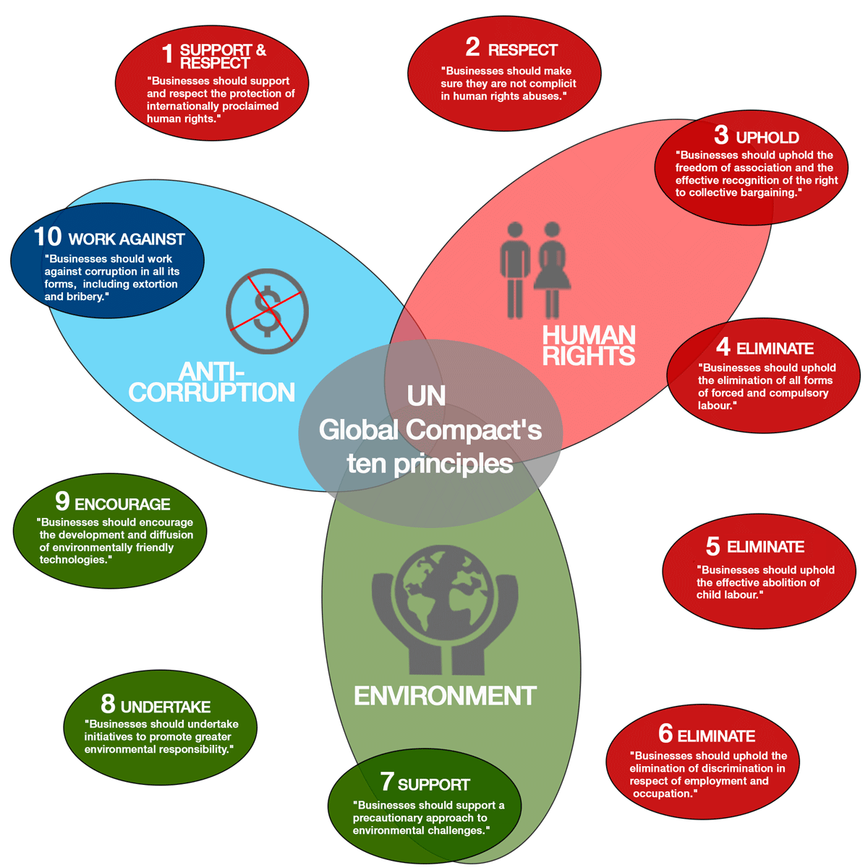

Slide 7
PRME’s Six Principles
Principle 1 | Purpose:
  Develop the capabilities of students to be future generators of sustainable value for business and society at large and to work for an inclusive and sustainable global economy.
Principle 2 | Values:
  Incorporate into academic activities and curricula the values of global social responsibility as portrayed in international initiatives such as the United Nations Global Compact.
Principle 3 | Method:
  Create educational frameworks, materials, processes and environments that enable effective learning experiences for responsible leadership.
(www.unprme.org/about-prme/the-six-principles , 2016)

Slide 8
PRME’s Six Principles
Principle 4 | Research:
  Engage in conceptual and empirical research that advances our understanding about the role, dynamics, and impact of corporations in the creation of sustainable social, environmental and economic value.
Principle 5 | Partnership:
  Interact with managers of business corporations to extend our knowledge of their challenges in meeting social and environmental responsibilities and to explore jointly effective approaches to meeting these challenges.
Principle 6 | Dialogue:
  Facilitate and support dialog and debate among educators, students, business, government, consumers, media, civil society organisations and other interested groups and stakeholders on critical issues related to global social responsibility and sustainability.
  (www.unprme.org/about-prme/the-six-principles , 2016)

Slide 9
PRME’s Working Groups
PRME Working Group on Anti-Corruption in Curriculum Change
PRME Working Group on Business and Human Rights
PRME Working Group on Business for Peace
PRME Working Group on Climate Change and Environment
PRME Working Group on Developing a Sustainability Mindset
PRME Working Group on Gender Equality
PRME Working Group on Poverty, a Challenge for Management Education
PRME Working Group on Sharing Information on Progress (SIPs)
PRME Working Group on Sustainable Leadership in the Era of Climate Change (this group is currently inactive)
PRME Working Group on the Incorporation of the Principles in Executive Degree Programmes (has fulfilled its mission and is no longer active)
Working Group 50+20 – Management Education for the World Joint Project

Slide 10
PRME’s Champions
Leadership Group
Mission
  Contribute to thought and action leadership on responsible management education in the context of the United Nations’ sustainable development agenda.
  Work collaboratively to achieve higher levels of performance in transforming business and management education in five key areas: curricula, research, educational frameworks, sustainability-based partnerships, and thought leadership.
  Serve the broader PRME community through active engagement with existing PRME Chapters, PRME Working Groups, Global Compact LEAD, and other global opportunities, as well as to support broader and deeper implementation of sustainability principles in the institutional context of the PRME initiative.
  Contribute to broader UN goals and issues, particularly helping to realize the Sustainable Development Goals.
(www.unprme.org/working-groups/champions, 2016)

Slide 11
PRME Chapters
Regional platforms advancing the Six Principles of PRME within geographic, national, regional, cultural and linguistic contexts
    PRME Chapter ASEAN+ PRME Chapter MENA
    PRME Chapter Brazil PRME Chapter UK & Ireland
    PRME Chapter CEE PRME Chapter North America
    PRME Chapter DACH PRME Chapter Nordic
    PRME Chapter Latin America and Caribbean
Emerging Chapters
    PRME Chapter Australia/New Zealand
    PRME Chapter East Asia
    PRME Chapter Iberian (Spain and Portugal)
    PRME Chapter India
    PRME Chapter South Asia
(www.unprme.org/working-groups/chapters, 2016)

Slide 12
PRME – Looking forward
15-year plan adopted in 2015 by all 193 UN member states (“2030 Agenda”)
Achieving a better future for all – good governance incl. peace and security
Ending extreme poverty – economic development
Fighting inequality and injustice – social inclusion
Protecting our planet – environmental sustainability
Addressing the most pressing economic, social, environmental and governance challenges of our time
Sustainable Development Goals (SDGs)
Common framework to enable dialogue and action among the PRME initiative, the UN, the UN Global Compact, business and students, as well as other stakeholders and partners
Education to develop globally responsible citizens, managers and leaders with capabilities and commitment to sustainability
Research to enable policy makers and (business) organisations to serve UN goals and SDGs.
Public debate to engage in the transformation of business and society.

Slide 13
Sharing Information on Progress
MMU Report 2012
To be recognised as a leading professional Business School as a result of our commitment to develop within our students the qualities of excellent academic scholarship, an entrepreneurial vision, a set of professional skills and the high standards of social responsibility that will positively impact organisations, communities, and the environment.
Determination to develop responsible managers for tomorrow and connect with employers, business and alumni
Faculty of Business and Law, Business School, Principles for Responsible, Management Education, www.unprme.org, Sharing Information on Progress Report, November 2012 http://www.unprme.org/reports/6343PRMEReportv3.pdf

Slide 14
Achievements since joining PRME
(MMU SIP Report 2012)
2006 – MMU ranked 91st in the People and Planet Green League (comprehensive and independent league table of UK universities ranked by environmental and ethical performance)
2010 onward – one of the top 10 greenest universities in the UK
  Carbon emissions reduced by 18.5%
  MMU awarded the Carbon Trust Standard
  Voted ‘Ecofriendly university’ by 94% of MMU students
  Green Impact Awards for recycling
2010/11 MMUBS review of UG curriculum
  All programmes have now embedded responsible management within the first year (L4) and in consequential units at levels 5 and 6.
2012 – two Green Gown Awards (UK and International) in the ‘Continuous Improvement: Institutional Change’ category (awarded by Environmental Association for Universities and Colleges, EAUC)

Slide 15
Achievements since joining PRME
(MMU SIP Report 2012)
Sustainability initiatives embedded in core business operations to help create a sustainable future
  Pilot organisation for highly innovative Carbon Literacy Project (creating shift in how we live, work and study) – 90 students involved
  Green Impact programme for staff and students (4th year running) e.g. third year business students investigating feasibility of keeping bees and selling honey, or running sustainable transport competitions
Collaborative approaches and inter-faculty linkages essential for embedding sustainable practices throughout MMU
Connections and interactions between groups of key stakeholders
Holistic approach to embed sustainability at MMU
Creating frameworks to deliver similar training opportunities to local communities over coming years

Slide 16
Achievements since last MMU SIP 2012 MMU SIP Report 2014
Steady progress and improvement in environmental and ethical performance since MMU failed the first Green League assessment back in 2007
2014 – MMUBS building has exceeded the ‘Excellent’ rating of the BREEAM
  Sustainability Award Winner
  The Concrete Society Awards 2012
  The Prime Minister’s Award for Better Public Buildings
  The British Constriction Industry Awards 2013
  Recognition by the Royal Institute of British Architects as an outstanding example of architecture in the North West
Greenest University in the UK topping the 2013 People and Planet league table of 140 universities for environmental sustainability and performance
(People and Planet – UK’s only comprehensive and independent ranking of universities by ethical and environmental criteria published by The Guardian)

Slide 17
MMU SIP Report 2014
2014 awards in Learning for a Sustainable Future, curricula or non-curricular activities engaging students in the sustainability agenda
Extra-curricular projects for Green Impact submission
Teaching project related to new final year unit – Entrepreneurs, Business and Society – strong sustainability / social enterprise content
Knowledge-sharing project related to workshops promoting more sustainability in curriculum
AACSB accreditation (March 2016) – PRME is part of the MMU AACSB accreditation ‘story’
Strategic management and resource
Learning and teaching practices including ethics and sustainability as measurable performance trait in student work
Student orientation, engagement, experience, academic progression and employability
Academic and professional career preparation and advancement, including a new value ‘Statement’ – “work in a collegiate and supportive way, continuously striving to enhance our qualities in a manner that is socially, ethically and environmentally responsible”

Slide 18
Sustainability in the MMU Business School Curriculum
QQR/AACSB Guidance
Quinquennial Review with Business School adopting AACSB related criteria (ethical and sustainability awareness)
Guidelines to include ethical/sustainability content in existing and/or new units (unit specifications and/or designing unit assessment – SEEG led)
Background - Sustainability is a broad and contested concept. UNESCO (2007) (UN Decade of Education for Sustainable Development, 2005-2014) presents four key learning concepts of education for sustainable development (ESD):
    Envisioning: being able to imagine a better future.
    Critical thinking and reflection: critical thinking skills help people learn to examine the economic, environmental, social or cultural structure in the context of sustainable development
    Systemic thinking: acknowledging complexities and looking for links and synergies when trying to find solutions to problems.
    Building partnerships: promoting dialogue and negotiation, learning to work together with different groups and stakeholders.

Slide 19
MMU SIP Report 2014
Key syllabus content - all units aiming to include some ethical or sustainability content (sustainability, sustainable development and CSR).
Five-Year Periodic Review of Programmes – 2014 five-year review leading to five programme learning outcomes for student attainment, one of which directly related to instilling sustainable and ethical awareness throughout studying and a professional development framework.
MMU Employability & Sustainability Outcomes - all MMU units include following statements:
    Analyse real world situations critically
    Demonstrate professionalism and ethical awareness
    Communicate effectively using a range of media
    Find, evaluate, synthesise and use information
    Work within social, environmental and community contexts
    Use systems and scenario thinking
    Engage with stakeholder/interdisciplinary perspectives

Slide 20
MMU SIP Report 2014
Research quality and impact with examples of innovation, impact and engagement achieved through targeted resource investment and collegial processes for critical reflection
Developing Educational Frameworks, Materials and Environments through The Early Career Professional
  Translate curriculum focus on employability, professionalism, ethical and sustainable enterprise into the development of a professional identity
  Promote student ownership of their own personal & professional development
  Develop students’ professional network and identity – engage in their chosen professional community and accredit skills (professional bodies)
  Encourage students to identify and capture transferable skills gained across curricular, extra-curricular, work, leisure and social activities, and record this in a portfolio (flexible and personally tailored approach)
Faculty of Business and Law, Business School, Principles for Responsible, Management Education, www.unprme.org, Sharing Information on Progress Report, November 2014 http://www.unprme.org/reports/9635PRMEProgressReportFINAL.pdf

Slide 21
MMU Sustainable and Ethical Enterprise Group (SEEG)
Founded in 2012 and given cluster status in 2013 by the university (monthly meetings)
Mission Statement
SEEG aspires to act as a central hub for researchers, academics, and environmental practitioners within the university who come together and share opportunities, exchange knowledge and work as a collective, so as to forward and to contribute to embedding sustainable and ethical considerations across all aspects of the MMU’s activities. Through such a mission we can ensure that our research is of social value, and that our students enter the working environment with an understanding of the wider socio-economic and environment impacts of everything they do. The group works in partnership with, and in support of the universities award winning Environment Team, in ensuring that Manchester Metropolitan University remains the country’s leading institution in environmental commitments and achievements.
(www.business.mmu.ac.uk/seeg, 2016)

Slide 22
MMU Sustainable and Ethical Enterprise Group (SEEG)
Multi interdisciplinary and cross-faculty group – applied (societal impact) and curricular (improving teaching of and understanding of sustainability issues)
Take part in teaching, curriculum development and supervision (UG and PG) across faculties and departments
Essential training/master classes for early career academics
Cross-faculty and institutional level programme and unit level coordination
Publications, reports and policy papers – Research dissemination
Delivery of courses leading to professional qualifications (e.g. CIMA)
External knowledge transfer/exchange activities through advisory and consultancy
(www.business.mmu.ac.uk/seeg, 2016)

Slide 23
MMU Sustainable and Ethical Enterprise Group (SEEG)
Guest lecturers and seminars e.g.
  The Business Case for Sustainability
  Selling Sustainability – Save One Planet, Get One Free
  Psychosocial processes involved in influencing pro-environmental decision-making in the organisation: an individual-level interpretative phenomenological analysis
  Education for sustainable development
  Waste management
  Environmental Management System and Energy Projects
  Green Travel initiatives at MMU
  Co-operatives
  Sustainable Curriculum
  The challenges and tensions that face fashion designers and fashion educators as we shift position from ego-centric to eco-centric
  The Circular Economy

Slide 24
MMU Cheshire Campus
Business and Management’s additional initiatives
Responsible and Ethical Organisations – core UG unit L5 following 2014 quinquennial review
Attendance at annual TIGE Conference, Caux, Switzerland http://www.caux.ch/Trust-and-Integrity-in-the-Global-Economy-TIGE
TIGERoadshow (may 2016)
  Ian Monteague, Chair of voluntary organisation Family Action in Rogerfield and Easterhouse (FARE), Glasgow
  Greg Davis, Founder of Community Wealth Creation, Community Enterprise, Manchester. UK’s first ‘Inner City Cultural Centre
  Mike Smith, ‘Pillars of Trust’ workshop
Research into PRME and Global Compact initiative at local level - working with the Centre for Enterprise (http://www.mmucfe.co.uk/ ) on two ERDF (https://www.gov.uk/government/publications/draft-european-regional-development-fund-operational-programme-2014-to-2020) funded programmes (400 local SMEs)

Slide 25
“The [MMU Business] School must demonstrate a commitment to address, engage and respond to current and emerging corporate social responsibility issues, including environmental sustainability and sustainable development, educational frameworks, materials, processes and environments that enable effective learning experiences for responsible leadership”.
Principles for Responsible, Management Education, Sharing Information on Progress Report | November 2014, www.unprme.org

Slide 26
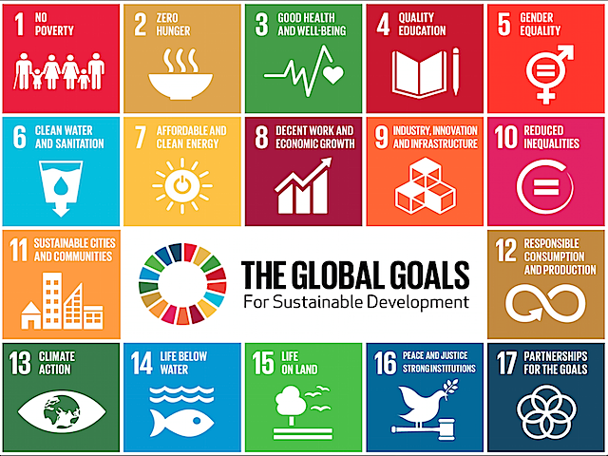

Slide 27
References and Useful Links
https://www.unglobalcompact.org/
http://www.unprme.org/index.php
PRME Implementation Transformational Model
Partnerships between Companies and Higher Education Institutions
Faculty Development for Responsible Management Education
Globally Responsible Leadership Initiative Learning in a Social Context
www.unprme.org/working-groups/champions
www.business.mmu.ac.uk/seeg
http://www.caux.ch/Trust-and-Integrity-in-the-Global-Economy-TIGE
http://www.mmucfe.co.uk/
http://www.mmu.ac.uk/environment/
http://www.unprme.org/reports/6343PRMEReportv3.pdf
http://www.unprme.org/reports/9635PRMEProgressReportFINAL.pdf
https://www.gov.uk/government/publications/draft-european-regional-development-fund-operational-programme-2014-to-2020

