Slide 1
Competency Based Interviews
Nicola Bowman
New College Durham
Nicola.bowman@newdur.ac.uk

Slide 2
Objectives
To Understand:
  The differences between a traditional interview and competency based interview
  How you can prepare for the competency based interview
  The assessment during the competency based interview

Slide 3
Semi-Structured Interview
Static list of questions
Same questions for each candidate
Relate to job role/person specification
Linked to previous experience
Could be linked to hypothetical situations

Slide 4
What are competencies?
Key Competencies:
  Qualities that an employer has decided are essential or desirable for the job
  Personal attributes or behaviours of an individual eg problem solving
  Competencies are used to rate and evaluate candidates
  Linked to performance expectations – individual and organisational performance

Slide 5
Strengths and Weaknesses
Strengths:
  Clear well-defined set of behaviours
  Linked to recruitment and appraisal system
  Transferable skills
  Processes are measurable
Weaknesses:
  Focus on past
  Creates clones

Slide 6
Competency Based Interviews
Standard questions – linked to reliability
Most effective method of selection interview
Compliments assessment centre exercise and psychometric tests
Increases validity of the selection process
Candidate provides evidence for level of competence
Focuses of 4-6 competences

Slide 7
Competencies Activity
Make a list of at least four competencies you think are important in the workplace.

Slide 8

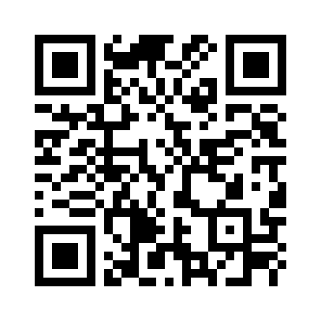
Competencies
Commercial Awareness
Communication
Computer Skills
Creativity
Customer Care
Emotional intelligence
Enterprise and Entrepreneurial skills
Problem Solving
Resilience
Team Work/ Management
Notes:
https://www.surveymonkey.co.uk/r/6QTM6VS
https://www.surveymonkey.com/collect/list?sm=bklssnlyLmhhmx3l7AXASishvlF_2B9dk653kXn02Blm0_3D#

Slide 9
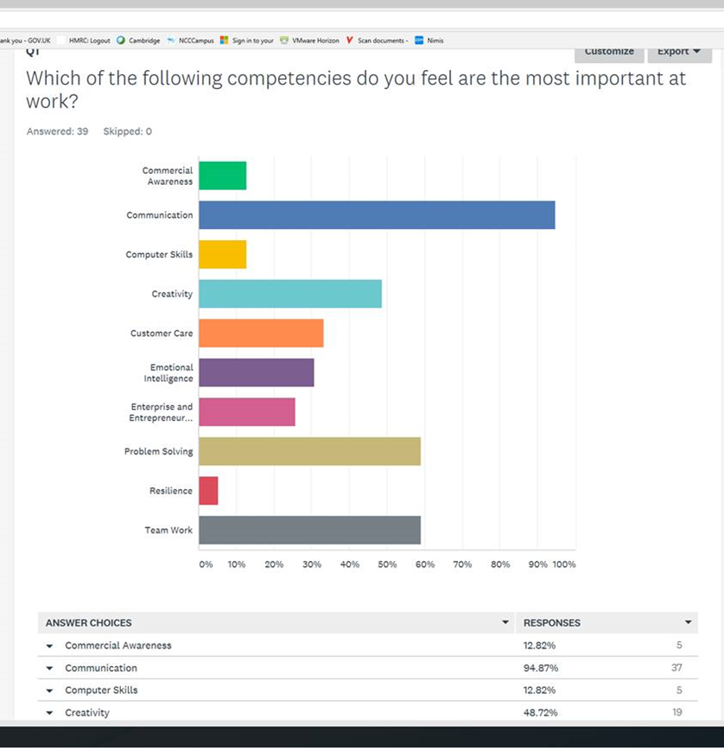
Results of the competencies question

Slide 10
Preparation for the Interview
Researching the role and what it entails
Predict key competencies for the role
Skills/experience deemed essential is often linked with key competencies
Think about evidence required for each competency
Practice and learn the answers
Skill set will be similar for similar roles
Stay calm

Slide 11
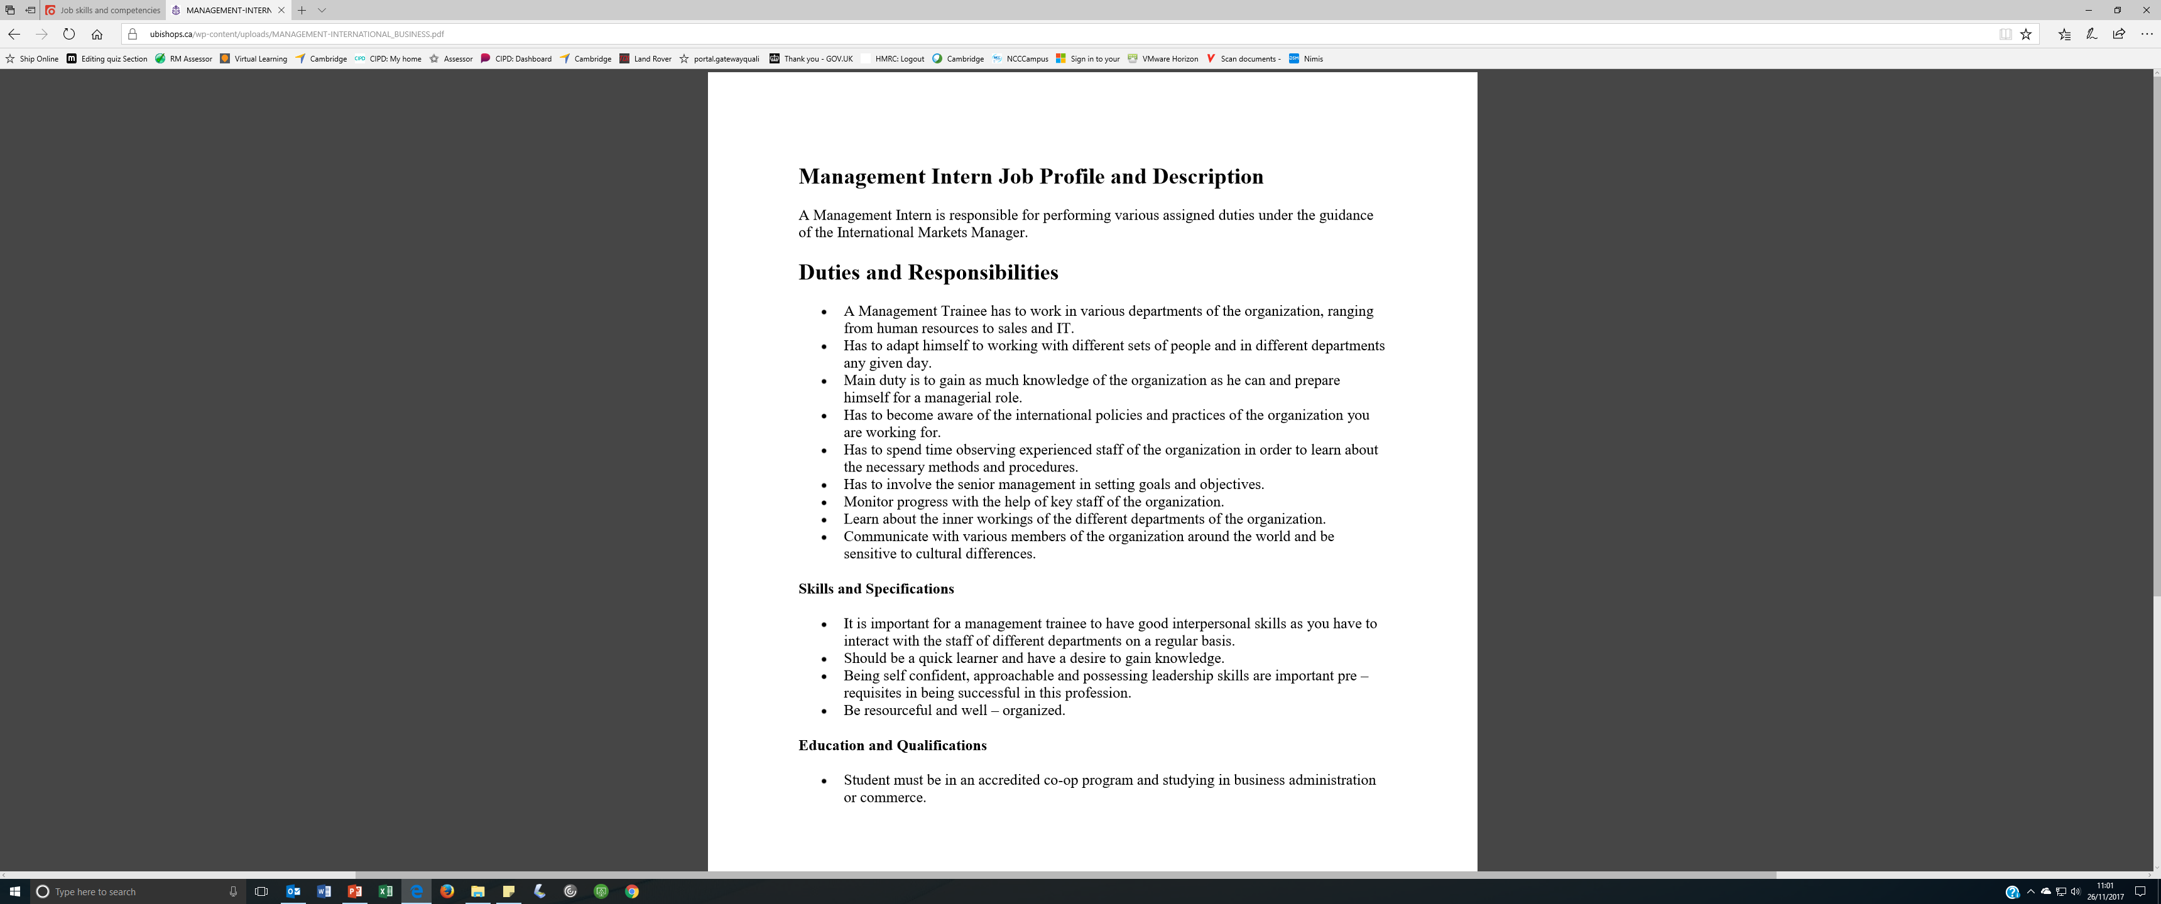
Preparation for the
Interview
Have a look at the job description provided
  Identify at least four different key competencies that you could predict being covered during the interview

Slide 12
Which competencies?
Communication
Team Work
Emotional Intelligence
Adaptable
Team Management
Business Awareness
Customer Service
Creative
Notes:
Have a look at the job description you have been provided with, which competencies do you think would come up during an interview?
What do you think would be the top 3?

Slide 13
Example Competency Based Questions
Describe a time when effective time management skills were the key to success.
Tell me when you had to manage or resolve a conflict between two or more co-workers.
Discuss an experience where you have explained complicated technical terms to colleagues or customers without the same knowledge as yourself? Communication
When have you needed to solve a problem using abstract, lateral thinking?
Describe a project that you have been involved in that required input from people at different levels within an organization. Team working
Describe a situation where you said or did something that had a positive impact on an team worker? Emotional Intelligence.

Slide 14
Probing Questions
Give me an example of where a strict, challenging deadline had to be met
  What needed to be achieved?
  How much time was provided?
  How strict was the deadline?
  What made the deadline challenging?
  How did you meet the deadline/why did you not meet the deadline?
  What was the result?
  What was the quality of the work produced within the deadline?

Slide 15
STAR Method
S – Situation – Setting the Scene
T – Task – what to achieve, goals set and desired outcome
A – Action – what course of action taken and why
R - Result – outcome of actions – highlight success or failure

Slide 16
Applying the STAR Method
Tell me about a time in which you were required to produce something to a high standard, within a fixed period of time.
  Situation – during my management programme I conducted a management project on leadership styles and staff within my team took part in this research.
  Task – in order to carry out this project and achieve a high grade, I was required to conduct high quality research over a 6 month period within the organisation. I was working full-time as a manager during this time and worked towards achieving a 70% distinction grade.
  Action – to help me complete a high quality project, I attended all the workshops that were delivered on this module and also spoken to my supervisor at regular intervals. I sent the questionnaires out as a pilot study to ensure that the project would meet the requirements.
  Result – getting the questionnaires back was challenging and working full time, however I managed to present my project to my lecturer at the given date/time and I achieved a mark of 80% which was great. The project also enabled the team to look at leadership styles and employee engagement which has also improved working practices in the organisation.

Slide 17
Example Questions
Describe a time when effective time management skills were the key to success.
Tell me when you had to manage or resolve a conflict between two or more co-workers.
Describe a situation in which the cause of a problem was not initially clear.
When have you needed to solve a problem using abstract, lateral thinking?

Slide 18
Activity
In pairs, pick one of the questions from the list and apply the STAR model:
  Situation
  Task
  Action
  Result
Draft answers to this question using the STAR method.

Slide 19
Assessment during the interview
Performance Indicators:
  Arrived on time/with time to spare
  Was dressed appropriately for the interview setting
  Showed evidence of knowledge of the role
  Brought CV/letter/application form.
Negative indicators:
  Arrived late
  Did not show evidence of preparation or research
  Candidate was anxious and unconfident
  The candidate was dismissive to the interviewer
  The body language and eye contact was inattentive.

Slide 20
Interview Scoring Booklet
Give me an example of where a you had to meet a tight, challenging deadline.
Probing Questions | Evidence:
What did you need to achieve?
How much time were you provided with?
Why was the deadline challenging?
What did you do to meet the deadline?
If you didn’t meet the deadline, why not?
What was the outcome of the task?
How successful were you in completing the task?
What was the quality of the task?

Slide 21
Summary
Standard questions – linked to reliability
Most effective method of selection interview
Compliments assessment centre exercise and psychometric tests
Increases validity of the selection process
Candidate provides evidence for level of competence
Focuses of 4-6 competences

Slide 22

Questions?

