Slide 1
hacking education
märt aro
tallinn 08.11.2018

Slide 2
government services 99% online
doing taxes 3 minutes
establishing a company 20 minutes
voting for parliament done online
internet is considered a human right
become an e-resident, get a startup visa!

Slide 3
passionate about education
co-founder of 4 companies in education
co-founder of 3 non-profit organisations
Notes:
Mobility Roundtable, DreamFoundation, BNEF;
HAKES, DreamApply, DREAM IMPACT OÜ, DREAM EDUCATION OÜ

Slide 4

Europe's Leading University Applicants Management Platform

Slide 5
achievements
Estonian national admission system for international students
estonia.dreamapply.com
AEC exchange management system
aec.dreamapply.com
Hungarian national scholarship system
apply.stipendiumhungaricum.hu

Slide 6
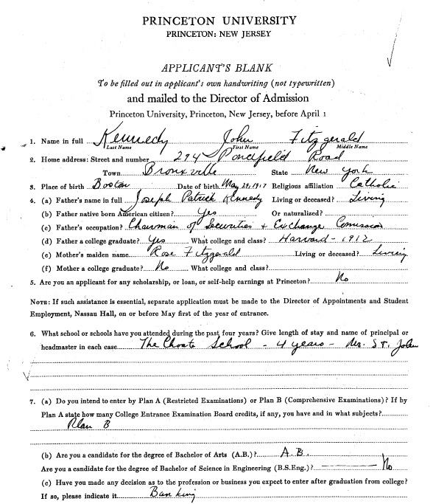
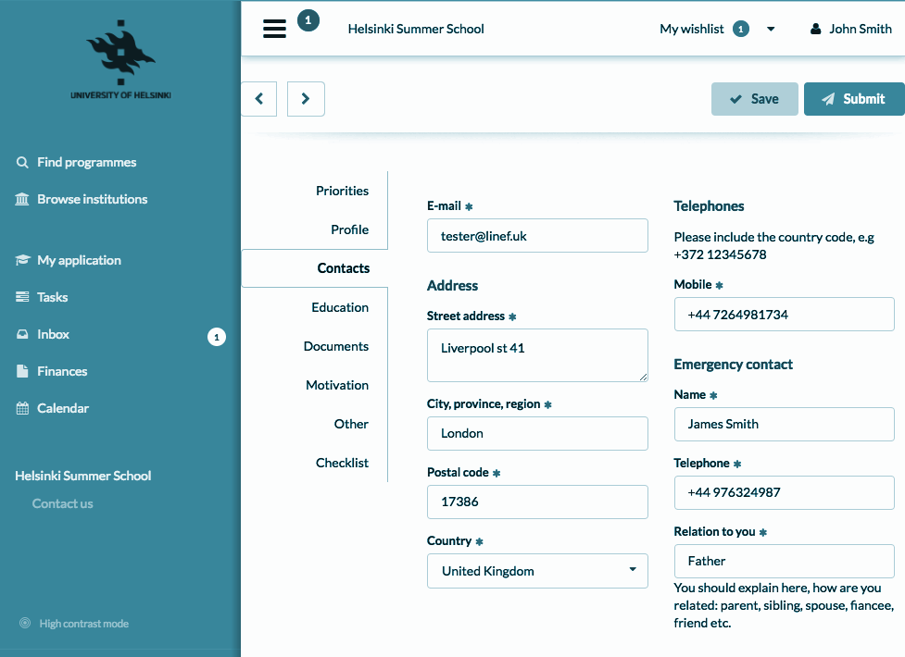
for applicants things have changed in 30 years...
1987
2017

Slide 7

but admission offices work like in 1987, only the process has become more complicated...

Slide 8
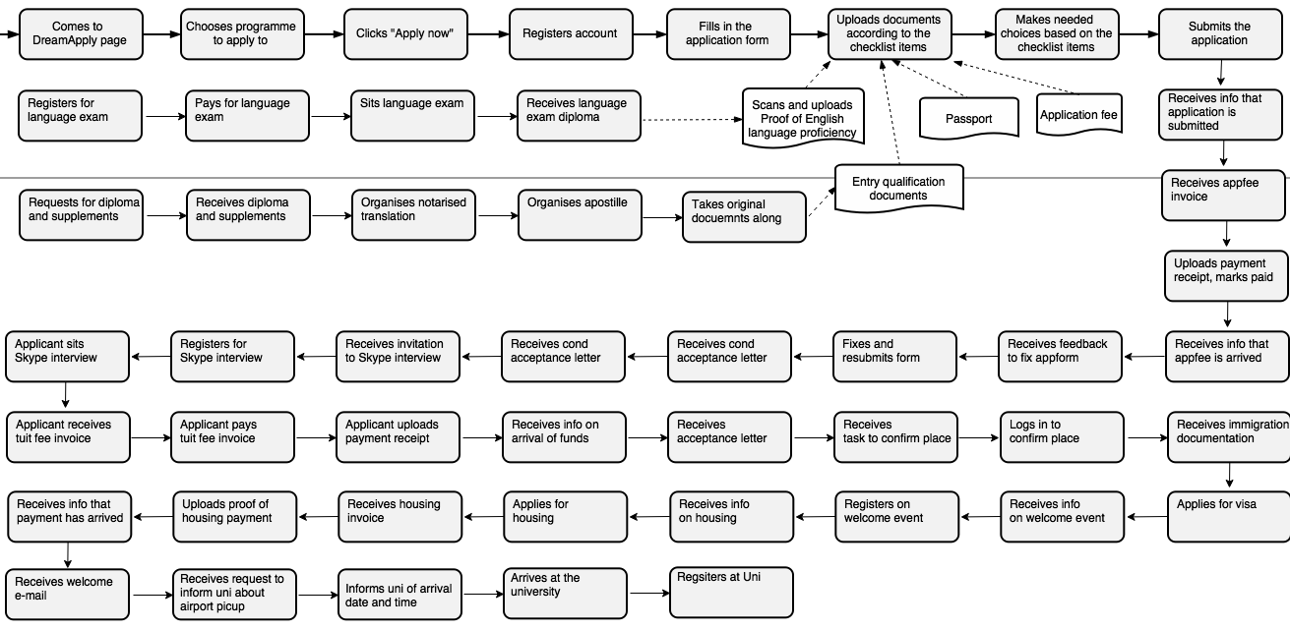
today's reality...

Slide 9




DreamApply manages applicants & automates workflow
Increases applicants number 50-100%
cuts 60% of admin work for universities
ROI in less than 6 months

Slide 10
100B EUR

Slide 11
startup - a small group of enthusiasts who wish to solve a problem in a new, sustainable and scalable way

Slide 12


Slide 13



Slide 14


Slide 15



Slide 16


Slide 17


Slide 18



Slide 19
let’s join forces!

Slide 20
global centre of excellence
for innovation in education

Slide 21


märt aro
mart.aro@dreamapply.com
+372 5341 5761

