Slide 1
Welcome!
Some technical details before the start
This sesssion is being recorded.
Please turn off your audio when you are not speaking.
You will be able to ask questions to the speaker using your microphone or chat box.
Should you want to speak, please raise your hand.
Raise hand
(Participants … Raise Hand)
Wave or Thumbs-up
Open chat

Slide 2
Welcome
Jean-Michel Gregoire
Businet President
Businet Spring Workshop, 11 May 2020

Slide 3
The Covid-19 crisis Lessons learnt for higher education
Nadine Burquel, international higher education expert

Slide 4
The “Covid-19” Digital Education Revolution?

Slide 5
Teachers’ skills?

Slide 6
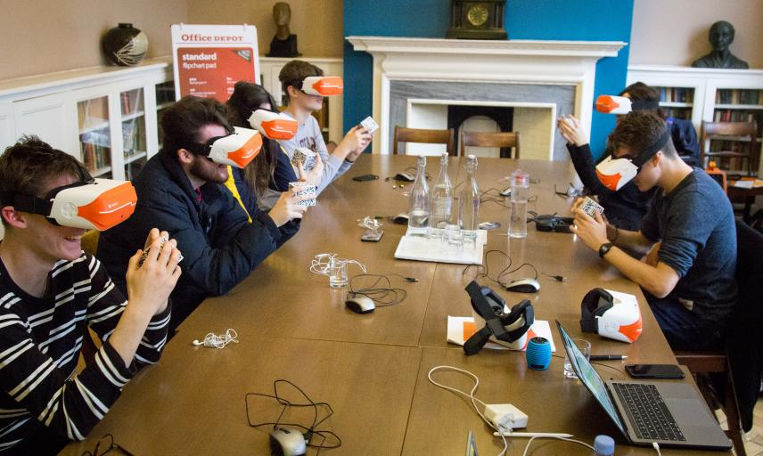
The new normal?

Slide 7
Rethinking HE Systems & Institutions
Calls for changes for many years (national/EU policy-makers and other bodies)
Modernisation, relevance, engagement
Bert van der Zwaan, book (2017) – “HE in 2040, a global approach”

Slide 8
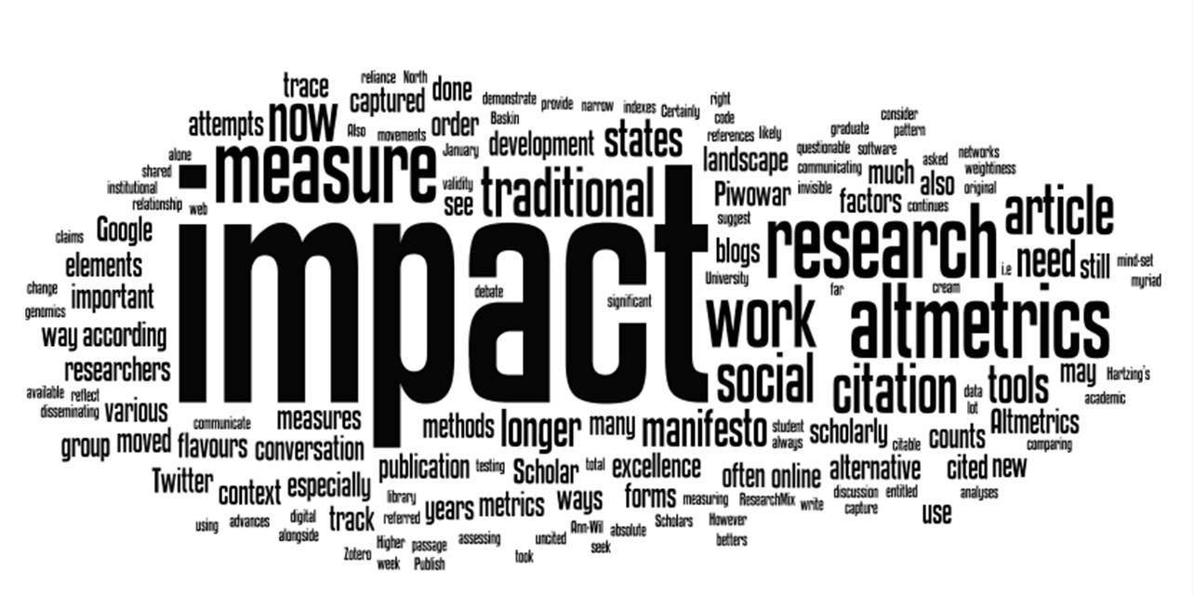
Rethinking the role of HEIs in society
A new legitimacy for institutions of higher education?
A source of knowledge and expertise for society

Slide 9
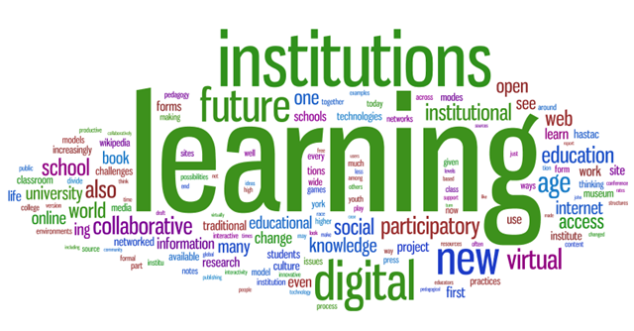
Rethinking (Higher) Education
Online, blended, flexible and experiential learning
On and off campus
Continuum with a lifelong learning focus

Slide 10
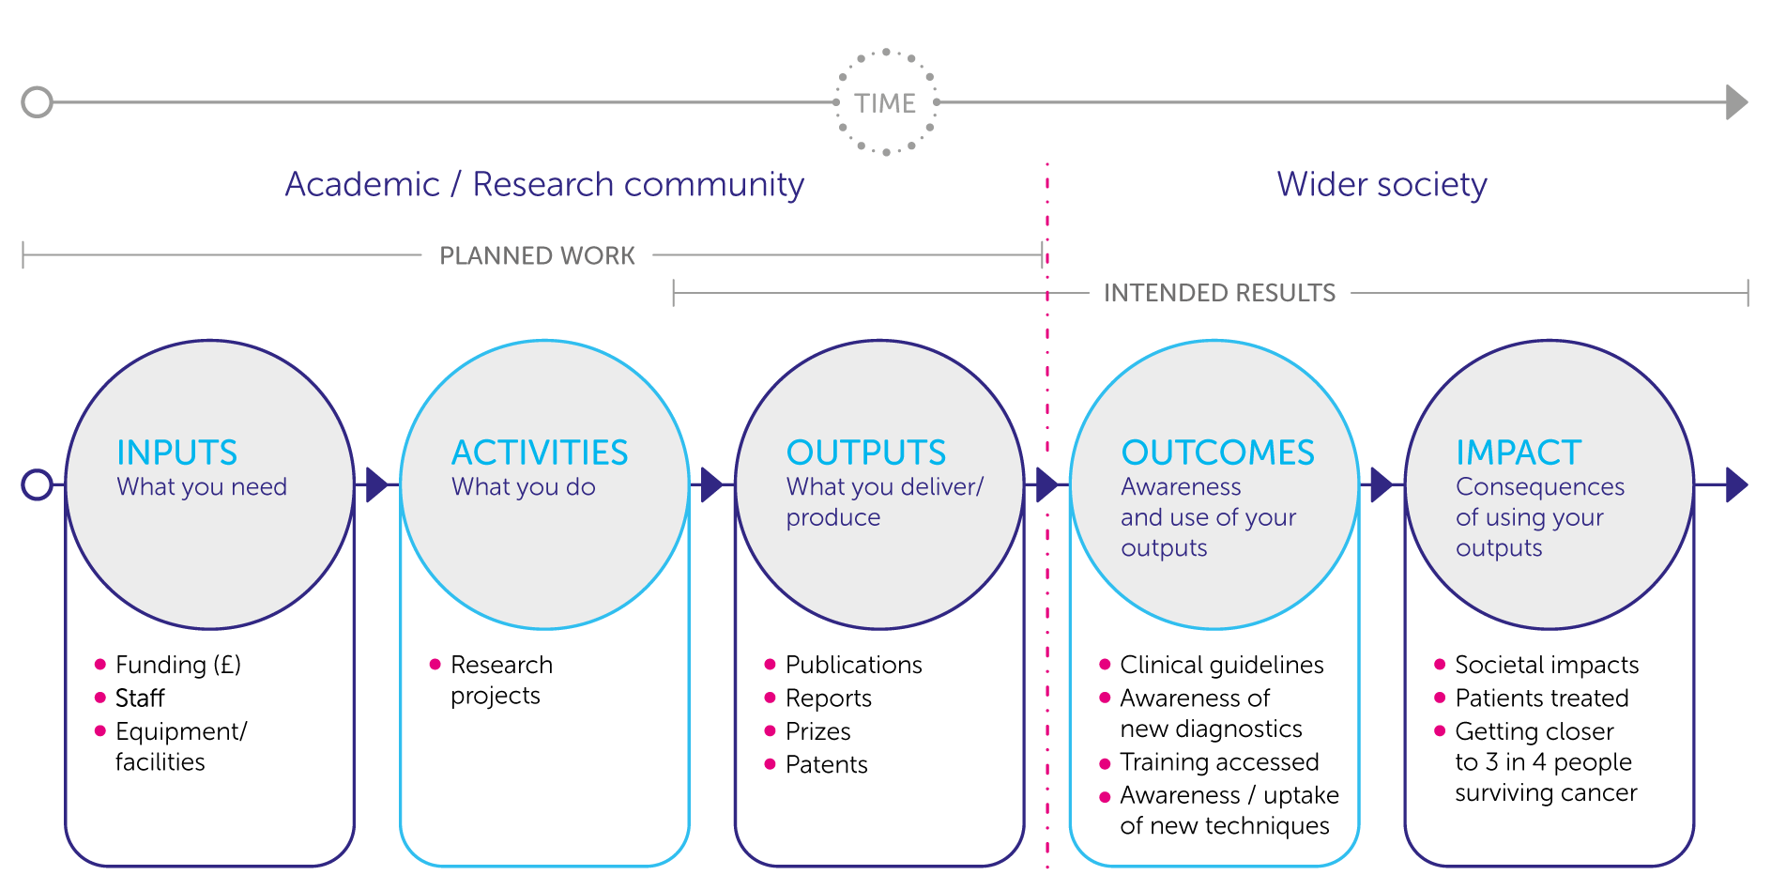
Rethinking Applied Research – Societal Relevance

Slide 11
Rethinking Internationalisation
Student international mobility (credit vs. degree mobile students)
Transnational education (double/joint degrees)
Internationalisation at home

Slide 12
Changes in student mobility patterns?
Pre-Covid - The facts and the predictions | Post-Covid - The unknown
Past growth - Internationally (degree) mobile students From 2M worldwide (2010) To 4.5 M (2013) 5.3 M (2017) 2019/20 – Figures not yet available | Short term (autumn 2020) – “Complicated” Early 2021 – Improvement; growing into 2021 Challenges: Travel restrictions New (health) immigration/visa policies
Destination (2017): 50% - 6 countries (US, UK, AUS, FR, DE, RU) | Mobility shifts Neighbouring countries in continental Europe Overseas mobility more affected
Predictions: UNESCO: 12 to 15 M students by 2030 USA and UK in decline GMAC (2018): 63% European business schools report increasing international applications | Different Views – QS Ranking, EAIE, ESN

Slide 13
Rethinking governance, management and operations
Building institutional resilience
Strategic profiling – “The value proposition”
Governance and proactive management (risk management)
The infrastructure
The business/financial model
HR/Talent management

Slide 14
Let’s talk!
Thank you!
Nadine Burquel (nburquel@bcs-consult.net)
https://bcs-consult.net/

