Slide 1

BUSINET
Introducing the network

Slide 2



Presentation overview
1. What is Businet?
2. The opportunities on offer
Networking
Activities
Project Partners
Curriculum Development
International Collaboration
3. Your commitment
4. Additional information

Slide 3
1. What is Businet?
A global business education network
Established in 1987
Operating in 35 countries, with 145 member institutions
Establishment to meet the needs of Institutes,
their staff, their students, providing for…
Curriculum and project development
Support for the international aims and objectives of the
member institutions
Promotion of international activities + mobility

Slide 4
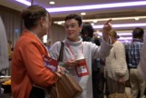
Networking and
supporting the network
Businet provides:
“This is a network based on
A platform for successful networking
Through conferences and events
Through a fortnightly news update
Through the use of a collaborative platform
mutual trust and confidence
the members have in each
other” – Anja Nagel, Euro Akademie
Hannover
Businet supports member events
By promoting the international activities, including practical assistance (flags, banners, promotional material)
Financial support where possible

Slide 5


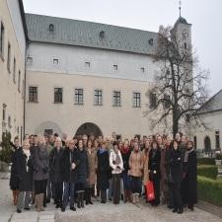
2. The opportunities on
offer include
Projects and programmes
Joint curriculum development projects
Erasmus
Intensive programmes – over 45 student events a year across a range of curriculum areas
“The annual conference is
the highlight of my academic
year. I always come away
from it buzzing with ideas”
– Jane Croad, University of Wales in
Cardiff
Conferences and working groups
Curriculum specific working groups
Student conferences
The Annual Conference
Exchange programmes
International work placements
Student exchanges
Staff exchanges

Slide 6

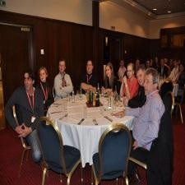

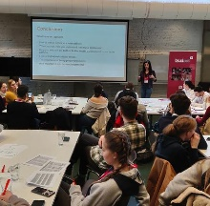
The opportunities on
include
offer
Conferences and Events
Annual Conference Istanbul 2024
Spring Workshops
May 2024
Student Conference – Thinking Employment Antwerp
March 2024
Intensive programmes – 45 + student events a year across a range of curriculum areas
“The Student Conference helped me focus on my career goals and increased my self awareness."
– Imre Feteke Szolnok University College

Slide 7
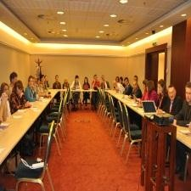


Working Groups
Special Interest Groups
Entrepreneurship
International Relation Managers
Research
Interdisciplinary Group
Internationalisation at Home
Private Institute Forum
Curriculum Groups
Health and Social Matters
Communications
Information Technology
Business Law
Marketing and International Trade
Tourism
InterCom - Intercultural Competencies
“The curriculum groups differentiates Businet from other networks that I am involved with.”
– Carina Saelen UCLL

Slide 8
3. What we ask in return
“This organisation is a
great way of adding
value to your
international work”
– Leen Van Tolhuysen, Thomas
More University College Mechelen
Your commitment
engagement
and
full
An annual membership
fee
of
…
Full Member EU (15), EEA 970 EUR Full Member Wider EU 550 EUR
Full Member Rest of World 250 EUR
Associate Member 350 EUR
Early Bird EU (15), EEA 790 EUR Early Bird Wider EU 440 EUR
NB Early Bird fee is offered if fees are paid before set deadline.
A special introductory membership fee is available to new members from
countries where Businet is either not represented, or is under represented.

Slide 9
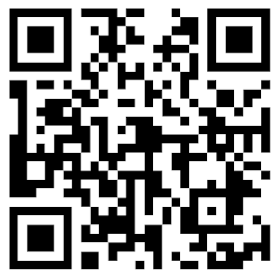


“Our students and staff have
gained so much from the
events organised by Businet”
- Ingeborg Kuehlug Garfield, EWS
Vienna
4. Where to
find
additional information
www.businet.org.uk
businet@gmx.com

