Slide 1


Building a More Inclusive University: The Importance of Gender Equality in the Light of Accreditation Standards
EQUATION
EQUality through AccreditaTION —
  Deniss Ščeulovs, Riga Technical University
  Pawel Urgacz, WSB University
  Businet Annual Conference 2023

Slide 2






Slide 3
Overview of the project
Key objectives of EQUATION
removing systemic and cultural barriers to the recruitment, retention and career progression of women in higher education
integrating the gender dimension in the development and quality assurance processes of HEIs

Slide 4
Report on Gender Equality in Business Schools and Accreditation Institutions
Research stream A:
GE in Consortium Schools
Research stream B:
GE in Accreditation Institutions
Research Strategy
Survey
Interviews
Institutional Report Chapters
Introduction to Report
Cross-Country Analysis
Research Strategy
Survey
Interviews
Chapter on Accreditation Institutions

Slide 5
GEP Implementation Plans and Guidelines
GEP Implementation Guidelines
LTT program on GE in Business Schools
GEP Implementation Plans
Dissemination event for HEI

Slide 6
Gender Mainstreaming Accreditation
LTT program for Accreditation Evaluators
Guidelines for Accreditation Institutions
Dissemination Event for Accreditation Institutions

Slide 7


Slide 8
Report on Gender Equality in Business Schools and Accreditation Institutions - CONCLUSIONS

Slide 9
Among the participants in the survey, 87.4% of students fell within the age range of 18-35, 77.5% of staff members were aged between 26 and 55, and 75.8% of leaders were in the 36-65 age bracket.
Regarding official documents related to gender equality at their Higher Education Institutions (HEI), 72.4% of leaders responded affirmatively (to knowing them), whereas 82.1% of students and 53.2% of academic staff indicated they were unaware (of the documents).
In response to the question about HEI organising initiatives to support gender equality, 69% of leaders answered positively, compared to 29.7% of students and 41.9% of academic staff.
Top three topics for future gender equality events as their HEI‘s among students, academic staff, and leaders were Work-life balance, Career progression, and Equal pay.
Regarding personal experiences of gender-based differential treatment, 24.2% of students, 19.4% of academic staff, and 17.2% of leaders reported having such experiences.
In response to the question about specific situations they had personally experienced, 52.3% of students mentioned being judged about their ability and character. In comparison, 42% reported experiencing problems related to sexual harassment, such as inappropriate comments, jokes, or offensive language. Among academic staff, 75% said judgment regarding their ability and character, and 41.7% mentioned decisions related to their appearance and behaviour.
Regarding witnessing gender-based differential treatment, 6.9% of leaders, 17.3% of students, and 22.6% of academic staff reported having observed such situations.
Leaders‘ actions that support gender equality are: avoiding gender differentiation in hiring and salary decisions, supporting family/private needs, conducting workshops on equal treatment, and maintaining a culture of respect.
Students and academic staff suggested various actions for institutional leadership to improve gender equality: promoting women in leadership roles, implementing equality standards in accreditation systems, providing parental support and promoting work-life balance, informing employees about their rights, and organising anti-discrimination training.
When university staff were asked if their career has been influenced by gender, only 8.68% of respondents agreed. When they were asked whether gender factors into achieving a favourable work-life balance at their institution, merely 11.78% of respondents concurred.
      The survey data reveals varying levels of awareness and experiences related to gender equality across different groups, with leaders generally showing higher awareness and involvement in initiatives. The responses suggest a strong desire to promote work-life balance, equal career opportunities, and awareness-raising efforts to improve gender equality within the academic community.

Slide 10
Students’ data per participant

Slide 11
Employees’ data per participant

Slide 12
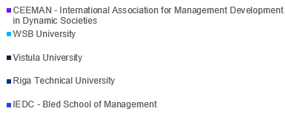
Leadership data per participant

Slide 13
CHALLENGES

Slide 14
Some challenges to existing measures on Gender equality in HEI‘s are:
A university has policies against reprehensible practices, including discrimination and harassment, and is committed to being an inclusive academic community. Challenges include preventing cheating and embedding awareness of gender-related issues into the organisational culture.
A university fosters a balanced participation of women and men, focusing on competency-based hiring and adherence to recruitment guidelines that prevent gender discrimination. Challenges include implicit bias, retention and advancement of underrepresented groups, and resistance to change.
A university employs cultural diversity initiatives and gender diversity analysis and conducts annual anonymous surveys to monitor and evaluate its gender equality and diversity strategies. The university aims to maintain gender equality and balance in its academic environment. Challenges include selecting appropriate data collection methods and overcoming resistance to disclosure.
The multicultural environment (in an HEI) presents unique challenges, such as addressing the needs of students with diverse backgrounds and traumas.
A university conducts annual anonymous surveys to respect non-discrimination principles. The challenge is the need for a comprehensive document covering all aspects of the procedure.
An institution is considering the European Commission's criteria and is committed to ensuring the implementation of these elements, including HR Excellence in Research. The challenge is the ethnic diversity of students, with the recommendation to compile all necessary components into a single public document.
An institution stresses that some of the challenges are deep-seated cultural issues within the institution's governance and management, unclear leadership on gender initiatives, and the absence of structured data to monitor progress.
For one HEI, the challenge lies in navigating cultural diversity and integrating gender equality topics effectively into accreditation processes.
An institution faces logistical challenges in mandating training and achieving gender balance due to cultural and age-related dynamics.

Slide 15
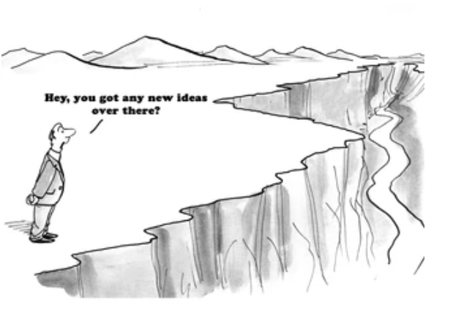

Slide 16
Thank you!
EQUATION
EQUality through AccreditaTION —
  Businet Annual Conference 2023

