Slide 1
HEALTH & SOCIAL MATTERS working GROUP
Griet t’Servranckx (UCLL)
Laurence Leonard (Henallux)
Mariana Pereira (IPS)
Sabien Van Rampelberg (Odisee)

Slide 2
programme
Busiskills in a nutshell
Objectives & Methodology
Final products
Evaluation strategy
Challenges & Opportunities
Questions –
Sharing experiences
Deze foto van Onbekende auteur is gelicentieerd onder CC BY

Slide 3
Interdisciplinary Coil Wellbeing@work

Slide 4
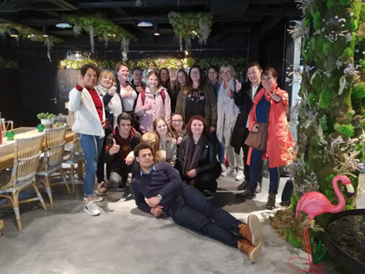
Evolution
2018-2019
Exchange week
Sainte-Adresse
2019- 2020
Virtual spring edition
2020-2021
Virtual fall&spring edition
online
Virtual fall & Virtual spring

Slide 5
Growth process

Slide 6
Our partners
Avans University of Applied Sciences
Centro Universitario Integrado
EGE University
Hénallux
IGS-RH
International Hellenic University
IPS – Polytechnic Institute of Setúbal
Lycée Jeanne d’Arc
Odisee
Tinaztepe University
UCLL

Slide 7
From exchange week to 8 weeks coil
Based on
ICOMS model
CO-Creation model
Deze foto van Onbekende auteur is gelicentieerd onder CC BY-SA-NC

Slide 8
Wellbeing@work
Happy@work
Selfcare@work
Resilience@work
Work-life balance
….
Intergenerational challenges@work
Covid19 and Mental Health@work
Conflict management@work
COVID-19 Impact on jobs/functions@work

Slide 9
From multidisciplinary to Interdisciplinary
International multidisciplinary student groups in Health, Social Work and HR
Starting from research in own professional context
Sharing and comparing information – countries + professions
Common search and development for best practices
Deze foto van Onbekende auteur is gelicentieerd onder CC BY

Slide 10
Learning objectives/outcomes ICOMS
International Disciplinary Learning – Professional Skills
- Soft Skills
Intercultural competences
Language competences
Global engagement
Personal growth
Deze foto van Onbekende auteur is gelicentieerd onder CC BY

Slide 11
Methodology Way of working
Common kickoff and final presentations
Lectures + work group meetings
Group work per topic
Follow up by facilitator/coach per topic
Detailed road map
Specific rotation system (roles)
Project sheets
Vocabulary sheets (translator role)
working towards final presentations/ outcomes
Deze foto van Onbekende auteur is gelicentieerd onder CC BY-NC-ND

Slide 12
Final Products
Presentations of countries/institutions
Final presentation best practices
Project sheets
Vocabulary list
Abstract
PR instrument (testimonial, quote, Businet website)
Final Report*
*home institution
Photo by LED Supermarket from Pexels

Slide 13
assessment
Educative assessment (Wiggins)
Realistic tasks
Innovative approach
Critical thinking
Transfer of knowledge
Continuous feedback
PROCESS & PRESENTATION
common evaluation grids
Image: Daily Jobseeker in How you can ace a skill assessment test by these 15 preparation practices (myamcat.com)

Slide 14
Project Evaluation
Detailed online evaluation
Intervision groups
Swot analysis
Improvement, changes to the next edition

Slide 15
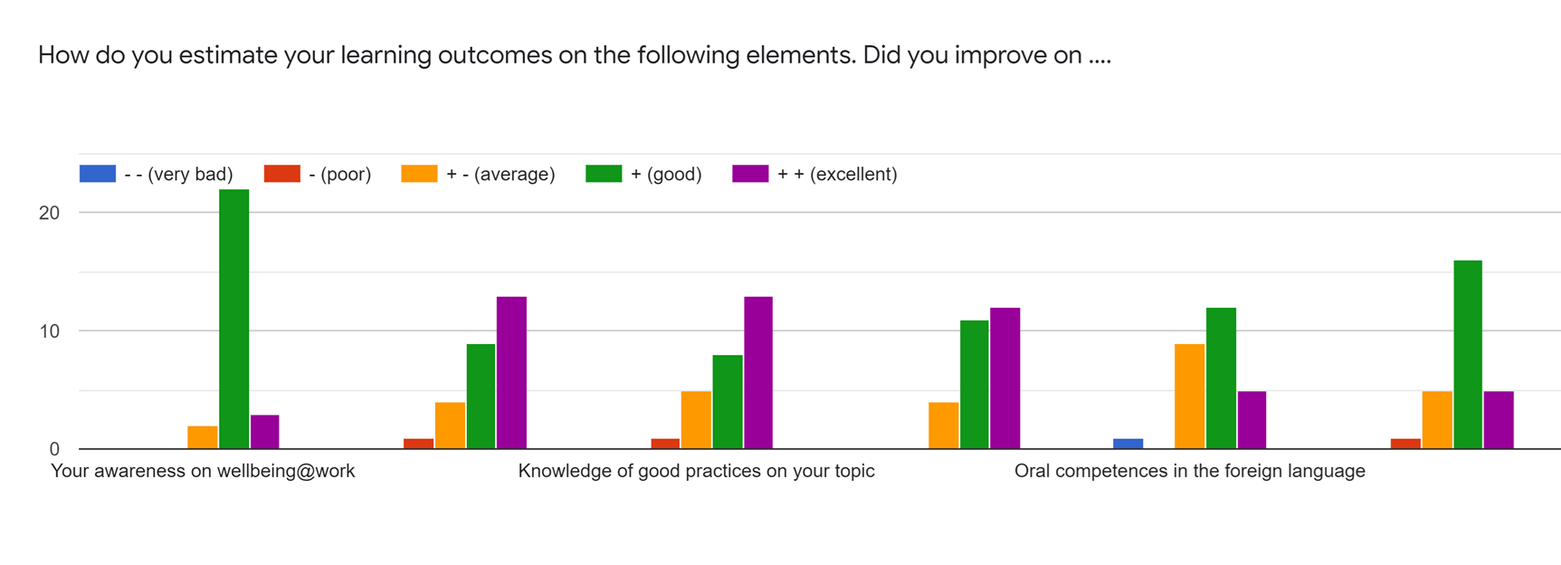
Project Evaluation
Online evaluation
Intervision groups
Swot analysis
Improvement, changes to the next edition

Slide 16
Challenges and opportunities
Keep 2 editions
Face-to-face
Virtual
Partners & growth
Growing numbers
Evolving COIL
Time management
Strengthen relationships
Preserve quality
Follow up new partners
Research
https://lh5.googleusercontent.com/j77_vS5i55PJL4dEn0S--gUa8-_RbB195NCRPZ0wQSNtVfpGLxnTbZQIt0US-YHi1pl2oO4_G_7mJS96w8un8Jmt1G_PYfUSMqQF1C2hDmq2_GDtKDvdGInxef-_8dqxpJrVJKAf

Slide 17
Fast growth Geographical spread
4 countries to 10 next edition?
Very nice geographical spread, extreme richness of study programmes and countries
Integration of new partners into the family
Mixture of levels (bachelor-master/EFQ 6/7)
Quality management

Slide 18
COIL
internationalization@home, integration into the curricula
Preparing students to the real-life work context
Focus on talent management and sustainable global goals
New Erasmus or other funding programmes - time, promotor, …
Practical issues : time schedules, time issues

Slide 19
organisation
Virtual – hybrid – face to face
Great commitment of the organizing team – quality driven
Availability of students and facilitators
IT proficiency
Proud of what has been achieved!
Co-Creation based on real time needs

Slide 20
any questions?

