Slide 1
Managing an international project: do you have what it takes?
Casestudy:
European Education Programme

Slide 2
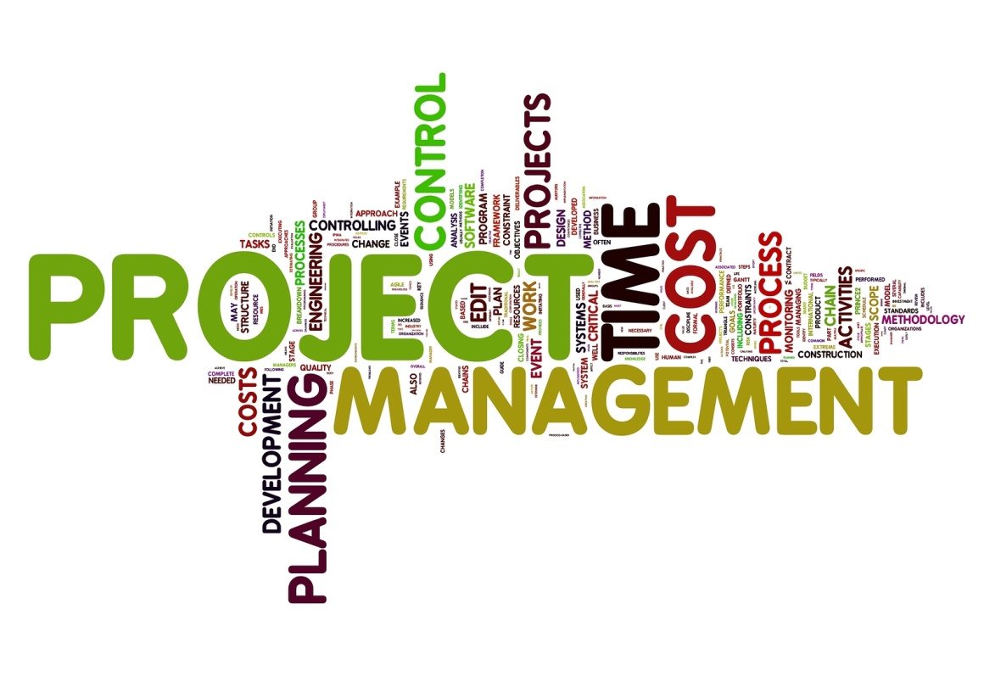
Intro
What is Project Management_.mp4

Slide 3
What is a project?
A temporary endeavour to create a product or a service,
With a definite beginning and a definite ending
Aligned with organisational objectives
Involves investment in staff and expenses
Might also involve external funding
Case study: multilateral projects in higher education

Slide 4
Possible benefits of optimized project management
Enhanced work environment
Eliminate mistakes
Reduce risks
Reduce stress levels
Improved team work
Better time management
Better use of existing resources
Better estimating
Better focus on goals
More research
More external funding and therefor more projects

Slide 5
Challenges in project management
Not delivering on time
Over budget
Not delivering the required results
Time investment when using external resources
Unexpected events that influence the project
Too rigid approach (time, goals, schedules, etc.)
Conflicts between team members

Slide 6
Working in a team – what’s your experience?
Ever worked in a team?
Positive elements?
Negative elements?
How did you maintain the positive elements?
How did you solve the negative issues?
Take The Bus l De Lijn l HD funny videos.mp4

Slide 7
Working in an international team
Transfer this to an international team
Which additional positive elements?
Which additional potential issues?

Slide 8
International project team
Different behaviour does not mean different culture
Culture evolves and is not a static concept
There is no such thing as cultural ‘principles’ – there are situations, individuals, …

Slide 9
Project management and leadership
Does the team take the important decisions?
Is the company strategy a team effort?
Does a decision have to be accepted by the whole team?
Does everybody involved get a say before a decision is made?
Does the management use listening skills?
Are meetings an efficient tool?
Do meetings have a problemsolving goal?

Slide 10
Leadership
YES | NO
Japan | Ukraine
Sweden | Slovakija
Denmark | Turkey
Norway | China
The Netherlands | Russia
Ireland | Cyprus
Estonia | France
Finland | Latvia
UK | Lithuania
USA

Slide 11
Project manager
Leadership
= the factual dimension
Planning
Organisation
Monitoring
Contractual management
Financial management
Reporting
= the interpersonal dimension
Vision – clear goals
Values and inspiration
Leads by example
Team building
Motivation, encouragement, recognition
Support and feedback
Clear communication
Conflict resolution
Understanding of interaction and development processes
Integrity

Slide 12
Leadership in an international project
Cooperative and democratic
Authorative and directive
Leadership can make or break the project.
If a good leader has done his job well,
people will think they have all done it by themselves
(K. Blanchard)

Slide 13
Leadership competences
Inspiring and motivating
Communicating effectively
Practicing intercultural sensitivity
Building performing teams
Solving emerging conflicts in a constructive way

Slide 14
Organisational background of the team
Personal relations
Flexible time
Tangible time
(agenda)
People
Network –
who you know
Activity
Organic
Who are
You?
Meritocracy
(own merits)
What do
you do?
Relations are rational
Systematic

Slide 15
Organisation
Organic | Systematic
Lithuania | Denmark
Bulgaria | Switserland
Russia | Finland
Turkey | Sweden
Greece | Germany
Spain | Austria
UK | Norway
 | The Netherlands
 | USA

Slide 16
Organisation & training
Organic | Systematic
Focus on personal staff management | Focus on visible management
Leadership | Budgetting
Team building | Planning
Verbal training: listening skills, feedback, … | Performance and assessment interviews
Presentations | Company rules
Motivation strategies | Quality systems
Meeting skills

Slide 17
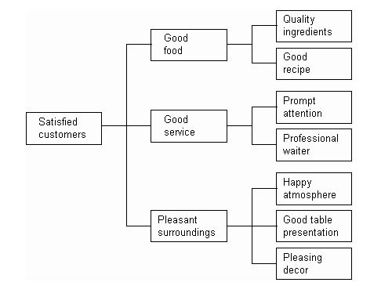
Planning aspects - practical
Tree diagram of all ‘work packages’, content and coordination

Slide 18
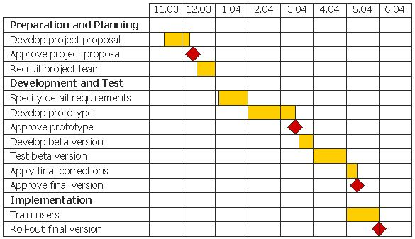
Planning aspects - practical
Gantt chart: project schedule combined with the start and end of each work package – especially important for work packages approach
Project milestones

Slide 19
Organisation & time
Flexible | Tangible
Portugal, Turkey, Greece, Spain, Italy, France | Sweden, Norway, Denmark, Finland, Switzerland, Germany, Japan
Flexible meeting time | ‘Appointment’
Estonia, Ireland, UK | Austria, Lithuania, Belgium, USA, Latvia, the Netherlands

Slide 20
Case study: project application
Know the rules and regulations
Know the buzz words
Relevance of the projects
Quality of the work programme
Internal and external communication
Management system and procedures
Innovative character
Quality of the consortium
European added value (European funding)
Cost-benefit ratio
Impact
Valorisation
= be prepared (content and admin)

Slide 21
Getting the project started
Analysis of
Contracts
Finances
Restrictions
Admin
Deadlines
Etc.
Setting up what was promised in the application
good (realistic) application = easier setup

Slide 22
Effective collaboration
Fantastic motivational teamwork montage video.mp4
Team > bringing a group of people together
Focusing on people involved
People will make the project happen

Slide 23
Diverse group project team
People in the project with
Different management styles
Different organisations
Different situations
Different project cultures
Different definitions
Different nationalities
Different languages
Different cultures
Different needs and expectations
Different personalities
Different jobs even with the same job titles

Slide 24
Kolb’s behavioural styles
The ideal team consists of
Innovator
focuses on new ideas and developing new ways of doing things
Pragmatist
focuses on practice and utilises previous experiences
Theorist
focuses on models and sees the big picture
Reflector
focuses on understanding and considers what’s going on
Find out what’s your style in one of the many free online tests

Slide 25
Alternative: Belbin
Find out what’s your style in one of the many free online tests

Slide 26
Diverse group project team
…. Need to be enabled to
Shared ownership
Common aims
Agreement and rules
Collaboration
Reflection
Learning process
… To come to an effective intercultural project team

Slide 27
Characteristics of effective teams
Clear common and shared goals
Share responsibility
Have allocated appropriate responsibilities, roles and tasks to each member
Produce a collective output
Measure their progress towards the goals
Are fairly small
Necessary blend of skills
Get support from their superiors
Can work together
Cultivate trust and dialogue
Handle conflicts constructively and openly
Get to know the team members
Appreciate cultural diversity
Reflect on performance

Slide 28
Phases of successful team development
Forming
Storming
Norming
Performing
Mourning

Slide 29
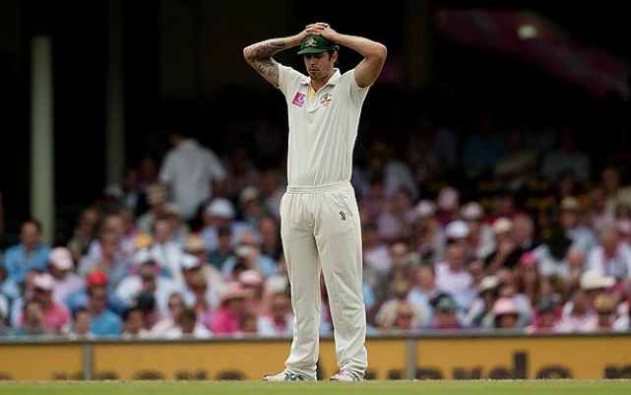
Undesirable phases of team development
Diplomacy
Endless talks
Cheap consensus
Rushing towards delivery

Slide 30
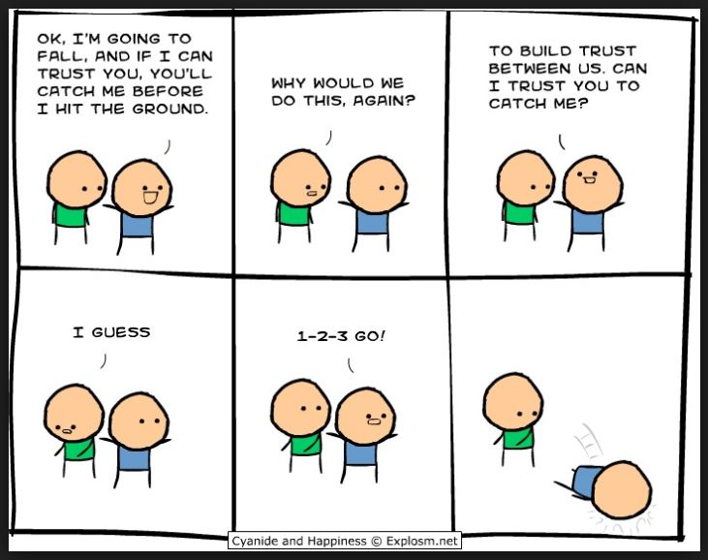
Very important keyword

Slide 31
Ground rules for each team member
Respect your team members
Be on time, and let the others know if you’re late
Send the agenda one week before the meeting
Handle conflicts in a constructive manner
Ask when you don’t understand
Be helpful and supportive to your team
Ask for help, don’t struggle alone
Follow the deadlines
Don’t be too strict, listen and try to understand
Give everyone a chance to try out different roles and responsibilities in meetings

Slide 32
Good project meetings
Agenda
Roles during the meeting: chair, expert, minutes, visualizer, evaluator, host, language inspector, etc.
Visualisation
minutes

Slide 33
Your role in an international team
Who are you?
What are your competences?
And your skills?
Your weaknesses? How do you try to overcome them? Any examples?
What could be your role in a team? Try out online tests to find out!
Consider this before you join a project and not on the spot!

Slide 36
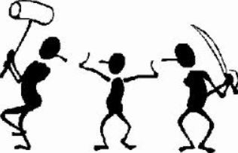

Slide 37
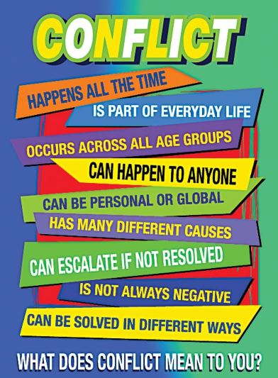

Slide 38
Conflicts
Conflict situations in international teams:
General misunderstanding (partner does not dare to show disagreement or ask further questions and stays polite and silent)
Linguistic misunderstanding
Cultural misunderstanding
Non-compliance with deadlines
Non-compliance with financial and admin issues
Poor performance level
Non-performance, violation of contracual obligation

Slide 39
Case study: conflict
One (Italian) team member repeatedly ignores the deadlines and hasn’t deliverd any acceptable materials yet, apart from a few roughly sketched and very general pages. The other team members are furious…
The whole team is supposed to work on jointly developed modular training materials for a course on management by objectives. The material will be launched very soon and tested with a pilot group.
What could be the possible explanations?

Slide 40
Case study: conflict explanations
Possible explanations
Francesco has family issues and can’t perform well – is this the case or not?
Being Italian he has a different approach towards deadlines (‘suggestions’) – is this so or is it a stereotype?
his organisation or department is struggling with not enough staff and too much assignments
he’s an experienced member of staff who doesn’t need all theoretical preparation: he knows what MBO is and relies on his experience – what about the quality of the outcome?
He thought he only had to work on the general approach of the course, rather than tangible handouts – misunderstanding
During the partner meeting the a colleague was quite explicit in criticising Francesco, which didn’t do the meeting much good - atmosphere

Slide 41
Conflict handling
It is not relevant what someone says,
But how it is meant,
And how it will be understood.
Said is not heard!
Heard is not understood!
Understood is not accepted!
Accepted is not done!
Done is not natural!

Slide 42
Conflict handling
Define the level of communication
Rational level: contents, themes, topics – your tools are words, numbers and graphics
Emotional level: relationships beteween the people who are communicating – your tools for indirect communication are body language like facial expressions, gestures, posture, movements and intonation
Structural level: the framework around the communication (situation, time available, social situation, location, personal feelings, work pressure, norms, standards, values, etc. – usable tools can be room, seating arrangements, competence, rescheduling, even clothes…

Slide 43
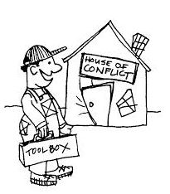

Slide 44
Conflict handling
Managing conflicts
Try to tackle conflicts on a rational level
Continue to express appreciation of the person involved in a conflict (emotional level)
Try to reach a common understanding of the problem
Try to create a win-win situation at the emotional level
Try to adopt a postive view of the nature of the conflict
Don’t put energy in avoiding conflicts:
you can’t avoid them,
they are sometimes necessary to reach the overall project targets
They show differences and can help to create a new level of common understanding
They are often complex but also help to establish common interests
The can make change possible but also help to preserve what already exists

Slide 45
Conflict handling
Hot and cold conflicts
Hot = yelling, negative emotions, etc. = highly visible
Cold = silence, icy atmosphere, etc. = not visible, difficult to discover
How to deal with it?
‘put it on the table’
= risky
= needs bravery
= adequate communication skills
But necessary…

Slide 47
Conflict escalation
Not often the case - most issues are solved by using the following strategies:
Forcing (authority – reallocate to other partner – risk of demotivation and further conflicts)
Accommodating (delivery by e.g. coordinator to avoid time lapse – risk of repeated behaviour by partner in not respecting deadlines)
Avoiding (ignoring non-deliverance – risk of multiplying the non-deliverance and the total project outcomes)
Compromising (reducing the volume of partner contribution – risk of lose-lose situation because of lower quality, and partner still doesn’t perform adequatly)
Collaborating (exploring the reason for non-delivery and convince partner of cooperation – risk of losing too much time and not finding a satisfactory solution)

Slide 48
