Slide 1
Leaving or staying?
Why not stay ( or come back)
Isabelle van tomme

Slide 2
Leaving or staying?
Why not stay ( or come back)
Isabelle van tomme

Slide 4
Starting point: research project
On a national level
Brain drain (brains=natural resources)
War for talent
Communication (image/identity)

Slide 5
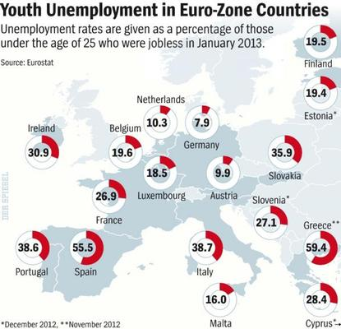
Paradox
Youth unemployment
Source:http://epp.eurostat.ec.europa.eu

Slide 6
2. Unfilled job vacancies/skills shortage
Causes are a.o.
Skills mismatch
Migration to bigger cities

Slide 7
Consequences
Economic
Innovation
Housing
Working
Spending
Studying
Socio-cultural
Environmental

Slide 8
Why leave?
Love of your life
Culture
Job opportunities
Higher salary
…………..

Slide 9
What is there to get?
Love of your life?
Culture ?
Job opportunities?
Higher salary?
…………..
Stress
Pollution
Noise

Slide 10
Vicious circle of
Migration of professional skilled class from smaller regions to the big cities
Companies can’t find candidates for jobs
Relocate to bigger cities
Less regional jobs
Migration
……

Slide 11
On an international level
E.q. Britain
3,6 million highly educated people left Britain during the last decade and it’s not just……

Slide 13
Only 125.000 are over 60
Nearly 2.000.000 between 25-44
Nearly 900.000 between 15-24
Why?
Less stress
Less taxes

Slide 14
Consequences:
Similar to regional migration
+ British taxpayers paid for their education
Skills shortage in following sectors
Pharmaceutical
Engineering
Creative
Health
Education

Slide 15
Future
Babyboom generation
More job opportunities for younger generations
Harder for companies to find skilled workers

Slide 16
Future
Consider the smaller regions when looking for a job
Field of expertise
Love your work
AND
Make sure there is enough time left for friends, family …….

