Slide 1
Gillian Westrip Lifelong Learning Manager New College Durham
CPD – What’s that all about then?

Slide 2
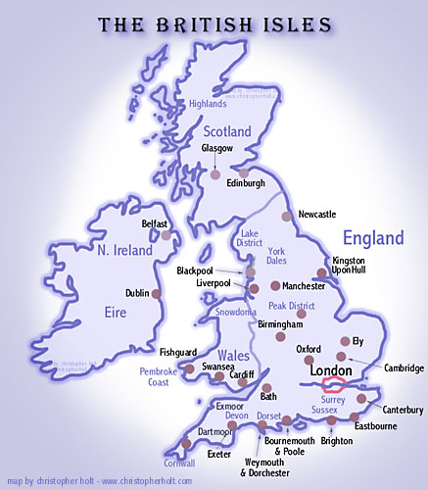
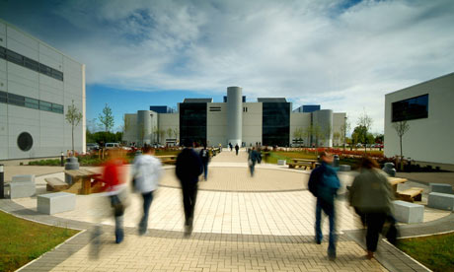
New College Durham is in the North East of England
We are here!

Slide 3
Lifelong Learning ….
On going voluntary and self motivated pursuit of knowledge for either personal or professional reasons.
Therefore it not only enhances social inclusion, active citizenship and personal development but also competitiveness and employability.

Slide 4
Mission of NCD
To provide outstanding learning and training for individuals, business and the community.
To be recognised as a leading provider of further and higher education, contributing to the social, economic and environmental well being of the region. We will support individuals of all abilities and aspirations to fulfil their potential through learning, achievement and progression.

Slide 5
Lifelong Learning Strategy at NCD
Investors in People Standard
Lifelong Learning Policy/Steering Group
Training Plan and Priorities
Probationary Review/Appraisal
Lifelong Learning Budget
Leadership & Management/Succession Planning
Staff Development Days/ Internal Practitioners
External Training
Management Systems
Continuing Professional Development

Slide 6
Staff Development Programme
Staff Development 25 October 2013
Introductions to concepts,
Roles and responsibilities
Who are our customers
How we can get better ? - continuous improvement principles
Identify opportunities
Review Improvement plans
Staff Development 27 March 2014
Effective communication
Using influence teamwork
Cross functional team roles
Self- awareness
Exploring obstacles to working together
Future actions
Staff Development 22 January 2014
Problem solving
Root cause analysis
Corrective actions,
Standardisation
Workplace improvement project
Improvement plans

Slide 7
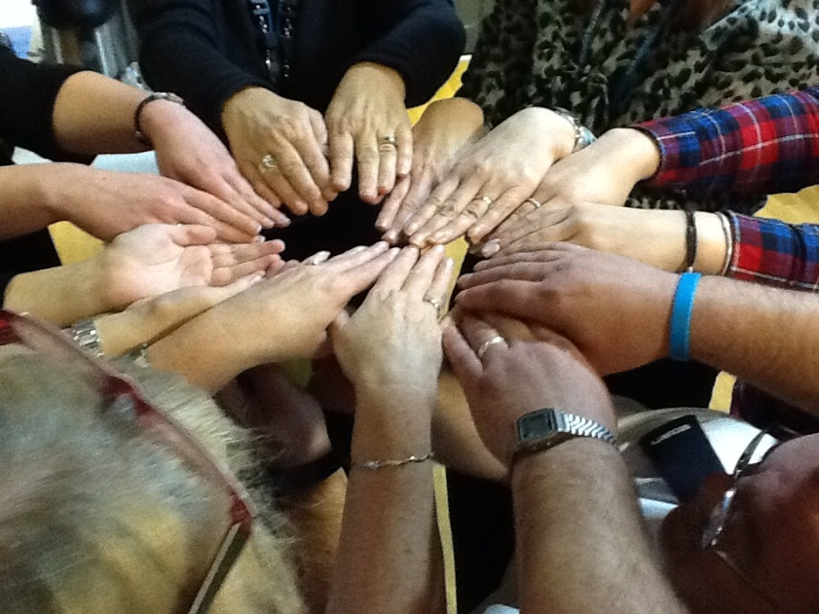
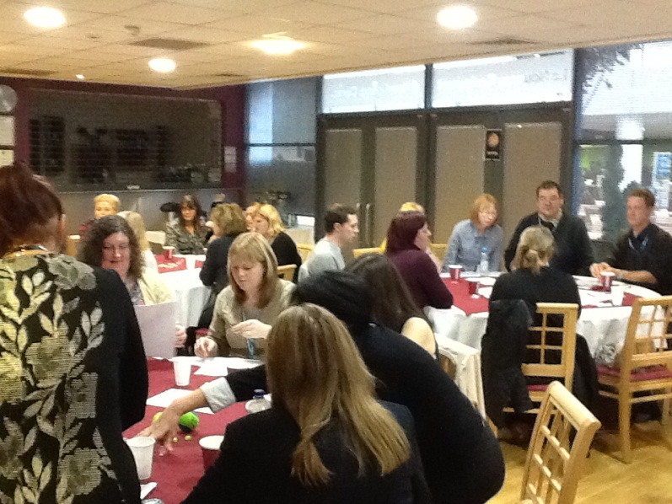
Why should we try to work better together?
Increases productivity
Better working environment
Understanding of objectives
Less conflict
Builds on working relationship

Slide 8
What is Continuing Professional Development?
CPD is a combination of approaches, ideas and techniques that will help you manage your own learning and growth. The focus of CPD is firmly on results – the benefits that professional development can bring you in the real world. Perhaps the most important message is that one size doesn’t fit all. Wherever you are in your career now, and whatever you want to achieve, your CPD should be exactly that: yours. (CIPD 2013)

Slide 9
Differences between CPD and Staff Development
Staff Development
Sponsored by Organisation
Professional
Technical
Mandatory
Evaluated/reviewed
Return on Investment
Recorded

Slide 10
CPD
May be a professional requirement
Flexible
Owned by individual
Reflection
Demonstrates proactivity
Record and plan

Slide 11
Professions /Codes of Conduct and CPD
Solicitors
Teachers
Nurses
Doctors
Accountants
Architects and Surveyor

Slide 12
Why important
Pre employment – criteria
Link your development to your role
Identify gaps
Promotion

Slide 13
What might CPD look like
Formal training… but also
Reading books/journals
Undertaking project/research
Coaching/Mentoring
Chairing meeting
Presenting at conference
Secondment/work experience/volunteering
Interpersonal skills
Watching videos
e-learning etc.

Slide 14
CPD Reflecting back
Q1 What do you consider were the three most important things (planned or unplanned) that you learned last year? Please also briefly describe how they were learned?
Q2 Please summarise the value you’ve added to your organisation/clients/customers over the last 12 months through your professional development?
Q3 What have been the tangible outcomes of your professional development over the last 12 months and what aspects of your work have changed as a result? Please give a brief explanation of why you’ve chosen to comment on these specific activities?
Q4 Who else has gained from your professional development and how?

Slide 15
Moving forward
Q1 How do you identify your learning and professional development needs?
Q2 What are the three main areas or topics you wish to develop in the next 12 months and how will you achieve these?
Q3 What are the key differences that you plan to make to your role/organisation/clients/customers in the next 12 months?
Q4 When will you next review your professional development needs?

Slide 16
Know Thyself - Right Brain Left Brain?

Slide 17
Which are you?

Slide 18
Left Brain Right Brain
Uses Logic
Detail Orientated
Facts Rule
Reality-Based
Safe
Practical
Feeling
Big Picture
Imagination Rules
Symbols & Images
Risk-Taking
Creativity

Slide 19
Know thyself
Learning style
Visual, Auditory, Kinesthetic - VAK
Multiple Intelligences
Personality Type Myers Briggs Inventory
Skills , knowledge and Experience
Inter and Intra personal skills
Self awareness - tools
Johari window, 360 degree feedback
Feedback and reflection

Slide 20
Personal and Professional Plan

Slide 21
Any Questions and Thank you

