Slide 1
Planning Your Future
Finding & keeping the right job !!!
David Allen (BA, MIoH)
Director of Scotland, People 1st

Slide 2
“if you don’t take control of where you are heading, you’ll always end up somewhere you don’t want to be”
Proverb

Slide 3
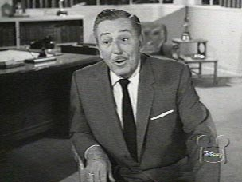
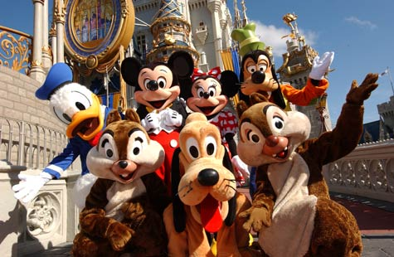
“you can design, create and build the most wonderful place in the world …… but it takes the people you employ to make the dream become a reality”
Walt Disney

Slide 4
Finding the right job !!!
With high unemployment and a continuing downturn in global economic growth, the demand for jobs is not currently being met by the supply of new opportunities.
This means that;
The employer has a much greater choice of candidate to choose from. (Average 16 applicants per job advertised)
Employers are setting much higher expectations of the standards they expect from potential candidates.
YOU NEED TO STAND OUT FROM THE CROWD WHEN APLLYING FOR A JOB
Survival of the fittest.

Slide 5
Finding the right job !!!
Have you ever visited a restaurant and been totally amazed at how great the service was?
Have you ever bought something online and been impressed with how easy it was to order your item / how simple it was to pay and how quickly you received your goods?
Have you ever gone out and bought a new mobile phone and been impressed by its quality, design and functionality?
If you have answered YES to any of those questions, then consider the following;

Slide 6
Finding the right job !!!
How many times have you gone back and used that company again?
How many people have you told about your experience (social media) ?
Have you ever thought about what makes that company stand out?
In a world of competition and unlimited choice, as consumers we hold complete power over where and how we spend our money.
But what influences our choice ?

Slide 7
Finding the right job !!!
Is it Cost
YES !!
Is it Value for money
YES !!
Is it Convenience
YES !!
Is it Location / functionality
YES !!
Is it The quality
YES !!
So in this world of competition and choice, where there are hundreds of businesses who can tick all these boxes, what other key factor will influence our overall choice of where we go to spend our money ……………

Slide 8
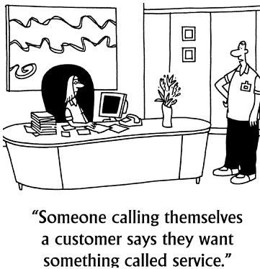
Finding the right job !!!
SERVICE QUALITY
The people we meet
The experiences shared
The speed and quality of service
The ability to make us feel special
Businesses that succeed in providing us with great and memorable service, will generally succeed in winning our loyalty and custom!!

Slide 9
Finding the right job !!!
In the same way that you demand a high level of memorable value and quality when purchasing goods or services as a consumer ………..
You should, as a potential employee, be equally as demanding when it comes to choosing where you want to work !!!
Businesses who treat potential employees like potential customers will always succeed in recruiting the best people !!

Slide 10
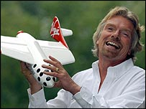
Finding the right job !!!
“ …. my first priority is the people who work for my companies, then the customers and then the shareholders. If the staff are motivated and happy, then the customers will be happy, and in turn, the shareholders will benefit through the companies success.”
Richard Branson
CEO Virgin Corporation

Slide 11
Finding the right job !!!
This all sounds great in theory, but how do I make myself stand out from the competition and find that “Right Job”??
FOLLOW THE 5 STEP RULE !!!!!

Slide 12
Step 1 – Be clear what it is that you want
Sounds obvious, but before you think about looking at and / or approaching a potential employer about a job, ask yourself the following questions.
What kind of role am I interested in doing / what are my career goals
Are these roles / goals realistic in relation to the skills, experience and qualifications I currently have, if not what do I need to do to get them
What sort of company will help me achieve these roles / goals i.e. Small vs Large organisation / Local or International Chain / independent.
Do you I have a clear expectation of what I want from my next job and employer

Slide 13
Step 2 – Research / Research / Research
With any business reputation is the key to success and most businesses don’t mind telling you when they are good at something. Some simple things to consider when looking at a potential employer are;
How long have they been in business
Do they conform to any industry standards or won any awards
What do other people say about them
How do they promote themselves in the marketplace / what's on the internet
What are there corporate aims / mission statement – does this fit with your own ecology
Are you able to visit the company before you apply for a job

Slide 14
“Getting information off the Internet is a bit like taking a drink from a fire hydrant”
Mitchell Kapor

Slide 15
Step 3 – Applying for the job / stand out from the crowd
Before applying for the job check to see if you have completed the 3 actions below;
Have you fully read, understood and picked out the key aspects of the job from the job advert – does this actually match your skills and qualifications
Have you tailored your CV and covering letter to fit with the job advertised (Within reason)
Have you asked for and received from the potential employer a detailed job description which you have read and fully understood.

Slide 16
Step 3 – Applying for the job / stand out from the crowd
An exciting opportunity has arisen at “David’s Coffee House” for an experienced Assistant Manager at its new Edinburgh store. David’s Coffee House is a leading player in a fast-moving, competitive industry. Part of a International Catering Group, David’s Coffee House is officially the fastest growing coffee shop chain across Europe, with 400 stores operating across 12 countries, with the latest global expansion taking the brand into Scotland.
As Assistant Manager your main responsibilities will include:
Assisting the Manager in the development of all members of the team through identifying training needs and performance management processes / ensuring that all food and drinks are prepared and served in a safe and hygienic way / effectively helping to manage the security of the store including stock, cash, premises and personnel / experience of a customer-facing environment, in the retail or hospitality sectors would be an advantage.
What we will be looking for in you:
As an Assistant Manager at David’s Coffee House you will be passionate about caring for our guests. Self-motivated, you will have an overall desire to deliver a superior service to all of our customers.
What we will be offering you:
David’s Coffee House is full of people who’ve gone from strength to strength, expanding their skills and experience as they progress through our business. We can offer you excellent development opportunities, what we need from you is passion, energy and commitment. When you join us as an Assistant Manager you will find out how you could benefit from a great reward structure, discounts across the Group, incentive pay and 25 days holiday. Supporting the Manager in training and developing the team, and assisting with the administration side of running the business, you will help to deliver our high quality service to our guests.

Slide 17
Step 3 – Applying for the job / stand out from the crowd
An exciting opportunity has arisen at “David’s Coffee House” for an experienced Assistant Manager at its new Edinburgh store. David’s Coffee House is a leading player in a fast-moving, competitive industry. Part of a International Catering Group, David’s Coffee House is officially the fastest growing coffee shop chain across Europe, with 400 stores operating across 12 countries, with the latest global expansion taking the brand into Scotland.
As Assistant Manager your main responsibilities will include:
Assisting the Manager in the development of all members of the team through identifying training needs and performance management processes / ensuring that all food and drinks are prepared and served in a safe and hygienic way / effectively helping to manage the security of the store including stock, cash, premises and personnel / experience of a customer-facing environment, in the retail or hospitality sectors would be an advantage.
What we will be looking for in you:
As an Assistant Manager at David’s Coffee House you will be passionate about caring for our guests. Self-motivated, you will have an overall desire to deliver a superior service to all of our customers.
What we will be offering you:
David’s Coffee House is full of people who’ve gone from strength to strength, expanding their skills and experience as they progress through our business. We can offer you excellent development opportunities, what we need from you is passion, energy and commitment. When you join us as an Assistant Manager you will find out how you could benefit from a great reward structure, discounts across the Group, incentive pay and 25 days holiday. Supporting the Manager in training and developing the team, and assisting with the administration side of running the business, you will help to deliver our high quality service to our guests.

Slide 18
Step 3 – Applying for the job / stand out from the crowd
Organisation
Leading Player
International Group
Expansion
Fastest Growing
Role
Training
Development
Admin
High Quality Service
Mgt Processes
Food Service
Security
Stock & Cash Mgt
People Mgt
Required
Passion
Customer Service
Experience
Energy
Commitment
Offer
Opportunities
Reward Structure
Discounts
Incentive Pay
Holidays

Slide 19
Step 3 – Applying for the job / stand out from the crowd
Dear Hiring Manager,
In respect of your recent advertisement, I wish to apply for the position of Assistant Manager at David’s Coffee House and have, as a first step in exploring the possibilities of employment with your company, attached my CV for your consideration.
As you will see from my CV, I am currently employed within a supervisory role having been promoted from customer service assistant. Within this role, I am responsible for the management and development of 6 customer service staff, and ensuring a high level of service is provided to all customers.
Throughout my studies, I worked within the hospitality sector as waiting and bar staff working as part of a team to serve customers within the restaurant and bar.
As a self-motivated and customer focused individual, I am passionate about customer service and committed to providing a high level of service to all guests.
I feel that the opportunity as Assistant Manager with David’s Coffee House would offer me the opportunity to utilise and develop my skills, and support my drive and commitment to progressing with a forward thinking company.
I would like to thank you for taking the time to read my covering letter and CV, and would welcome the opportunity to discuss this role in more detail with you.
I look forward to hearing from you in the near future.
Yours faithfully

Slide 20
Step 4 –First impressions always count
Having been selected for an interview it is important to consider the following when you first arrive at the business
What was your first impression of the people you met when you first arrived
How do the staff you meet interact with one another …… and with you !!
What is your overall impression of the standard of care, cleanliness and attention to detail of the business you have arrived at

Slide 21
Step 5 – During the interview
Remember an interview is a two way process therefore do not be frightened to ask questions, challenge comments or seek clarity – its all part of the process. Things to consider are;
Did they take any interest in you as a person
Did they show interest in you career aims
Some questions you could ask
What focus do they place on staff development / how would they support your career aims
How do they monitor performance / how regularly do they feedback to employees
How would people within their business describe the management style
What are the staff turnover levels

Slide 22
Step 5 – During the interview
Most common mistakes people make at interview are;
Not answering questions fully or properly – don’t waffle
Not showing any excitement or enthusiasm for the job
Not being clear about your skills or abilities
Not showing that you considered all aspects of the job you are being interviewed for
Not showing that you have looked into the organisation that is offering the job

Slide 23
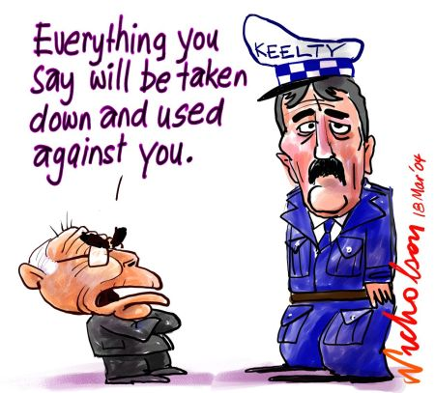
Step 5 – During the interview
ALWAYS ASK FOR FEEDBACK AFTER THE INTERVIEW
(EVEN IF YOU HAVE BEEN OFFERED THE JOB)

Slide 24
No such things as Failure !!!!
F = focused
A = and
I = insightful
L = learning
U = using
R = real
E = experiences

Slide 25
What Employers want …………
A “People Person”
Someone who is “Approachable”
“Good Communication Skills”
Someone who understands “Team Working”
Someone who is “Enthusiastic”
Someone who is “Self Motivated”
Someone who has a “Positive Attitude”
Someone who shows “Initiative”
Understands “Good Quality Service”
Someone who is “Open and Honest”
Someone with a “Can Do Attitude”
Someone who is “Flexible”

Slide 26
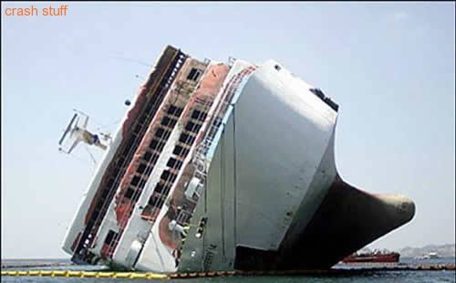
“a good sailor was never taught to sail on a calm sea”

Slide 27
The value of work experience
Work experience should be regarded as a critical part of your learning and development.
At the time of recruitment, employers will generally favor those graduates who have complimented their academic studies with industry experience.
Work experience is an opportunity for you to;
Learn first hand what the industry has to offer
Balance academic theory with practical hands on experience
Set realistic career goals
Make mistakes in a safe environment

Slide 28
“The day we stop learning is the day we stop being good”
Proverb

Slide 29
Continuous Professional Development (CPD)
Once you have graduated your exposure to learning should only have just started, always encourage yourself to take every opportunity that you can to further your skills, experiences and qualifications throughout your career.
A good way of doing this is to register with the professional body that supports the sector you choose to go into.
Benefits of this include;
Access to up to date industry information and business resources
Management & Development Guides to help you through your career
Access to discounted CPD tools and training
Industry networking events
Recognition from your industry peers

Slide 30
NEXT STEP ACTIONS
Some simple career prompts:
Do you have a clear vision of what it is you want
Do you have the passion to inspire a future employer
Do you have the commitment to see it through
Are you prepared to change / learn new things along the way
Will you be decisive when the opportunities do come along
What Action will you take to make things happen
Fun not work

Slide 31
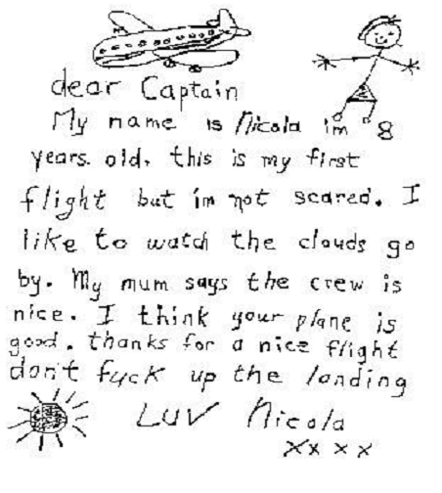
Last bit of fun

Slide 32
Thank you for listening !!!
David Allen
Director of Scotland – People 1st
07920 870 528
david.allen@people1st.co.uk

