Slide 1
gamification

Slide 2
game4change
ERASMUS+ (3 years, 1 year in)
gamification of (3) ‘entrepreneurship’ courses
KRAKOW
running project
WP contents
Roles (omnipresent)
wants & needs (myriad)
ClassCraft? (thanks, Rick), Alter Ego? (text-based vintage game)
WHAT IS GAMIFICATION?

Slide 3
gamification
= MY PET PEEVES !
≠ GAMING !!! (Tetris, Call of Duty, FarmVille, …)
reputation in educational context (~ frivolous)
≠ ‘Triple-A’ graphics
≠ tekst = 666
≠ CAPTATIO BENEVOLENTIAE (“Yes, I’m woke!”)
≠ BREAK (“Wake up, you youngsters!”)
= THE FUTURE … (magic 8-ball?)

Slide 4
gamification4change
MAIN DIFFERENCIATORS = story line & integration
story line = case study, … (easy part)
INTEGRATION?
‘run-of-the-mill’ educational frameworks (Blackboard, Moodle, Dokeos, Sakai, …)
= administrative power houses
common ground:
logistics (enrollment, scheduling, messaging boards, …)
content delivery (syllabi, course notes, exercises, wiki …)
assessment & grading
(social) interaction
“All THAT and THEN SOME !!!”

Slide 5
the (master) plan
“COMPATIBILITY” (flexible, generic)
=> MODULAR (not only for flexibility – “optionality”)
=> LOW THRESHOLD (resistance to change)
=> OR-DEAL (instead of ordeal)
=> i18n (internationalization)
(=> full API) (Application Programming Interface: cfr. infra)
GENERIC SCAFFOLDING + (WHY? Scalable!)
theming & branding (identity & flavours, both for institution AND users)
single source of “truth” (vs manual grade entry, for instance)
facilitation of gamification mechanics
STORY LINES !

Slide 6
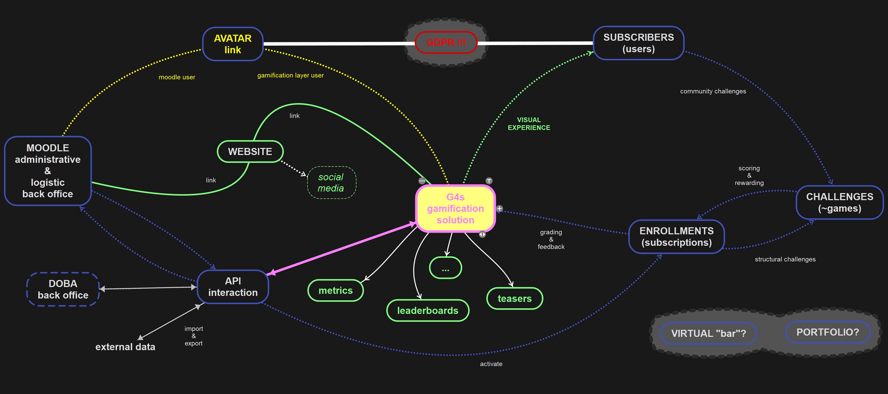
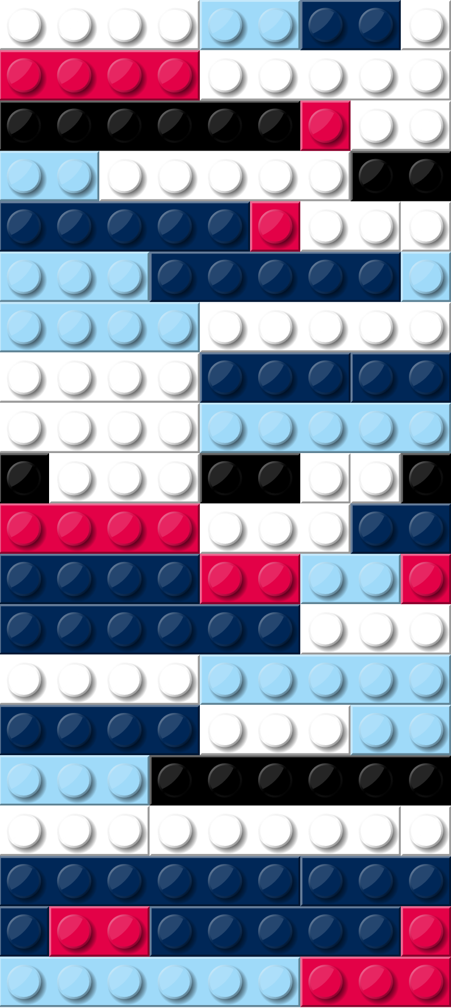
brainstorm mind map

Slide 7
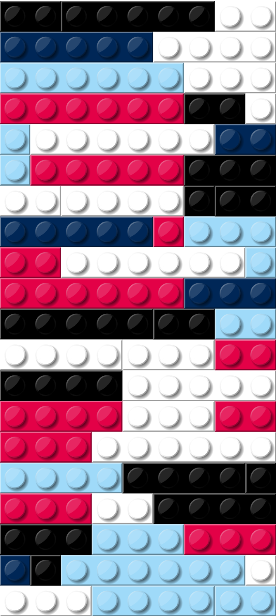
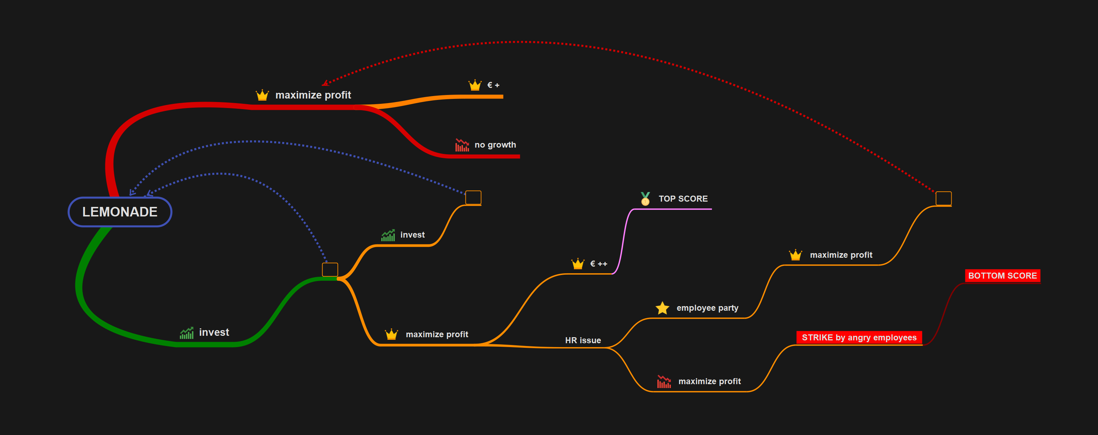
epic 1 mind map

Slide 8
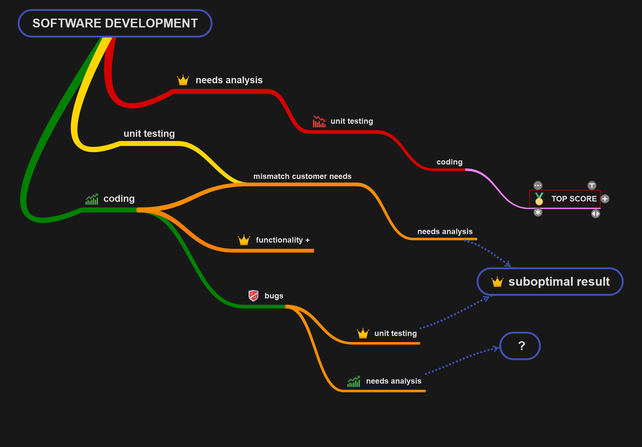
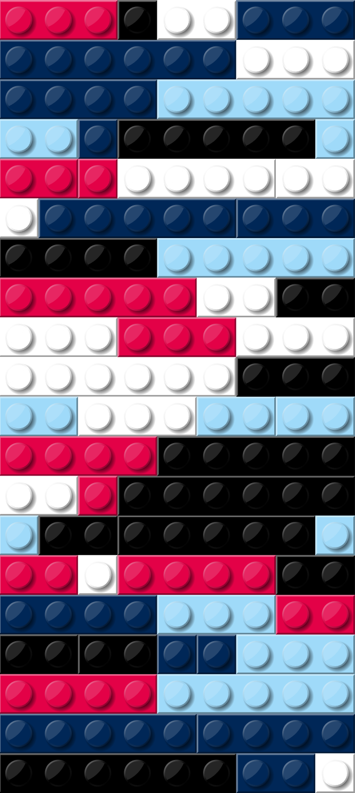
epic 2 mind map

Slide 9
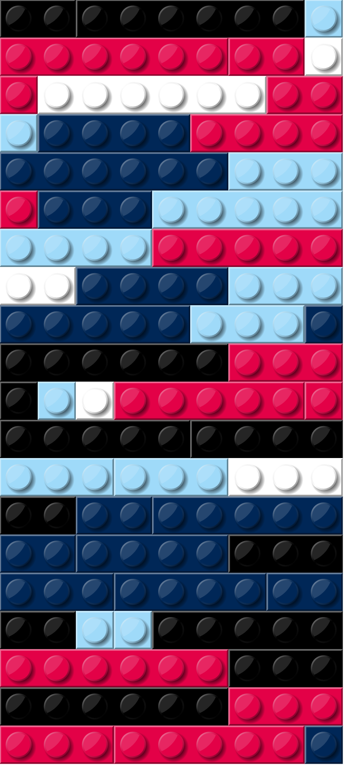
the “demo”
WORD(S) OF WARNING (work in progress)
1 POSSIBLE incarnation (remember theming? G4C… )
TRIVIAL examples & BASIC “challenges”
TO BE EXPLAINED:
epics (story line with “challenges”)
currencies (general results + aspects)
evaluation “conglomerate” (rubrics, subrics, SA, PA, …)
rewards & perks (visual & functional!)
identity, anonymity, GDPR & security

Slide 10
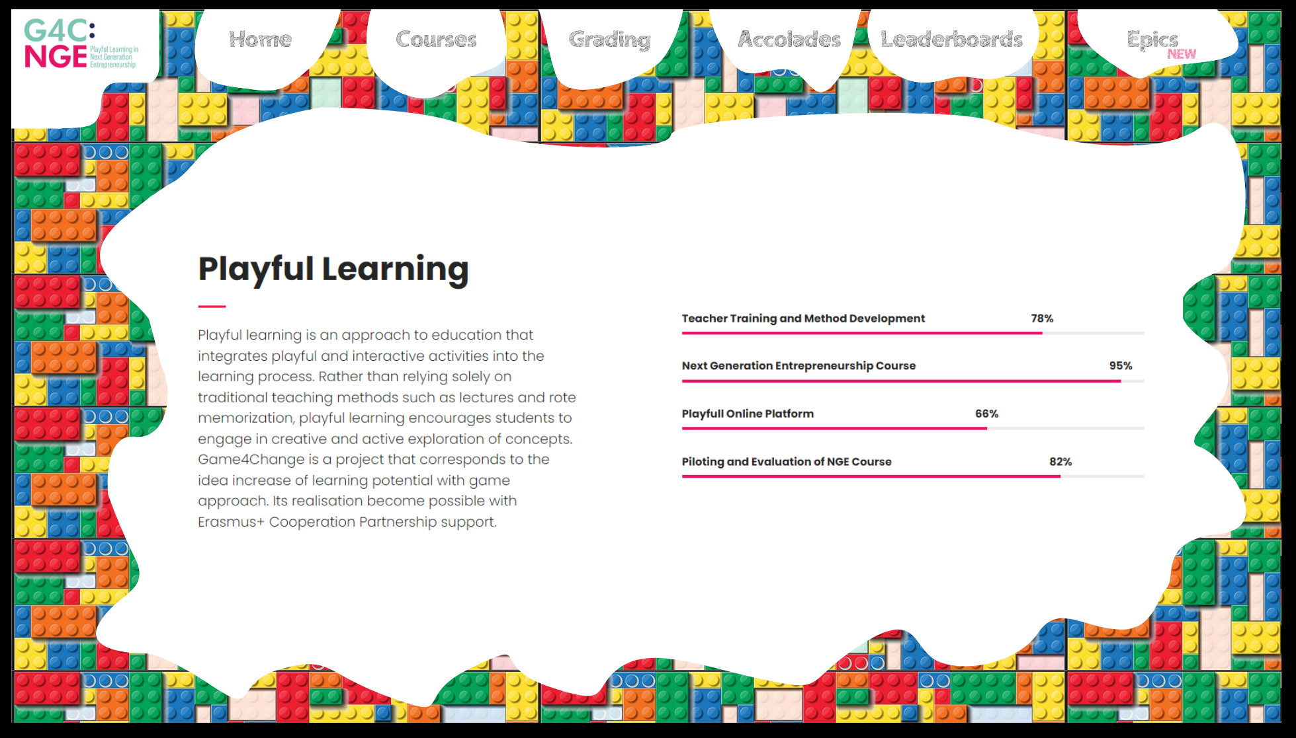
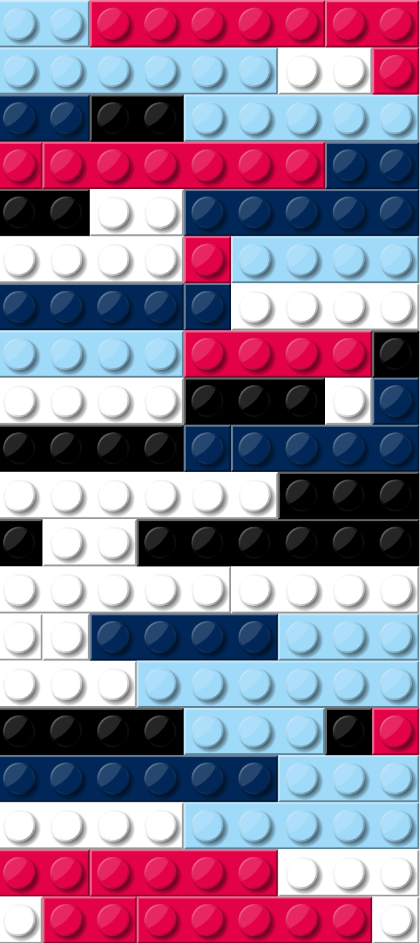
the “demo”

Slide 11
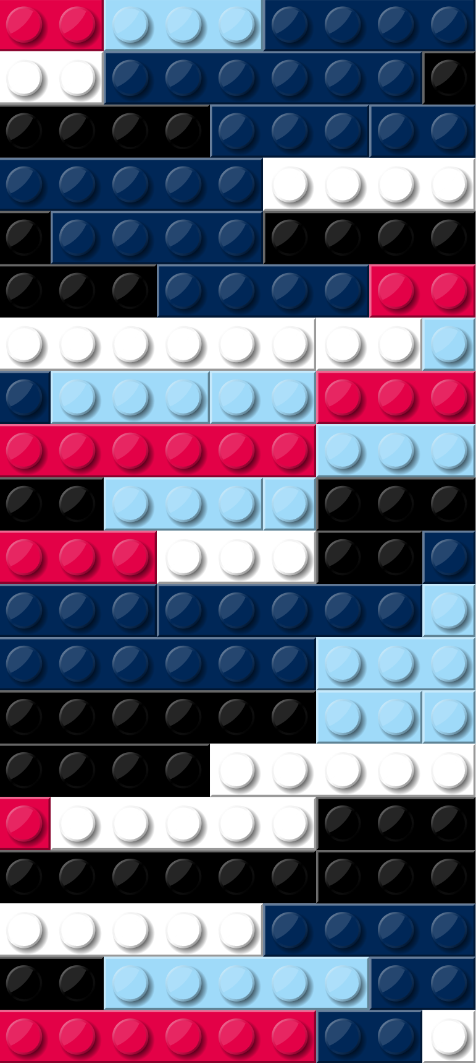
(future) synergies
data visualization (research, both for staff & students)
attendance registration (linked to central…, remember?)
presentations (slide shows, websites, …)
talent matchers (research, EUDRES, …)
interactive courses (AI-driven, “wiki-like”)
social biotope (TETRA: blogs, virtual bars, collaboration boards, …)
portfolio integration (preparation, presentation, evaluation)
surveys (quantitative & qualitative research, QC, …)
… (your suggestion and/or idea?)

Slide 12
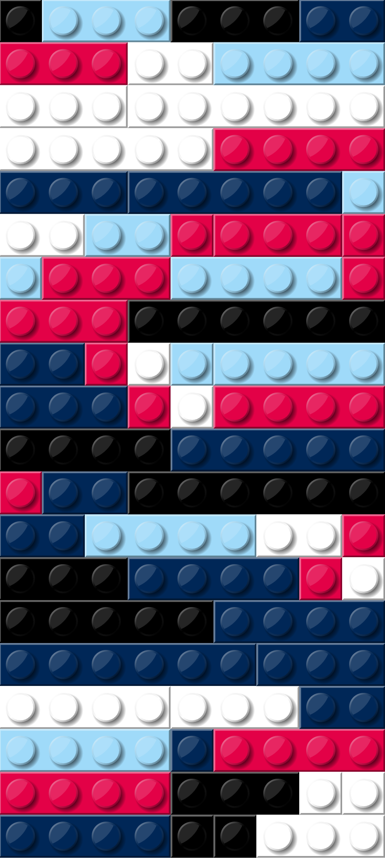
all things must end
about APIs, as promised …
https://g4c.io/API/getmedals {security token, user ID}
https://g4c.io/API/getranking {security token, challenge ID}
https://g4c.io/API/getchallenges {security token, epic ID}
QUESTIONS?
THANK YOU, BUSINET & G4C !!!

