Slide 1
About?
Does hard work and good study results lead automatically to great job opportunites? Maybe! But better taking fate into your hands and create your future. Use networking opportunities wherever you can find them and maintain your network lifelong. Start today, build strong relationships and make them usable for your career – or your own company as one attractive opportunity after graduation. Lets think about the activities besides your studies and develop your own ideas becoming an entrepreneur instead of an employee in the threadmill of a big company.

Slide 2
Unité Conference 2017, Edinburgh
taking control of your future
thoughts, ideas, best practice

Slide 3
WHAt are you here For?
Beautiful city of Edinburgh
Improve Language Skills
Interesting format of this conference
Home Institute forced me to go
Meet new people
Other reason

Slide 5
My story
taking control of your future
thoughts, ideas, best practice

Slide 6
WHAt are your goals?
become rich? work international?
travel the world? create my own business?
something in sports/football? have a family?

Slide 7
WHO
can help you with this?

Slide 8
Y O U

Slide 9
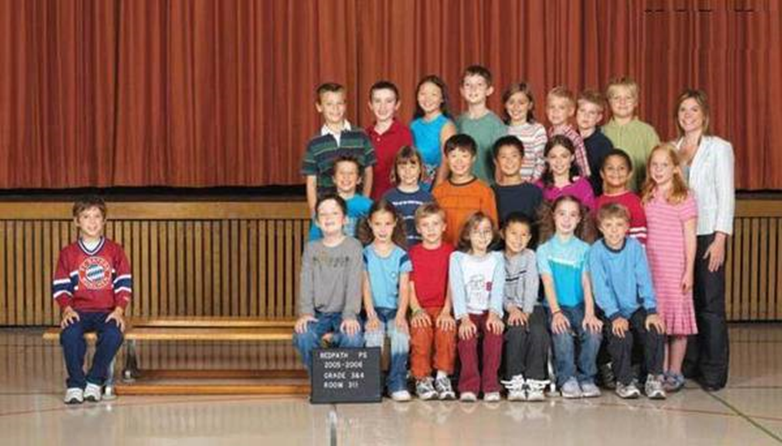
Where is your first and EASY network Opportunity?
Here!

Slide 10
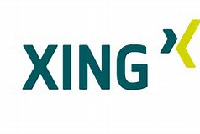

Slide 11
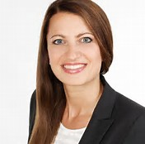
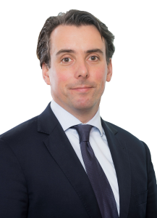
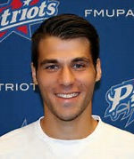
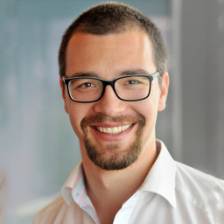
Student fellows

Slide 12
Henrik&TUI

Slide 13
PROFESSIONAL VITAE
1995 german Abitur (A-Levels) in Hanover, Germany
1999 first own business – tour operator for canada & sports travel
1999 foundation degree in vocational training for real estate management
2000 second company in solar industry
2003 diploma in economics at Leibniz University Hanover, Germany
2004 german sales manager CANescapes – a Division of BCAA in Vancouver
2006 european sales manager CANescapes – based in Hanover, Germany
2008 head of school, Dr. Buhmann Academy, Hanover
2012 start of PhD program at Leibniz University Hanover
2016 funding of DeinTeam App and MS4 Sports GmbH Sportsmanagement Co.

Slide 14
PERSoNAL VITAE
1990 founder and chief editor of school newspaper
1996 freelance editor at BILD sports editorial
1999 football referee, linesman in 4th division
2000 football coach of regional under 19 team
2002 member of university parliament and local government
2005 regional director lower saxony for german-canadian association
2008 regional director of sports managers association (VSD)
2009 education coordinator of Hannover 96 youth academy
2012 team manager of U19 team TSV Havelse (U19 Bundesliga)

Slide 15
MAKE use of it
Think about your options
Use the vital network for:
Easier access to labour market
Creating your own company

Slide 16
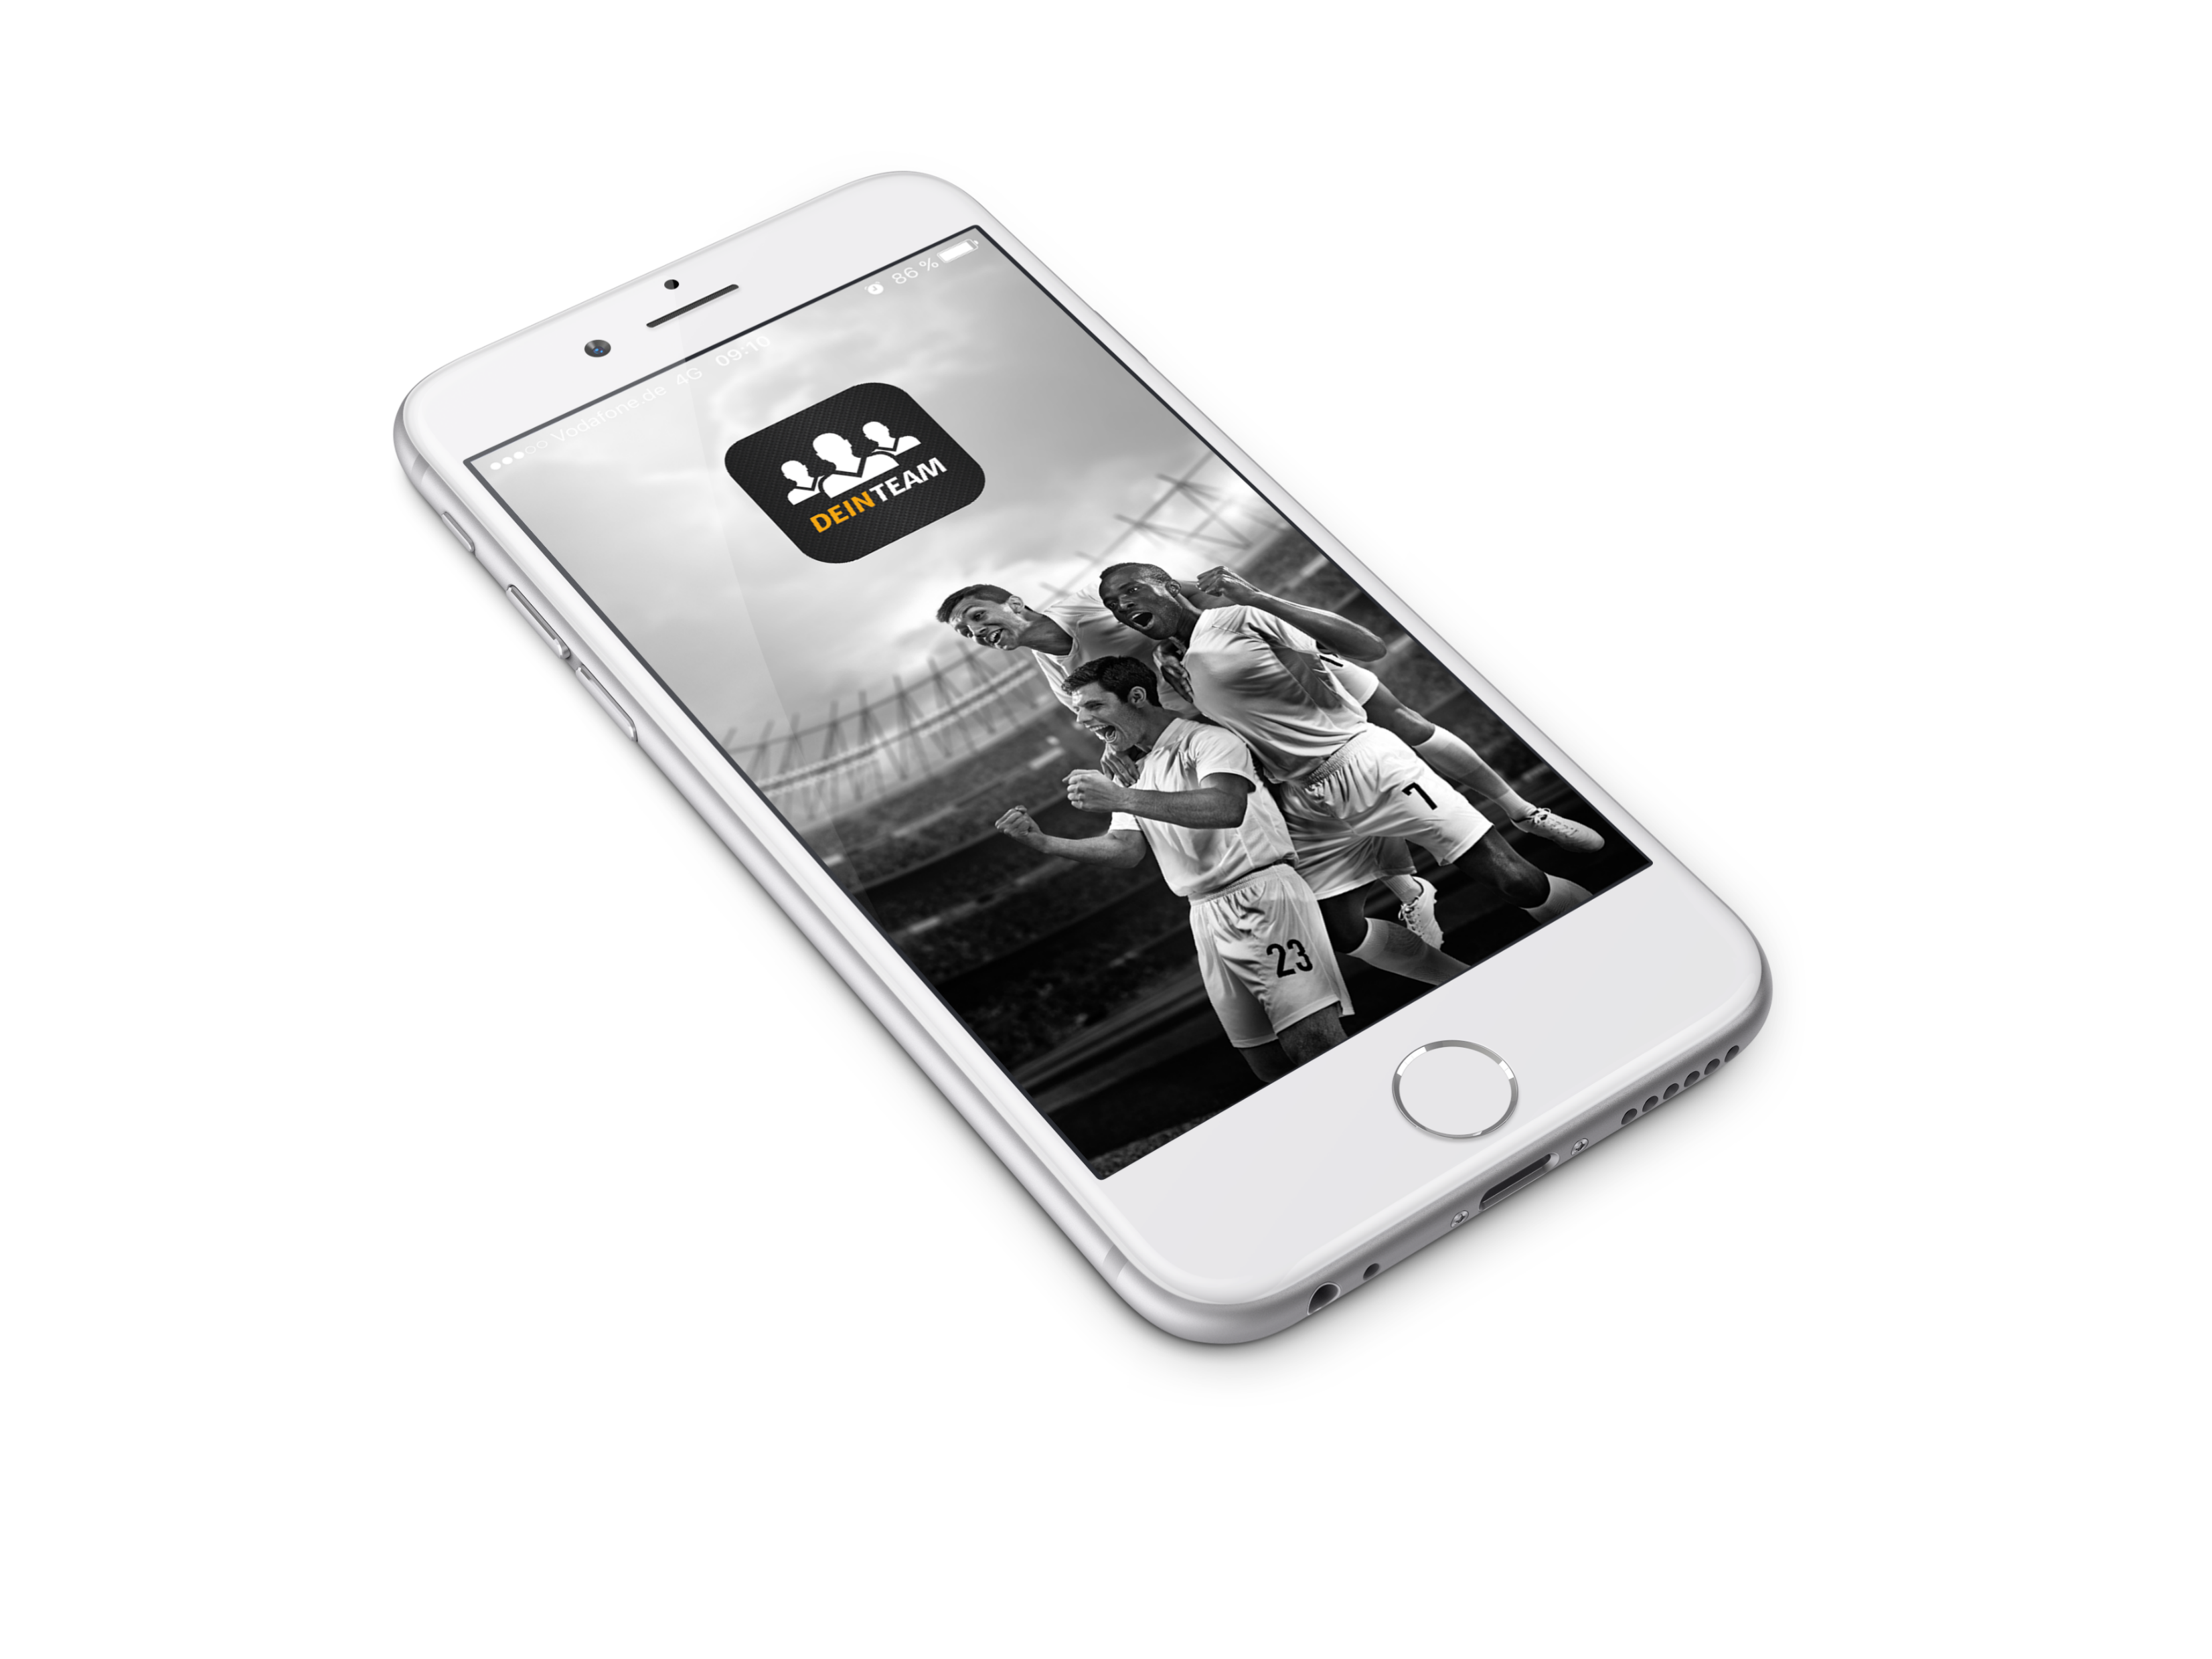
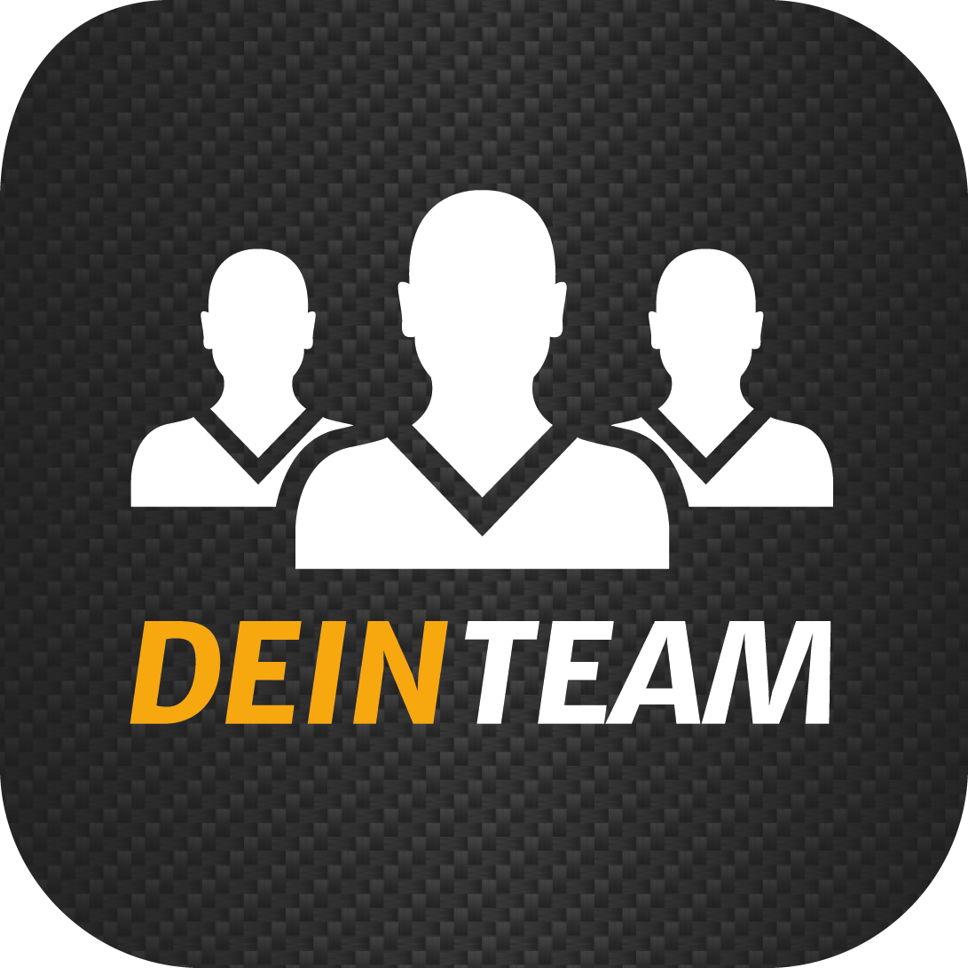
Dein Team Deine App.

Slide 18
DeinTeam – Deine APP. Manage your Team per APP.
DeinTeam already solves problems from over 75.000 teams: The App facilitates the whole communication and logistic within teams.
Developed by Bundesliga professionals as a practical tool for amateur sport:
Transparent organisation of team calendars, overview of the team register as well as all logistics around your team – everything everywhere available on your smartphone mobile at a glance.
For free, ad-free and for all age groups: wether Bundesliga or Sunday league, old boys team or Bambinis, DeinTeam facilitates your daily club routine.

Slide 19
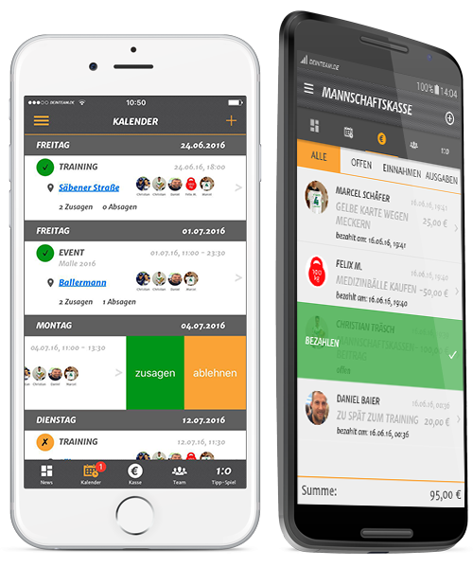
WHAT IS DEINTEAM?
CALENDER
All appointments at a glance. Practice times, matches, events etc.
TEAM
Voting tool, squad view and statistics around the team.
CASH REGISTER
Penalty- and team cash register inkluding a sinner ranking.
FOOTBALL POOL
Own team internal Bundesliga tipping round.
Notes:
Film für sich sprechen lassen. Video vielleicht direkt als Video in die PPT integrieren!?

Slide 20
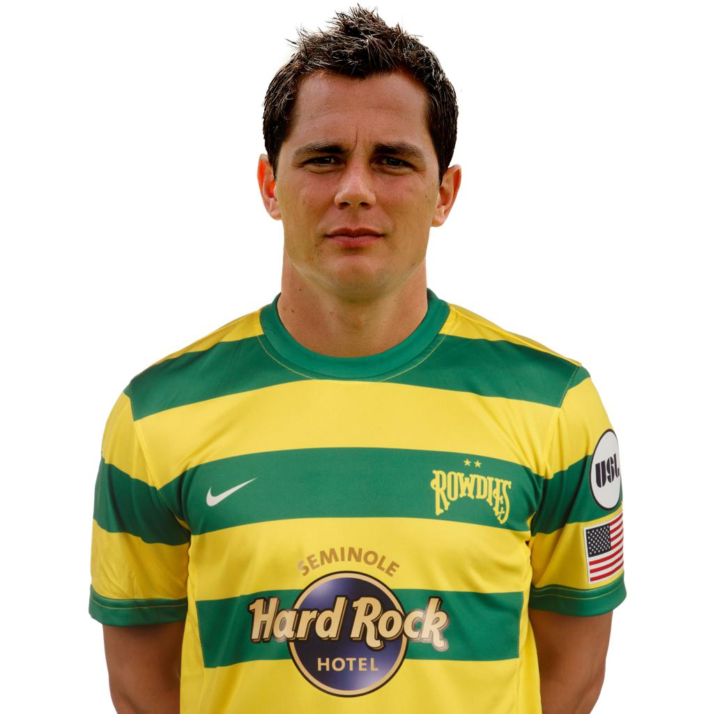
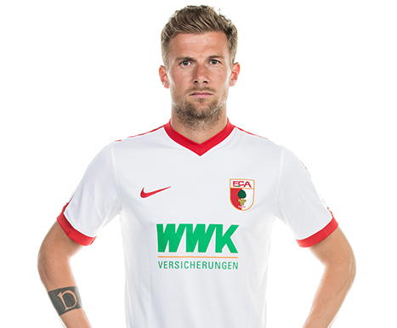
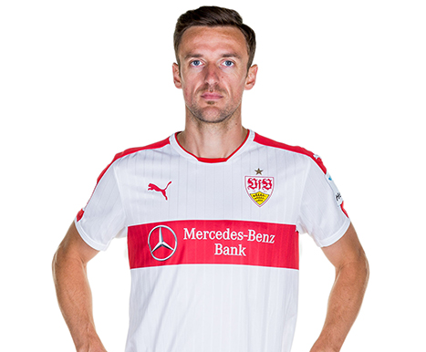
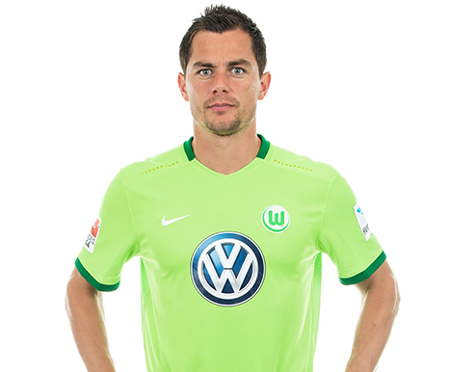
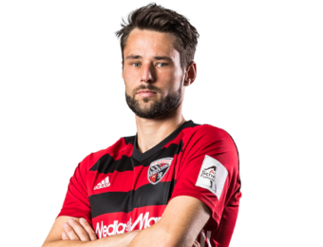
The Founders „By PRO‘S FOR AMATEURs!“
The App was the idea of four football pro‘s with long-term Bundesliga experience
Marcel Schäfer Christian Träsch Daniel Baier Christian Gentner
Notes:
Weitere Gesellschafter / Verflechtungen auf der Tonspur nennen.
Das Team aus Fußballprofis, Technologie- und Vermarktungsexperten deckt alle relevanten Kompetenzfelder für eine Sportdienstleistungs-App ab.

Slide 21
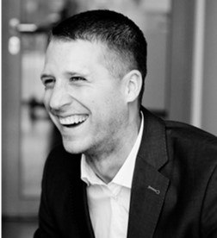
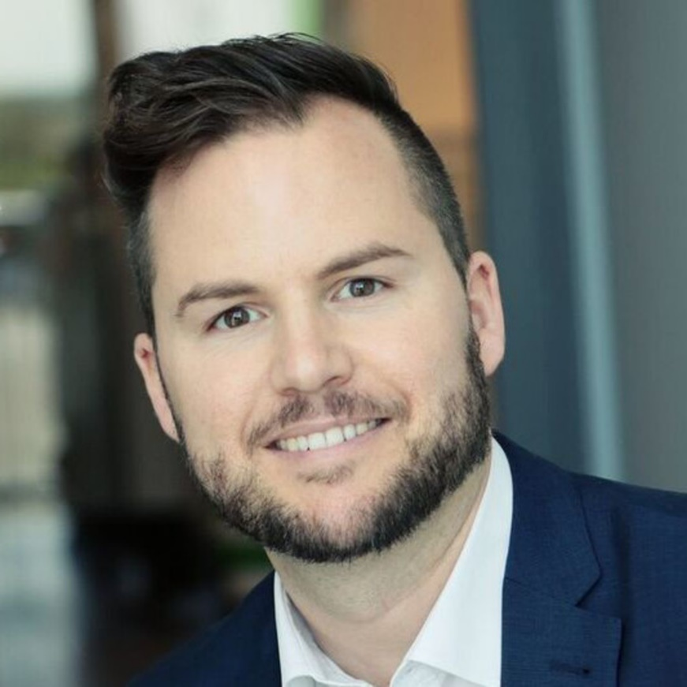
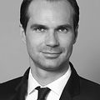
Executive team
Sebastian Carlin
Daniel Peikert
Michael Ketzler
CEO – MS4 Sports
Founder and partner of MS4 Sports
Previously Sponsoring & Sales
at VfL Wolfsburg
CMO - MS4 Sports
Previously Head of Sales
at VfL Wolfsburg
More than 15 year sales experience
and Marketing expertise
CFO – MS4 Sports
Commercial Graduate
Tax Consultant/ Certified
Financial Planner/Consultant

Slide 22
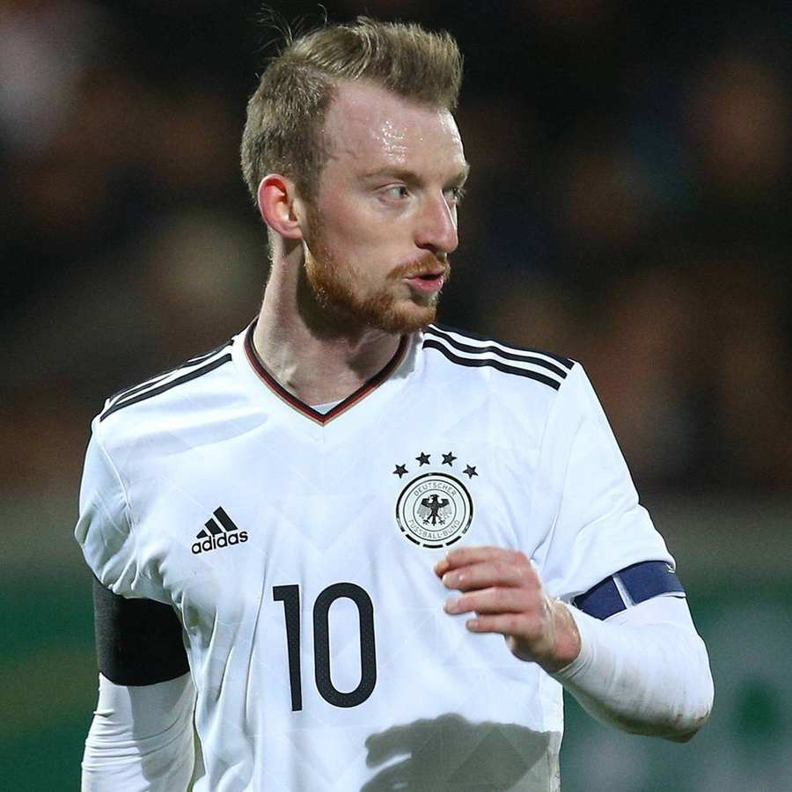
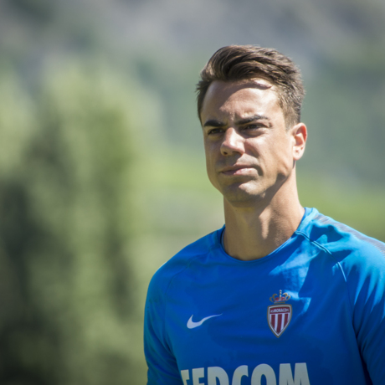
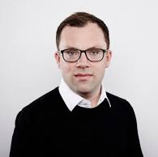
Shareholders-abstract
Maxi Arnold
Diego Benaglio
Patrick Rohner
Partner MS4 Sports
Professional Football Player
VfL Wolfsburg
DFB-Pokal Champion and U21 European Champion
Partner MS4 Sports
Professional Football Player
AS Monaco
German Bundesliga Champion,
DFB-Pokal Champion and
61 caps for Switzerland
Partner MS4 Sports
Avantgarde Sponsoring GmbH
Sports Agent
Clients e.g. Bastian Schweinsteiger,
David Alaba and Co.

Slide 23
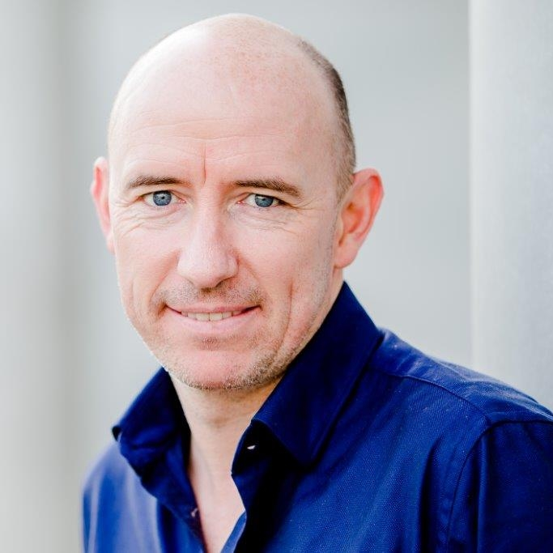
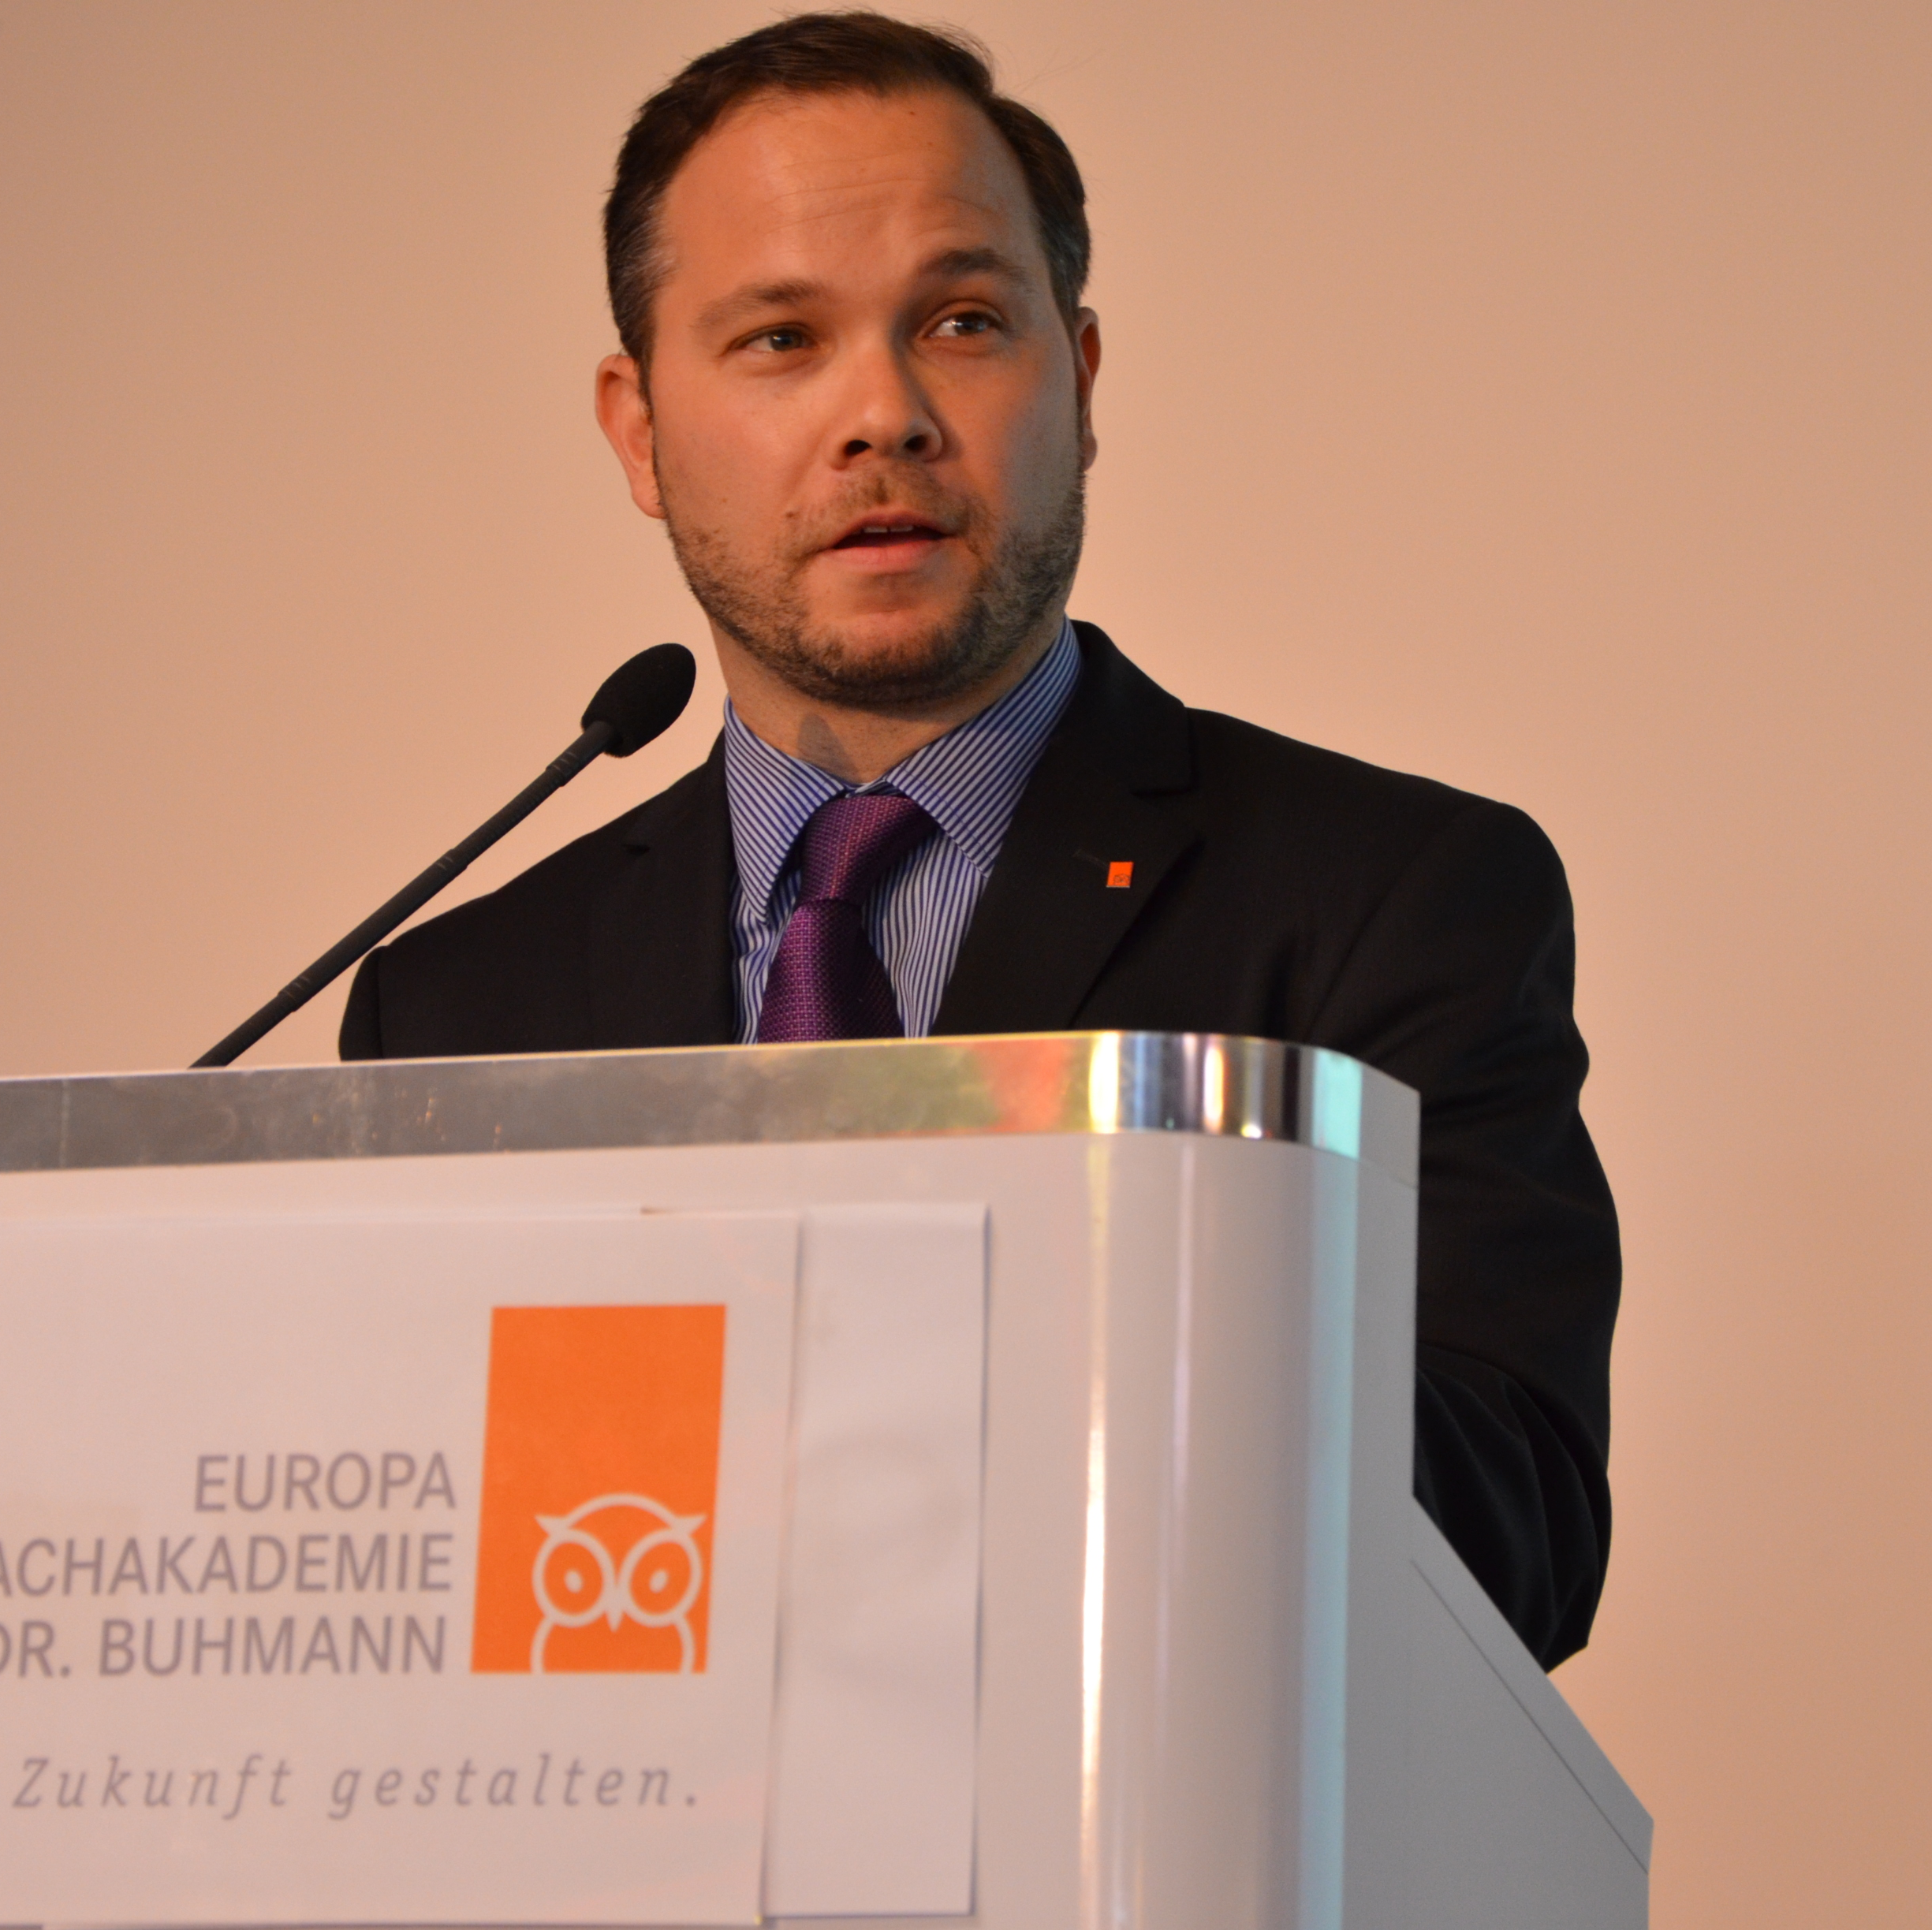
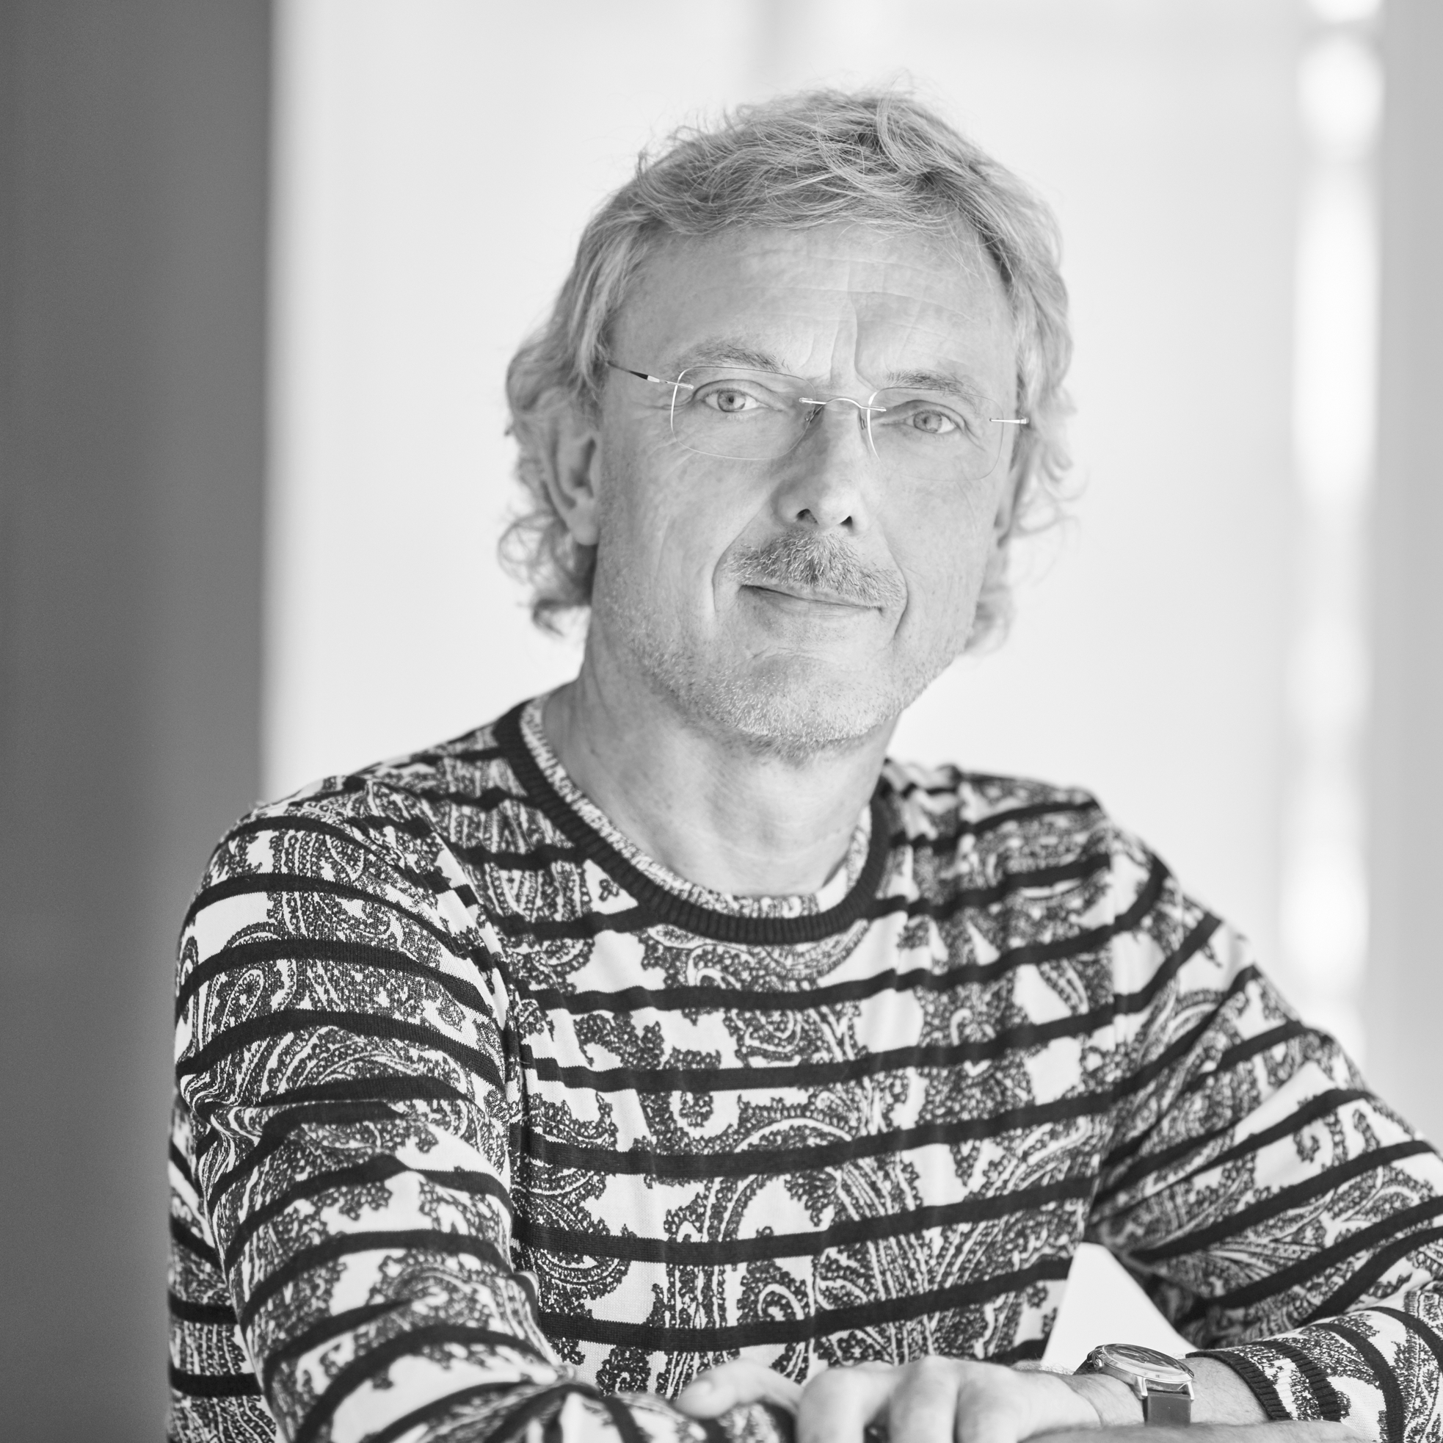
Shareholders-Abstract
Sven Froberg
Matthias Limbach
Manfred Hörnschemeyer
Partner MS4 Sports
General Manager SID
Previously Head of Sports of ProSiebenSat.1
and editor-in-chief of DSF
Partner MS4 Sports
General Manager of
Dr. Buhmann Schule gGmbH
Partner MS4 Sports
Business Man in the economic branches
Publihsing Houses and Dialoguemarketing

Slide 24
Market relevance
RANKING APP STORE
#1
in the sport category for several weeks
over30
weeks in the „Top Ten“ of the AppStores
#5
of all free Apps in the first week.
DeinTeam is With over 650.000 Downloads and 75.000 Teams one of the biggest Mobile Apps in the sports field in germany.
Notes:
Ggfs. aktualisieren

Slide 25
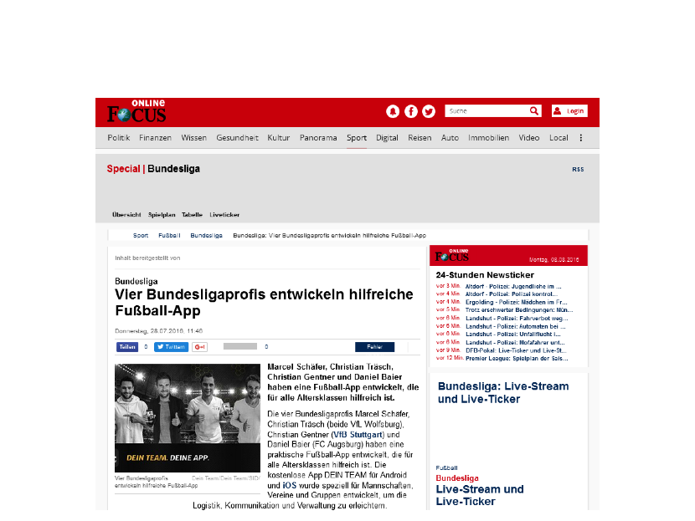
The press Authentic Story with massive PR Effect

Slide 26
Media cooperationS
Sport-Informations-Dienst customers:
90% of ALL GERMAN MEDIA

Slide 27
Target audience
Typologisation
STEFAN (23)
Fifth division team, admin
„The app is great. In that way we get everything organised with the team. In todays digital age it was neccessary for such a tool. Everyone participates with the app and contributes to it, because it is so easy!“
OLIVER (35)
Old boys team , treasurer
„Through DeinTeam I have the perfect overview and I am more proactive due to it‘s functionality. Somehow the app also promotes the team spirit and we are always digitally connected.“
SILVIA (42)
Son plays in the U10
„As parents we have the great possibility to organise ourselves digitally and exchange the most important information. The app is so intuitive, that even my son gets more and more involved.
Notes:
Altersstruktur, Handystruktur und ggfs. Geschlechterverteilung aus Google Analytics auf der Tonspur.

Slide 28
Strategic focus
The app focusses on the contemporary communication and connects the professional with the amateur sport
DIGITAL
Grassroots
Sports
INNOVATION
Added value through a easy, flexible and userfriendly setup
CREDIBILITY
Through a authentic story which provides the amateur sports with additional value

Slide 29
Status Quo
User statistics
As of end of July 2017:
Average In-App duration ca. 4:00 minutes
Already more than 20 Mio. In-App sessions and over 210 Mio. onscreen invocations in the App
> 650.000
Downloads
>210.000
Aktive User / Month
>50.000
New Downloads / Month
Notes:
Aktualisieren Anfang November

Slide 30
Forecast
2018
Internationalisation >UK, BeNeLux, Scandinavia a.s.o.
Marketposition Stabilisation of the market leadership in the area of „Team-Apps“ a.o. through marketing spendings & Media-Coops
Involvement > Surplus values through strategic partnersips (keyword/commercialisation)
NO BOLD BANNER PROMOTION
Relevance >350.000 Active Users
Reach >1.000.000 Downloads

Slide 31
CONCLUSION
Have your dreams and goals
Find and maintain a sound network
Think of entrepreneurship as an option for your career

