Slide 1
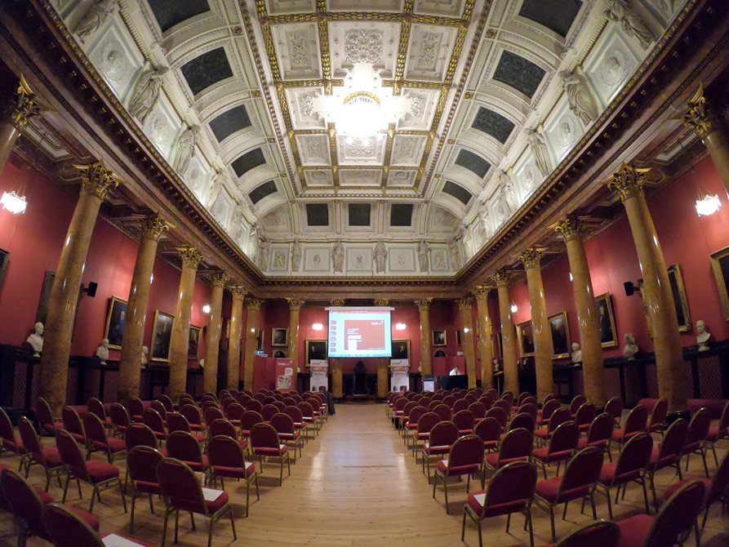
Businet Student Conference 2019
“Thinking Employment”
businet.org.uk businet@gmx.com

Slide 2
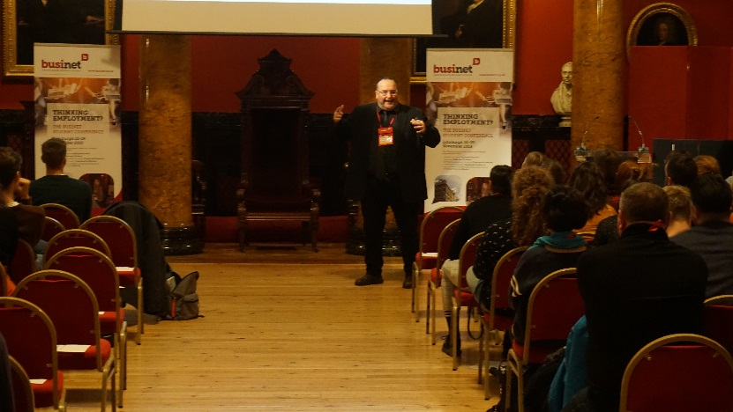
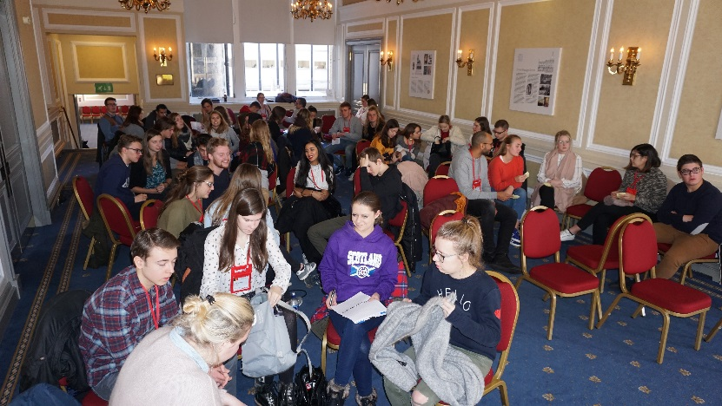
2018 Event
Extensive evaluation – very positive feedback. Some lessons taken on board
Very successful – three pillars of learning were seen as been both interesting and relevant
Concerns over preparation of students and accompanying staff raised
Student comments on leaflets in your folder

Slide 3
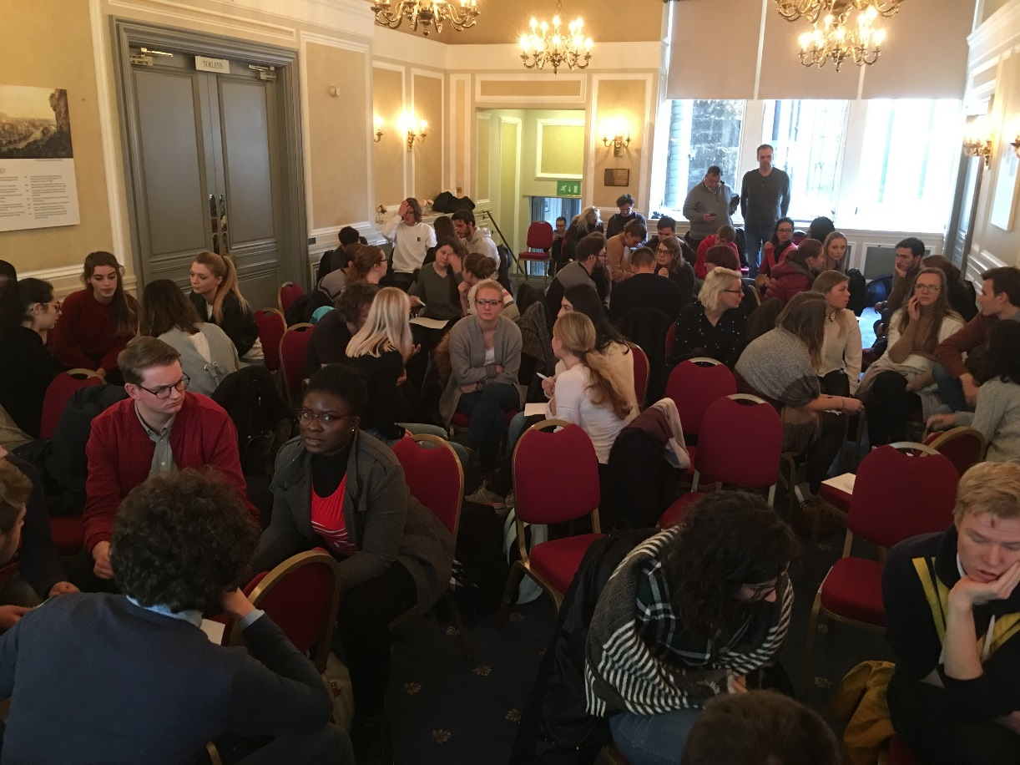
3 pillars of learning
Employability Skills
Experiential Learning and
Emotional Intelligence
Networking and reflection demanded
businet.org.uk businet@gmx.com

Slide 4
2019 Event
Edinburgh 24 to 28 November
Aimed at year 2 students studying on BA programme, from any curriculum area / study route
Initially 5 home students per institute
Cost 320 Euro, includes 3* centrally located hotel and breakfast, plus one evening meal
Registrations from 01 June

Slide 5
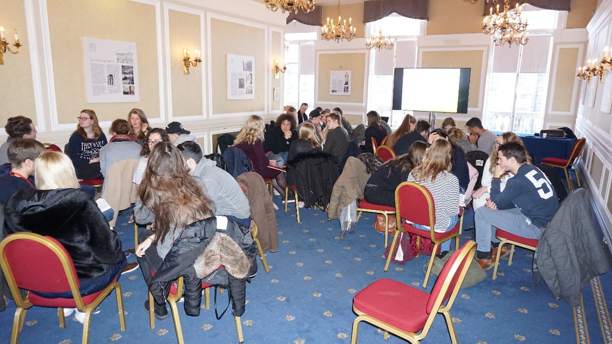
Students informed that they need to:
Commit to the programme
Respect the speakers
Consider why, not just what
Make the most of the opportunities presented
Socialise responsibly
Reflect
www.businet.org.uk
businet@gmx.com

Slide 6
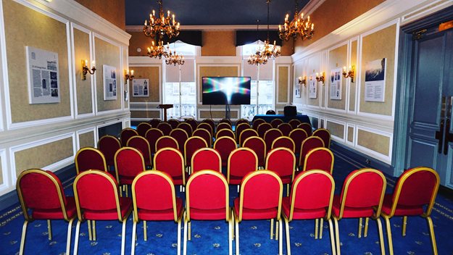
Leaflets in folder for both staff and students
The staff leaflet is to inform you / your colleagues about the event
The student leaflet is to inform the students

Slide 7
Post of a student delegate on Linkedin:
Two weeks ago I was attending the Businet Student conference - Thinking Employability in Edinburgh. I intentionally waited a while to post something about this event because I wanted to take the time to reflect on everything I experienced.
It's fair to say that I had an amazing time in Edinburgh and I will definitely go back.
I have learned a lot form all the lectures, Stuart, Dale, Florian, Matthias, David, Julia, Lorenzo, that I can apply to my professional life and that will have a positive influence on my personal life. It was a fabulous opportunity to meet kind and talented people from all around Europe!
Cont’d
www.businet.org.uk
businet@gmx.com

Slide 8
Post of a student delegate on Linkedin:
I also want to thank my amazing teammates Arjan, Edwin, Jane and Edouard. I'm very pleased I met you guys!
I'd like to take a second to thank …….. for introducing me to Businet and giving me the opportunity to go on this international adventure.
I would also like to thank …………….for being an amazing host at the annual Student conference.
In education and life it’s not all about what you have to do, but why you have to do it and what you can learn from it. That’s the main idea I took home with me.
Julie D
DEC 2018
www.businet.org.uk
businet@gmx.com

