Slide 1
Summer School ‘Changemaker bootcamp’

Slide 3
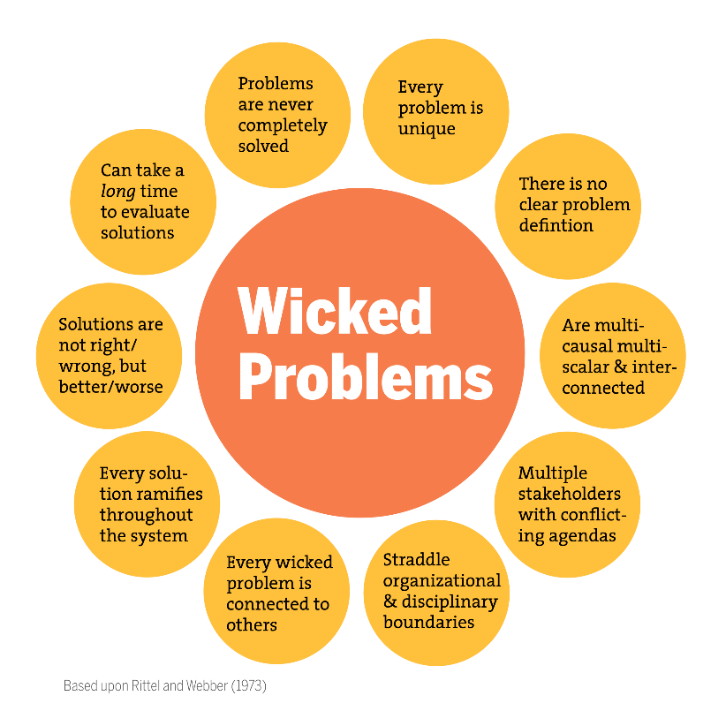
WICKED PROBLEMS
‘Problems that are difficult or impossible to solve due to incomplete, contradictory and changing conditions’
Ecology and climate
Energy and resources
Financial issues, money and debt systems
Wellbeing

Slide 4
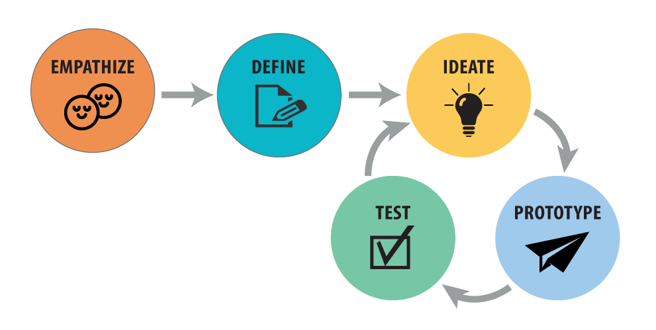
DESIGN THINKING
Understand the user
Challenge assumptions
Redefine problems
Identify alternative strategies and solutions

Slide 5
HOW TO MAKE A DIFFERENCE YOURSELF
Solo time in nature (day 1-3)
Joint involvement around wicked problems

Slide 6
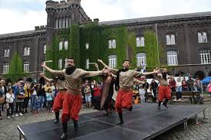
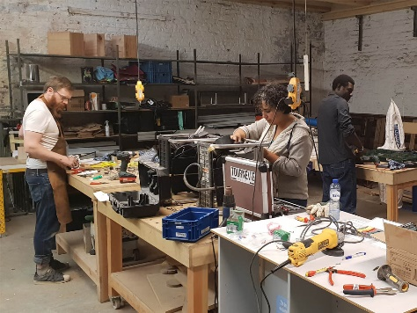
Visits to values driven organisations/
companies
Global Citizenship Education
Fedasil/Klein Kasteeltje (centre for asylum seekers)
Oxfam

Slide 7
Target group
International students, Belgian students and UCLL students from all fields of study
-> Multidisciplinary approach is key

Slide 8
Practical Information
Date: 2-12 September 2019
Price 1600€ :included is fee, accommodation including breakfast, lunch, transportation, field trips
Deadline for registration: 10 July

